Slide 1


Information Matters: capacity-building for ambitious reporting and international learning – experiences from Georgia
Oscar Zarzo, GIZ & Kakhaber Mdivani, MoENRP
Side-event “Innovative approaches to MRV: the EU experience in the Enlargement and Neighbourhood countries” at COP23, Bonn, 9.11.2017

Slide 2





PROJECT IDEA
Goal: Strengthen in-country capacities for enhanced reporting (BURs and NCs) of climate relevant information to UNFCCC
Activities:
  Identification of specific needs and priorities of the MRV systems and GHG monitoring in the partner countries
  Provision of tailor-made capacity-building trainings and backstopping as well as concepts for institutionalization
  Support the process through peer-to-peer exchange and generation of knowledge products
Side-event Innovative approaches to MRV

Slide 3

PROJECT IMPLEMENTATION
Workshop for all IM partner countries for sharing experiences & lessons learnt
Peer-to-peer exchange
In-country workshops & backstopping to address needs identified through technical capacity building
Capacity Building Activities
In-country workshop to review results of the stocktaking, identify priority needs and develop a roadmap for tailored capacity building activities
Kick-Off
& Roadmap
In-country stock-taking to identify strengths and gaps in the current system & development of a roadmap to address identified needs through capacity building
Stock-taking
Side-event Innovative approaches to MRV

Slide 4
PARTNER COUNTRIES
Georgia
Dominican Republic
Vietnam
Egypt
Philippines
Colombia
Ghana
Chile
Side-event Innovative approaches to MRV

Slide 5
Roles and responsibilites of project partners
BMUB - IKI
GIZ
GIZ Dom Rep
GIZ Chile
GIZ Ghana
GIZ Phil
UBA
Technical Support
NIRAS A/S
UNDP LECB
Ghana EPA
Chile MMA
Dom. Republic CNCCMDL
New MRV and Transparency initiatives
PHL CCC
WRI
GIZ CO
GIZ Georgia
GIZ VN
GIZ Egypt
Egypt EEAA
MONRE VN
Georgia MoENRP
Co MADS
UNDP/
UNEP GSP
Partnership on Transparency in the Paris Agreement
(PATPA)
MoU
provision
of expertise
Side-event Innovative approaches to MRV

Slide 6
AREAS OF SUPPORT
Institutional arrangements
Identification of key stakeholders, communication patterns and responsibilities
Systematization of existing structures
Institutional arrangements, IPCC methodologies and trainings on the IPCC software, QA/QC
Project-internal reviews of national GHG inventories
National MRV system
National GHG inventory
Climate change data management
Support for BUR preparation
Feedback on draft reports before submission to UNFCCC
Mitigation actions and support chapters
Preparation for the ICA process
Support for developing national data management systems
Support to enhance quality and quantity of relevant data and information
Side-event Innovative approaches to MRV

Slide 7
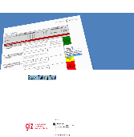
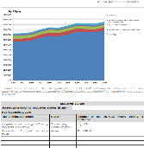
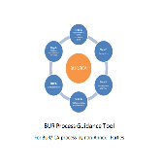
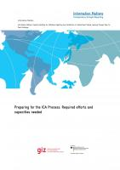
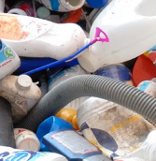
IM KNOWLEDGE PRODUCTS
Stock Taking Tool (2017)
BUR Template
(2017)
BUR Process Guidance Tool (2016)
Preparing for the ICA Process: Required efforts and capacities needed (2016)
Good
Practice Study on GHG Inventories in the Waste Sector (2015)
Sharing lessons learned and incorporate experiences
Side-event Innovative approaches to MRV

Slide 8
Project Activities in Georgia
Side-event Innovative approaches to MRV

Slide 9

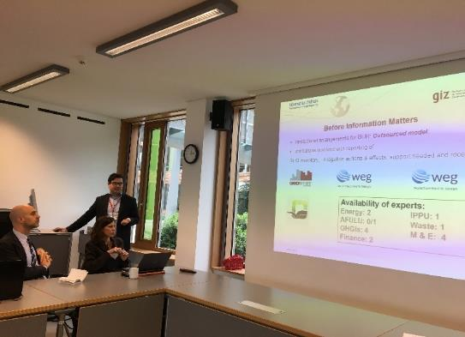
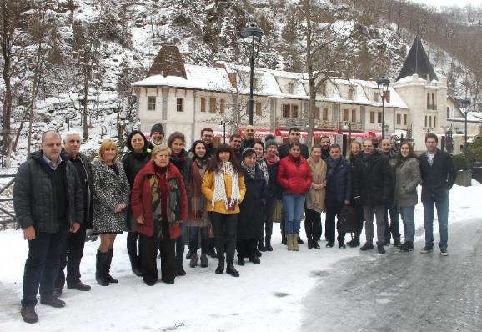
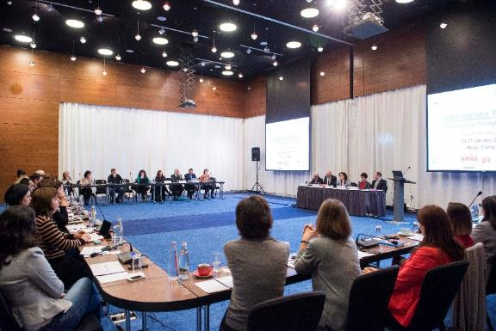
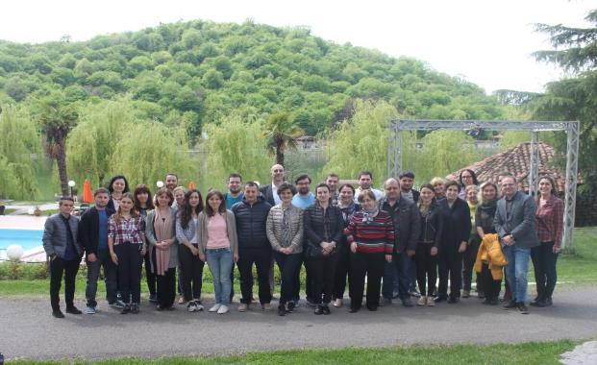
Timeline Information Matters
Georgia
GEORGIA
Kick-off workshop & mission
Capacity Building mission (I)
Capacity Building missions (II/III)
Peer-to-peer exchange
January, 2017
April, 2017
April, 2017
27July, 2016
September 2017
→ With countries phase 1
Backstopping (desk) support
Side-event Innovative approaches to MRV

Slide 10
Capacity Building Plan for Georgia:
Capacity Building mission 1: Institutional Set-up of the MRV System & Training on 2006 IPCC GHG Inventory Guidelines (3.5 days);
Capacity Building mission 2: MRV of mitigation actions (3 days);
Capacity Building mission 3: Stakeholder workshop on the proposed institutional set-up of Georgia’s MRV system (20 September) & Training on data collection and QA/QC (21-22 September);
Knowledge exchange: Global P2P & BUR Champions Workshop in Dessau & Berlin, Germany, April, 2017;
Backstopping support: Training and sharing views on the ICA Process, MRV of climate finance in Georgia, HFC emissions.
Documents and deliverables: Workshop documentation & Guidance Documents: a) Institutional set-up for an MRV system, b) Legal setup to operationalize the MRV system.
Side-event Innovative approaches to MRV

Slide 11
Results achieved in Georgia
Raised awareness on climate change mitigation and MRV at different ministries and agencies
Developed a high-level strategy for the setup of an overarching MRV system and promoted stakeholder involvement
Provided training on 2006 IPCC GHG Inventory Guidelines
Integration of private sector organisations in the GHG inventory (e.g. HFC importers)
Identification of mitigation actions and understanding their effects
Preparation for the International Consultation and Analysis Process
Identification of improvement areas for forthcoming 2BUR
Side-event Innovative approaches to MRV

Slide 12
Innovative approaches of the project for Georgia
Key stakeholders have an understanding of the role of reporting system under the UNFCCC for the country and them as well;
Sharing of views and challenges with a climate community;
Tangible results:
  Clear guidance on setting up the HFCs data management system;
  Recommendations for developing the MRV system in Georgia;
Side-event Innovative approaches to MRV

Slide 13
Inter-ministerial Committee
(recommending body)
NCs, BURs, GHG inventories, NDCs…
UNFCCC
QA Service
MoENRP
(coordinating entity)
Reporting project
Measurement report
Finance/Support report
Private sector
GNSO
Measurement activities
Implementing Entities
Relevant Ministries…
Mitigation activities
MoF; Donors…
Inventory MRV
Mitigation MRV
Support MRV

Slide 14
Remaining challenges and next steps for Georgia
Full institutionalisation of the MRV system, secure resources (financial and HR) to increase capacities of the CCS, improve measurement and reporting of the progress of mitigation actions, track progress of NDC goal, improvement of cooperation with Ministry of Finance for tracking support received….
Question for discussion with the audience:
    How have other countries managed to establish operational institutional structures for MRV?
    What is the approach taken for MRV of support/ MRV of mitigation actions? ….
Side-event Innovative approaches to MRV

Slide 15


Thank you very much! დიდი მადლობა!
For more information please contact:
oscar.zarzo@giz.de
(GIZ Information Matters country coordinator)
k.mdivani@moe.gov.ge
(Chief Specialist GHG Inventory and MRV – Min. of the Environment & Natural Resources Protection of Georgia
http://mitigationpartnership.net/information-matters

