Slide 1
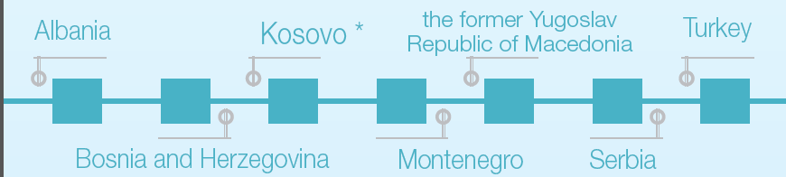
Sustained MRV capacity building
in the Western Balkan and Turkey
Monique Voogt
Justin Goodwin
9 November 2017

Slide 2
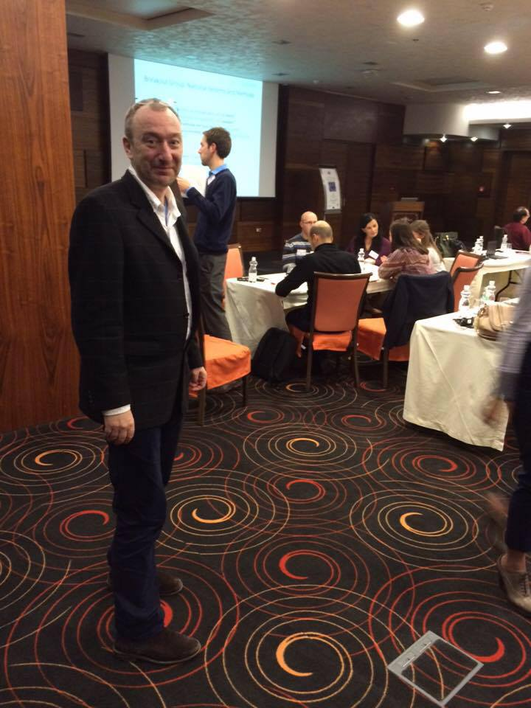
Imre Csikos
1962 – 2017
Team Leader RENA (2010-2013) and ECRAN (2013-2016) projects

Slide 3



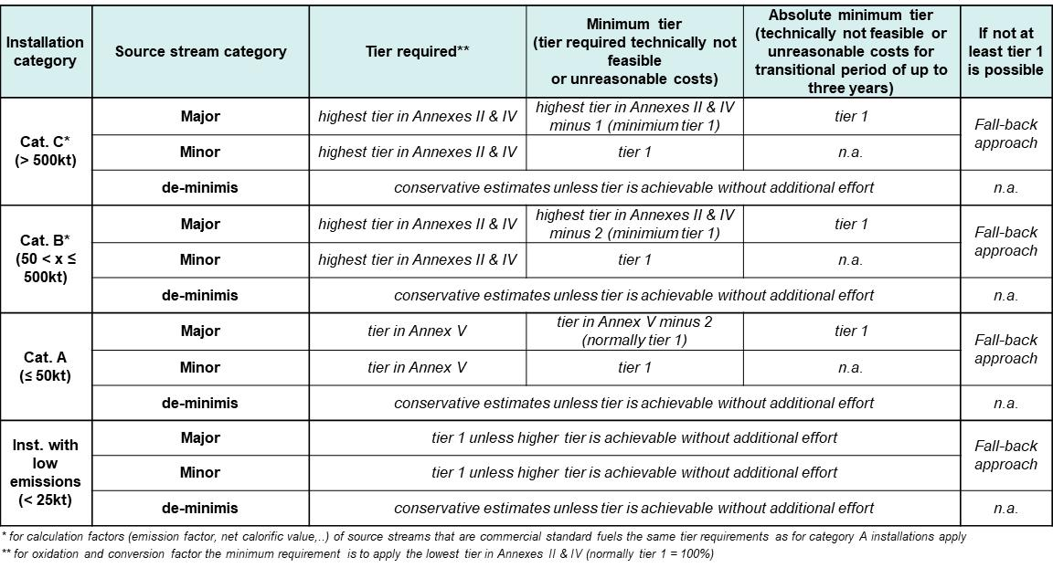
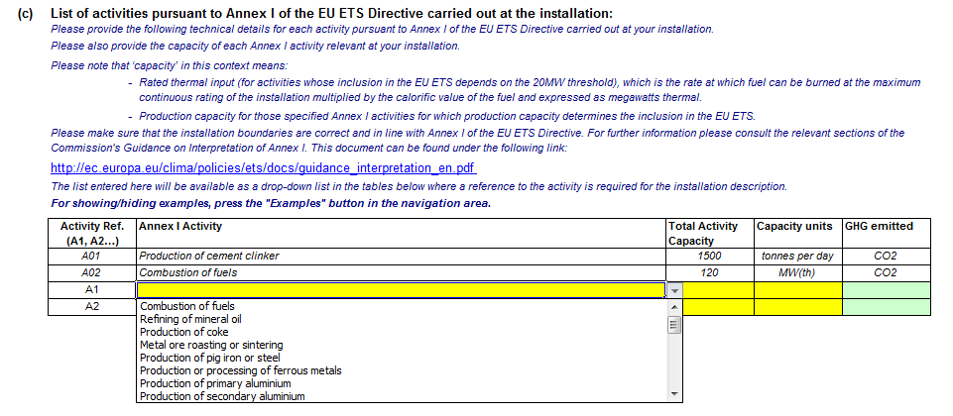


Capacity building on MRV – A challenge!
Notes:
This sheet aims to illustrate some of the complexity of capacity building. Orally we add other challenges such as the lack of political commitment, lack of resources, the high level of abstract of the various dossiers, and the technical complexity.
The sheet aims to draw attention, seek contact with the audience and build the story to tell that we have a different approach.

Slide 4
Regional Implementation of Paris Agreement Project - RIPAP
RIPAP aims to support capacity building for:
  Implementation of the 2015 Paris Agreement
  Low emissions development strategies
And to support regional cooperation through exchange of:
  Information
  Best practices
  Experience
  Awareness-raising low emissions development strategies
RIPAP targets 6 countries in the Western Balkan and Turkey
RIPAP runs from August 2017 – October 2018
The project builds on earlier network cooperation conducted under the RENA (2010-2013) and ECRAN (2013-2016) projects

Slide 5
RIPAP Events
National Systems: Awareness and building of National Systems.
  Remote engagement & mentoring
  National Systems workshop (January 2018) (Combined Component 1 & 2)
GHG Estimation: Improving methods, data sources and assumptions.
  Remote engagement & mentoring.
  Modelling systems and tools (May 2018) (Component 1)
  GHG inventory improvement (June 2018) (Component 2)
  Data availability for modelling (Sept 2018) (Component 1)
EUETS:
  Supporting implementation of climate change policy in Montenegro. Study tour or presentations. (Nov 2017)
  Extensive training on MRV for EU ETS in Serbia (Mar 2018)
  Regional training event (Apr 2018)
  ETS stakeholder information in The former Yugoslav Republic of Macedonia (Jun 2018)

Slide 6
RIPAP Activities

Slide 7
RIPAP: Scope (MRV/Transparency)
Long term Solutions for Beneficiary countries: “decision maker support tools”
Climate Action (Component 1)
  Awareness: NDC, Action quantification
  National Systems
  Projections: Scenarios and Modelling
GHG Inventories (Component 2)
  National Systems: Technical capacity
  GHG Estimation: Improving methods, data sources and assumptions.
Emissions Trading Systems (Component 3)
  (MRV) requirements targeted at operators, authorities and verifiers under the EU ETS
National Systems
  Institutional Arrangements,
  Stakeholder engagement
  Data availability,
  Technical Capacity,
  Tools, Systems, Procedures
EU 525/2013: EU Legislation
Article 5: National inventory systems
Article 12: National and Union systems for policies and measures and projections

Slide 8

Trends, Projections and Actions: Component 1 & 2:

Slide 9
Trends, Projections and Actions: Approach
Long Term Objective:
  Compliance with Paris Agreement up to and beyond 2030.
  Permanent sustainable National System for production for NC/BR/BURs and MRV of the NDC update and Development of Long Term Climate Strategies.
  Support of National Decision makers on climate impacts of national strategies and actions
Framework for elaboration of actions and means to achieve:
Established relevant institutional arrangements and engaged stakeholders.
Engaged data suppliers and sustainable data flow.
Established sustainable responsive cross organisational teams of experts.
Regular timely production of high quality* outputs (Reports).
Ensuring sustainability and profile (national usefulness) of the MRV system.
Interactive action progress system, mentoring, remote workshops, tracking engagement, workshops.

Slide 10
Trends, Projections and Actions: Technical assistance
Decision-makers engagement:
  GHG inventories
  GHG modelling, projections and quantification of action
Improving sustainability of teams, data and quality of GHG inventories, the modelling process and models:
  Methods, data sources and assumptions
  Completeness, accuracy & consistent reporting
  Improving transparency
  Improving projections linkage to actions

Slide 11
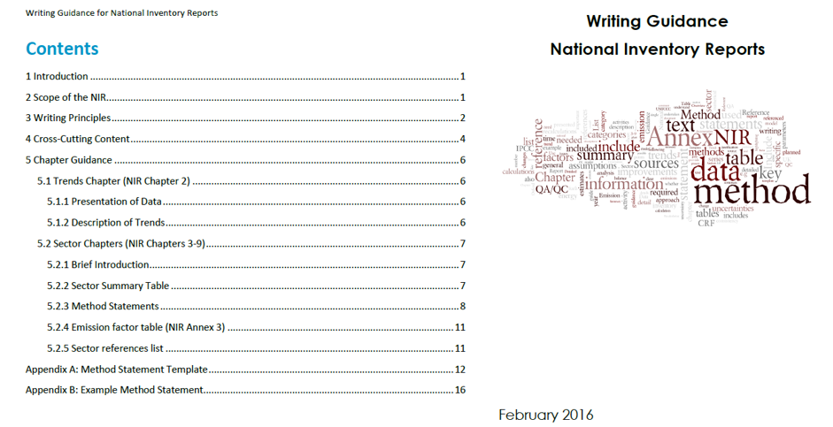
Technical Assistance: National Inventory Reports

Slide 12

Technical Assistance: Engagement Portal

Slide 13
Component 3: EUETS

Slide 14

Study tour of Montenegrin experts to Slovenia
Study tour for staff from Ministry, EPA and operators from Montenegro
Learning from peers in Slovenia
  Competent authority for ETS (Ministry)
  Environment Agency
  Various operators
Agenda contains among others:
  Visit to aluminium plant and two power plants
  Organisational set-up at Ministry and EA
  Understanding permitting process and registry system
  Data management systems
  Learning about preparation of monitoring plans and emission reports
  Understanding impact ETS on companies

Slide 15

Learning on ETS verification in Serbia
Training in two parts:
  Completion of the Monitoring Plan
  Organising an ‘as-if verification’
Bringing Ministry staff and operator experts together
International verifier to work with the operator team; Ministry and EPA staff as ‘observers’
Using the actual draft MP and the actual site plot, emission reports and laboratory reports
  Results:
  For operators – ready to submit a fully compliant MP and emissions report
  Ministry and EPA – ready for validation of MP and full understanding of how a verifier should conduct his/her work

Slide 16
Some of the lessons learned
Feedback forms show high appreciation of training, especially in terms of:
  breaking complicated dossiers down in understandable parts
  telling ‘the honest story’: the upsides and downsides
  bringing peers to share their experiences and mentoring
  providing hands-on support such as joint exercises and helping prepare actual implementation materials
Beneficiaries show solid progress in understanding and implementation. Although political support remains a key challenge
Key necessities include:
  Early start with preparation and implementation
  Credible team of hands on experts
  Involving both public and private sector from a very early date
  Repeating messages and learning
  Keeping the current style of training (as effective)
  Learning from experiences elsewhere (EU and outside EU)

