Slide 1
M.I.S.C.A.
A DEDICATED PORTAL
FOR NDC IMPLEMENTATION
THE STUDY CASE OF LEBANON
COP23 - BONN
9 November 2017
Dario Berardi
dberardi@dev4u.it
Funded by the European Union
Notes:
It’s a real pleasure to be here today to talk about MISCA.
Well! Let’s start to say What is MISCA?

Slide 2
M.I.S.C.A.
Management &
Information
System for
Climate
Action
Funded by the European Union
Notes:
MISCA stands for ...
To understand better what we are talking about, let’s quickly go back to the basics.

Slide 3
M.I.S.C.A.
Whatever we do ...
... we consume energy ...
... we produce CO₂...
Funded by the European Union
Notes:
Whatever activity we are carrying out ... We are going to consume energy. This energy consumption will produce a certain amount of Co2

Slide 4
M.I.S.C.A.
How much CO₂ ?
Depends on:
Where are we getting this energy from
(type of fuel)
How good we are in using the fuel
(efficiency)
Funded by the European Union
Notes:
How much Co2 will depend most on ...

Slide 5
M.I.S.C.A.
Under Paris Agreement, all countries have decided:
to count
- How much energy they are consuming
- How much CO₂ they are emitting
to implement
- Specific measures to Reduce CO₂ emissions
to share this information each others
Funded by the European Union
Notes:
We should consider that, Under the Paris Agreement...
...
In order to understand what this is going to entail

Slide 6
THE PLOT
Sectors
Data Management
Calculation
Transport
Different Data Owners
Tot CO2 eq.
produced
Data
Collection
Industries
Energy
Consumption
Different Parameters and algorithms based on fuel type and sectors for emissions calculation
Agriculture
Data
Collection
Different Responsibilities for data management
Waste
Data Entry
Data Validation
Data Release
Tot MW from
renewable
produced
Private Generators
Data
Collection
Mitigation
Measures
Tot CO2 eq.
reduction
…..
Data
Collection
Tot MW from
Fossil
avoided
OUTPUT
Energy
Consumption
National
Grid Emission
Factor
Data
Collection
Power Plants
Data Validation
Data
Collection
Data Entry
Data Release
Mitigation
Measures
Data
Collection
Tot CO2 eq.
produced
MISCA SCOPE

Slide 7
CHALLENGES
Multi-sectoral dimension and the commitment of each sector to get involved
Complexity of a tool that should:
ensure ownership of the process
enforce quality of data
be flexible to adapt to evolving situation
be easy to use
be parameterized
be based on an open architecture
No previous well-established experiences in the region
Funded by the European Union
Notes:
--------------
Let’s see how we tackle these challenges with MISCA. We decided to pilot-test MISCA in LEBANON

Slide 8
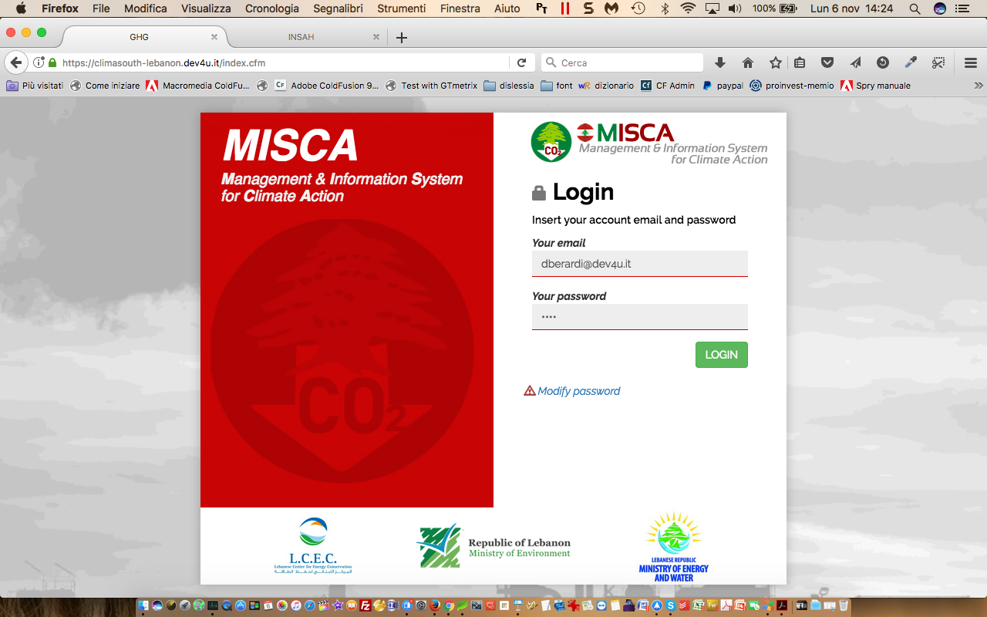
MISCA - LEBANON
Funded by the European Union

Slide 9
WHY LEBANON?
The right persons
in
the right positions
at
the right moment!
Funded by the European Union
Notes:
WHY LEBANON
I suppose that there are many project managers in the room here today and I’m pretty sure that all of you will agree with me in saying that for the success of a project the most important thing is to have ...
It’s not that easy... It’s like an astral combination: it happens once in a while...
Well ! This was the case in LEBANON when we start this adventure and I’m glad to say it is still the case now, after one year more or less of working together

Slide 10
OBJECTIVES
Facilitate sharing and access to information on Policies, Measures, Actors, Finance related to Lebanon’s actions against climate change
Facilitate Reporting to UNFCCC of Lebanese NDC implementation progress
Funded by the European Union

Slide 11
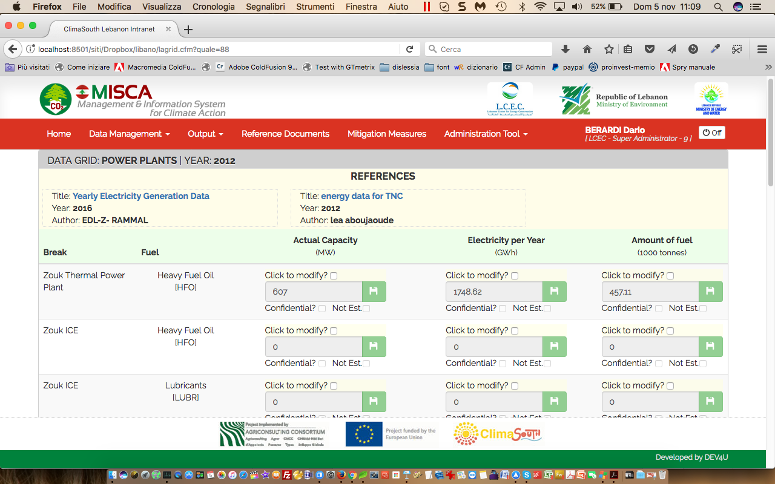
HOW IT WORKS
3 KEY CONCEPTS
USERS
SESSIONS
GRIDS
Users are the operators within the platform: they are sector-related with different rights within each sector
A Session is a logical container that includes Data entry, Data validation, Data calculation for all grids in one specific year.
The GRID is the Working Unit within the platform: data entry,
data validation and basic calculations are done on a per-grid basis.
Funded by the European Union

Slide 12
USERS TYPOLOGY
Super Administrator
Sector Administrator
Data entry Operator
Validation Operator
Data Release Operator
BY SECTOR
Funded by the European Union
Notes:
We have 5 users type.

Slide 13
SESSIONS & WORK-FLOW
OPEN SESSION
Inventory Phase : ENERGY CONSUMPTION
Super
Administrator
Sector
Operators
Data Release
Data Validation
Data Entry
Mitigation Measures
Recording
Sector
Administrator
Emissions
Calculation
Super
Administrator
OPEN SESSION
Mitigation Phase : ENERGY SAVINGS
Data Validation
Data Entry
Sector
Operators
Data Release
Funded by the European Union

Slide 14
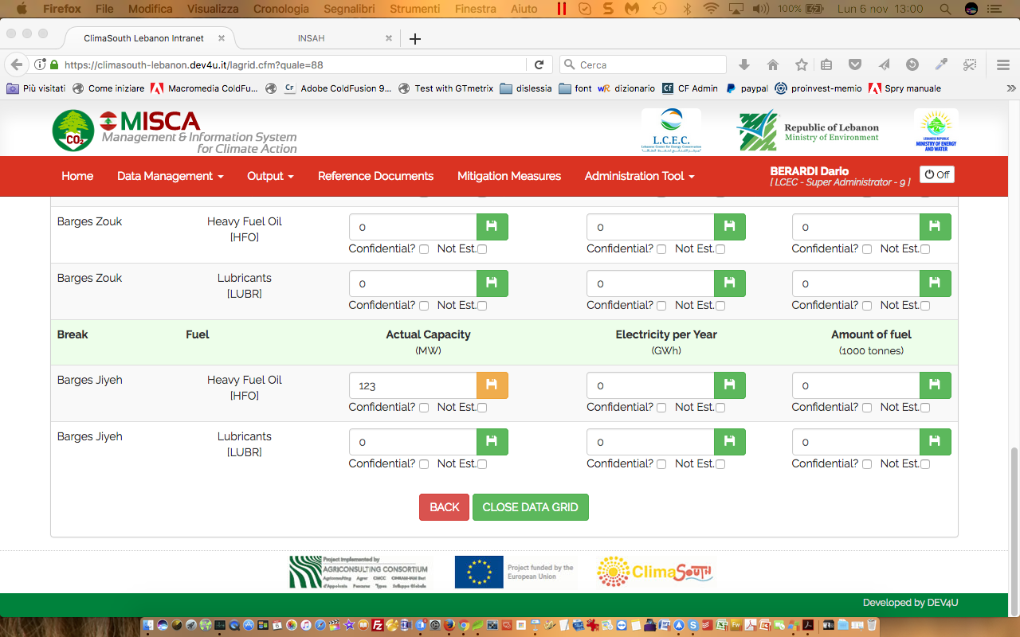
Data Entry
Funded by the European Union

Slide 15
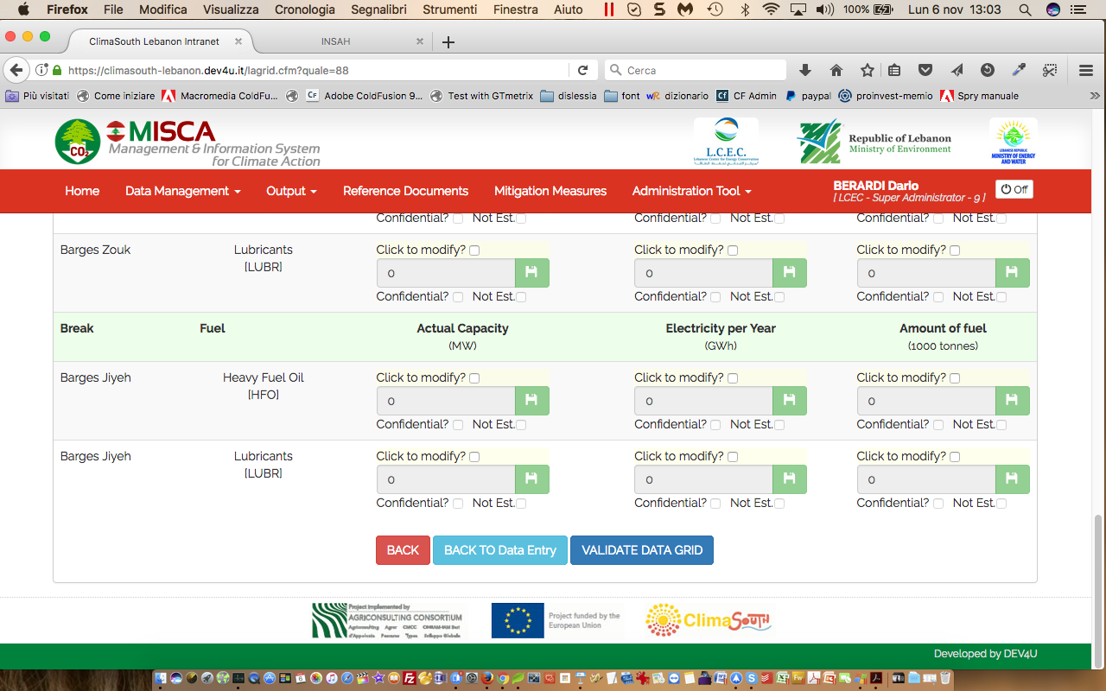
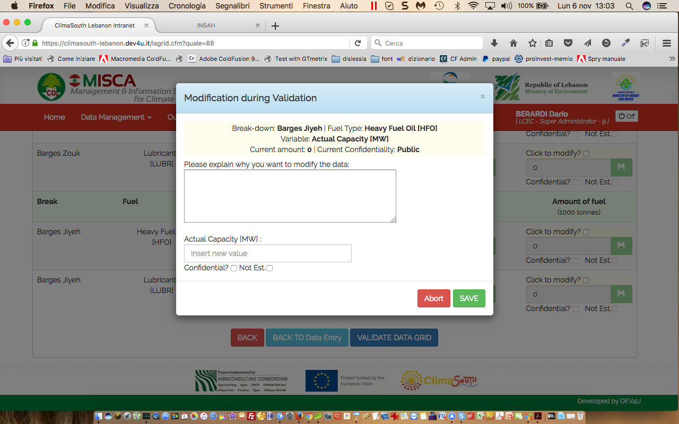
Data Validation
Funded by the European Union

Slide 16
Data Validation

Slide 17
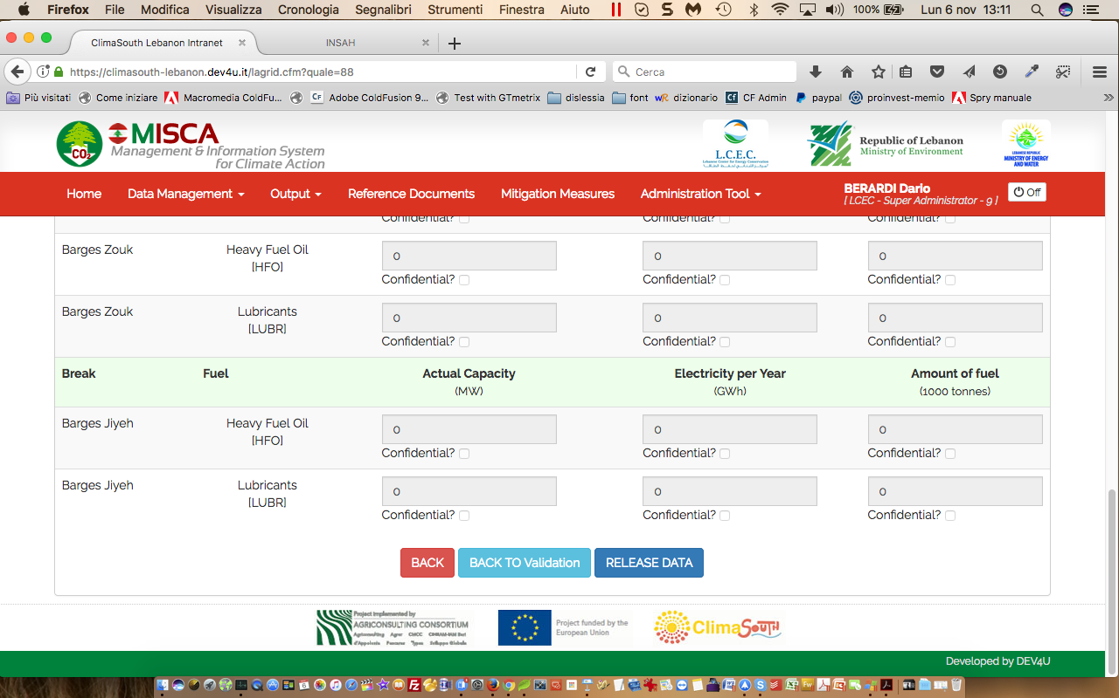
Data Release
Funded by the European Union

Slide 18
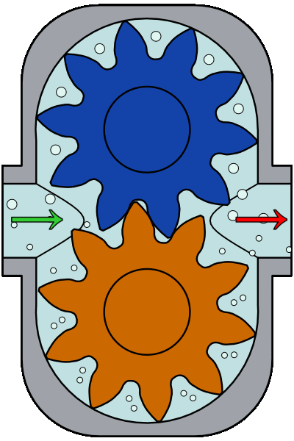
CALCULATION
Data Released
on Energy Consumption
Data Released
on Energy Savings
Conversion Factors
Grid Emission Factor
Emissions
CO2 Eq
Emissions avoided
CO2 Eq
Funded by the European Union

Slide 19
CALCULATION
Calculations are done using conversion factors.
Conversion factors are parameters
that can be modified: they are grouped together in PROFILES.
By creating different profiles, it is possible to compare emission results based on different conversion factors.
Funded by the European Union

Slide 20
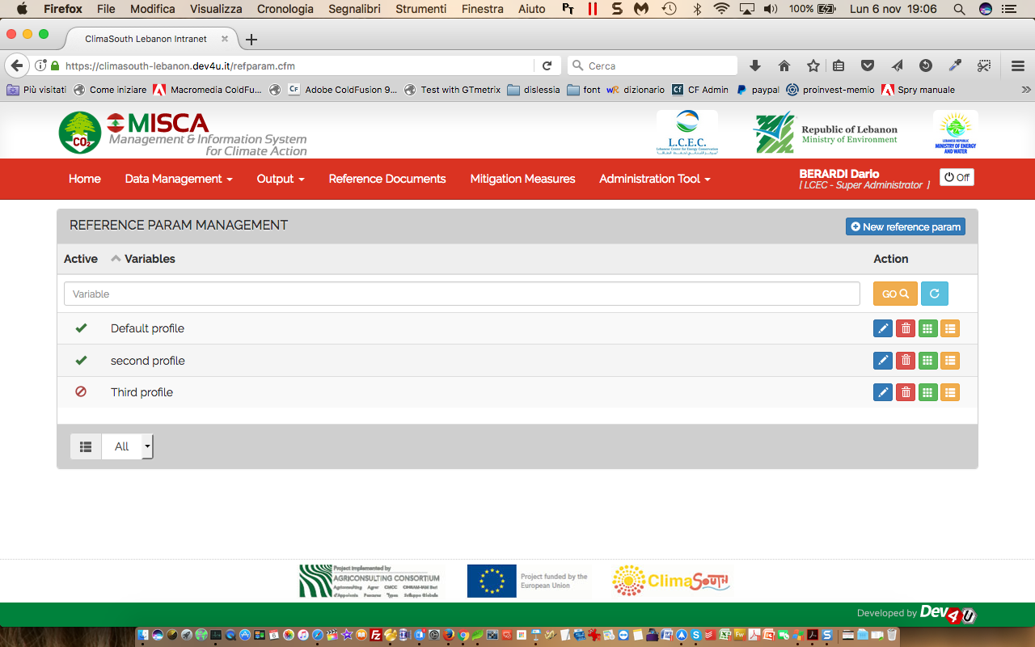
PROFILES
Funded by the European Union

Slide 21
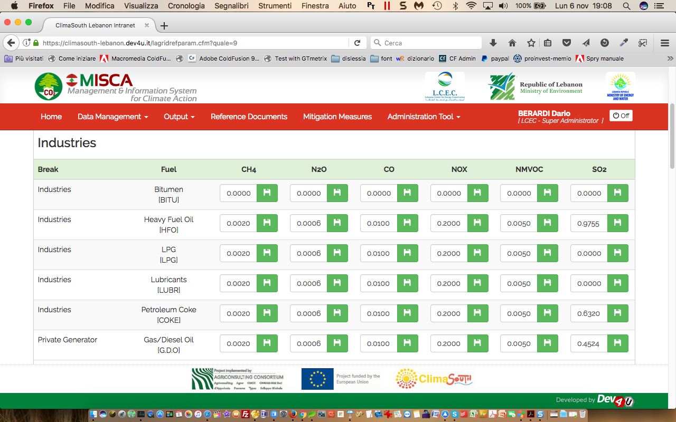
PARAMETERS
Funded by the European Union

Slide 22
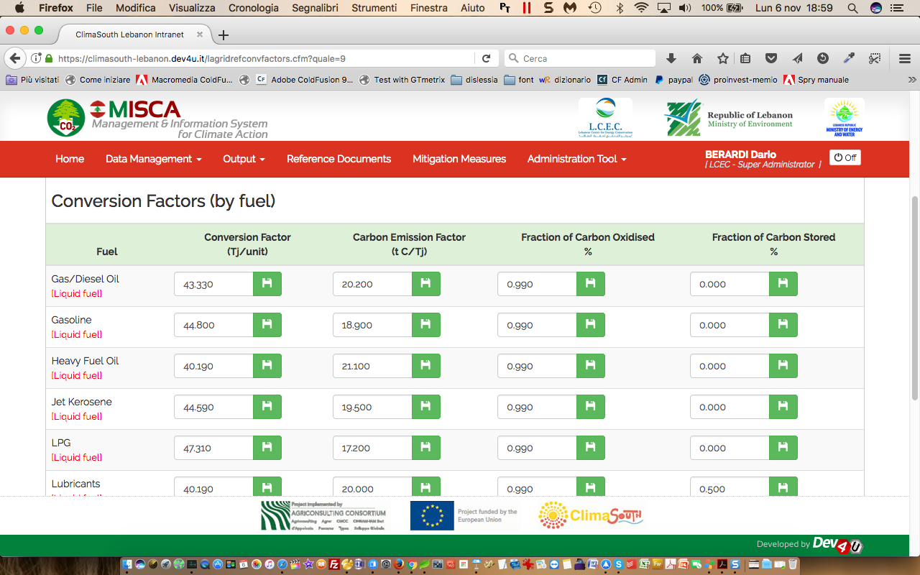
PARAMETERS
Funded by the European Union

Slide 23
OUTPUT
Two types of OUTPUT
- At Grid Level
Tables (export in Excel)
- At National Level
Graphs (can be copy-pasted)
Funded by the European Union

Slide 24
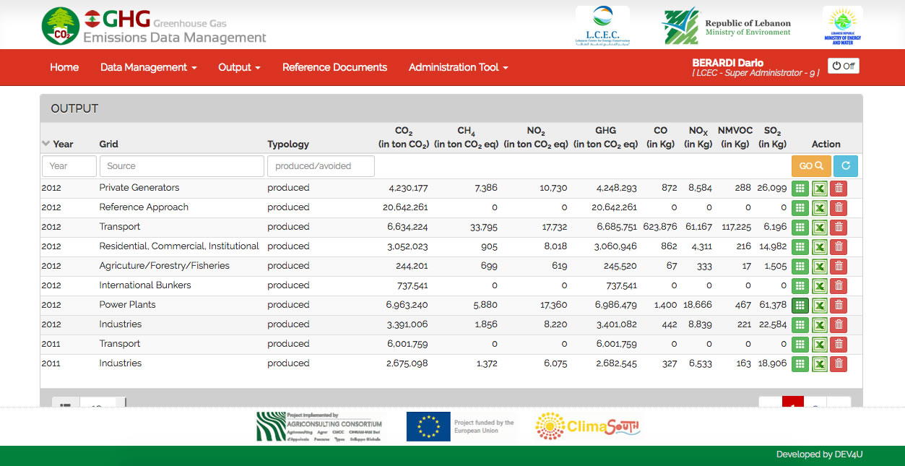
OUTPUT
Funded by the European Union

Slide 25
OUTPUT
Funded by the European Union

Slide 26
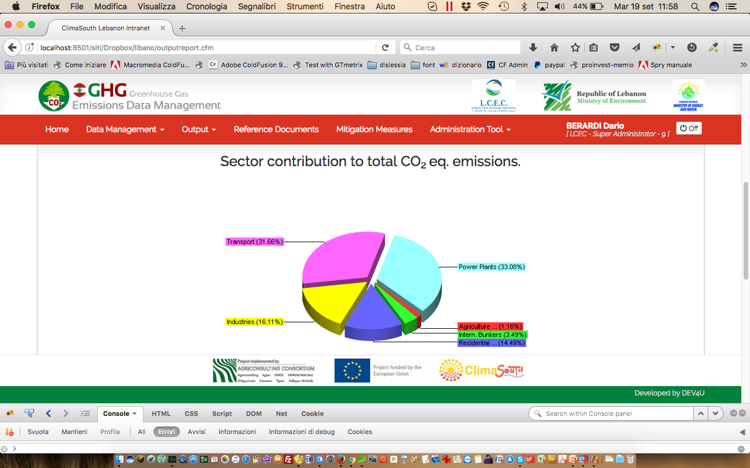
OUTPUT
Funded by the European Union

Slide 27
FINAL CONSIDERATIONS
When we started working on this assignement there were many big challenges!
Thanks to the commitment of the Lebanese stakeholders and the ClimaSouth team we were able to bring the development of MISCA almost to completion.
What we have now is an online portal that:
Funded by the European Union

Slide 28
FINAL CONSIDERATIONS
is built so that stakeholders of each sector are the only ones who have access to the raw data management of their sector:
Data Ownership is enforced
Sensitivity and confidentiality of raw data is granted
collaboration among government, public and private institutions is stimulated
Funded by the European Union

Slide 29
FINAL CONSIDERATIONS
Data Quality is enforced - by means of role separation:
before being used for data calculation
- by always associating data to one or more references.
Data is entered
Data is verified
Data is released
Funded by the European Union

Slide 30
FINAL CONSIDERATIONS
Data Management is organized in a structured Work-flow:
notification by mail are sent before the start and after the end of each step.
Date and time of each step achievement is recorded
Funded by the European Union

Slide 31
FINAL CONSIDERATIONS
It is completely database driven for easy
customization
portability
scalability
Funded by the European Union

Slide 33
M.I.S.C.A.
Thank you!
Dario Berardi,
Chief Technology Officer
Funded by the European Union

