Slide 1
ClimaSouth project
Low Carbon Development for climate resilient societies

Slide 2
Why ClimaSouth
Mediterranean region a hotspot for Climate Change
Need to promote low carbon development and climate resilience
Need to overcome political, institutional and technical constraints (MRV, INDC, LEDS, UNFCCC, negotiations, mainstreaming,…)
Launch of ClimaSouth in 2013

Slide 3
ClimaSouth work areas

Slide 4
Climate finance in action
Assessment of needs. Regional climate finance seminar.
Key finding. Low capacity among key stakeholders in partner countries to develop bankable proposals for climate funding.
Responses:
Support the preparation of climate finance applications.
Advisory services on the use of international climate finance.
Facilitate the mobilisation of domestic funds for cleantech innovation.
Elaboration of climate finance handbook.

Slide 5
Climate finance handbook
Practical toolbox with following main functions :
preparing and assessing project applications for climate finance;
capacity building/training in workshop type settings;
reference material for climate finance applications.

Slide 8
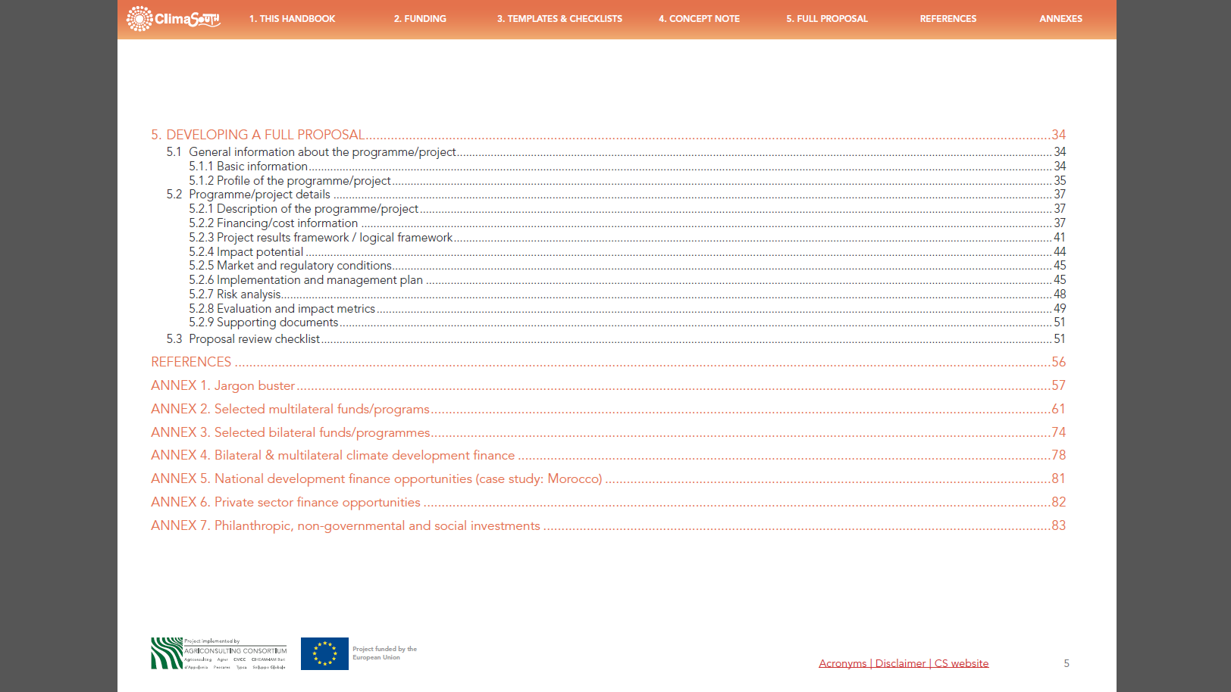

Slide 10
How does the handbook help ?

Slide 11
Concept note template
General information about the programme/project
Basic information
Profile of the programme/project
Programme/project details
Description of the programme/project
Financing/cost information
Expected results and benefits
Implementation and management plan
Risk analysis
Evaluation and impact metrics

Slide 12
Concept note checklist

Slide 14
Full proposal template
General information about the programme/project
Basic information
Profile of the programme/project
Programme/project details
Description of the programme/project
Financing/cost information
Project results framework / logical framework
Impact potential
Market and regulatory conditions
Implementation and management plan
Risk analysis

Slide 15
Full proposal checklist
Continues…

Slide 16
Annexes
Selected multilateral funds/programs
Selected bilateral funds/programmes
Bilateral & multilateral climate development finance
National development finance opportunities
Private sector finance opportunities
Philanthropic, non-governmental and social investments

Slide 17
Thank you

