Slide 1


ClimaSouth
Lebanon National Activity
Beirut 06.02.2017
Project funded by the European Union

Slide 2
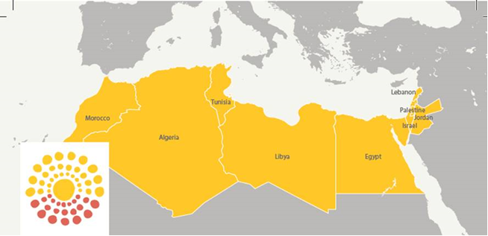
ClimaSouth – The Project/1
- EU FUNDED (5M EURO)
- 2013 – 2018
- ENPI SOUTH

Slide 3
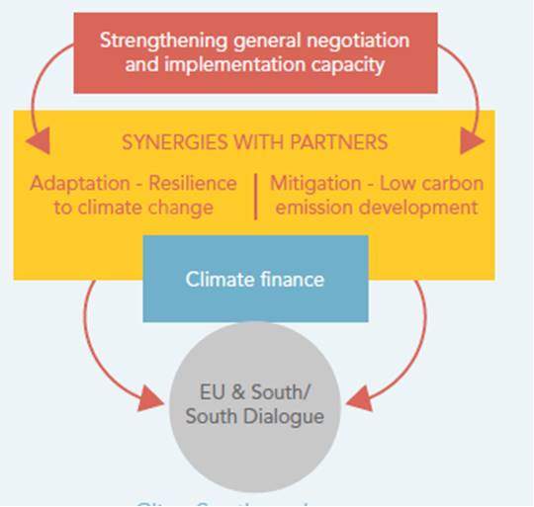
ClimaSouth – The Project/2

Slide 4
ClimaSouth action in Lebanon
Combination of national and regional activities:
  Support to national MRV system
  Support to access to climate finance
  Mainstreaming of climate change in the private sector: Lebanon Climate Act
  Enhancement LARI EWS system in Beqaa Valley

Slide 5
ClimaSouth National Activity in Lebanon
National Activities: bottom up approaches in sharing knowledge and assistance in priority sectors affected by the impact of climate change.
In Lebanon, the Ministry of Environment, trough a participatory process, has selected agriculture in Bekaa Valley as priority for the ClimaSouth National Activity, with the objective of enhancing the existing LARI Early Warning System (EWS) by:
assessment of the LARI EWS;
design and project proposal for enhanced LARI EWS;
EWS operational training

Slide 6
LARI EWS Assessment Report
The assessment has provided in depth:
Analysis of the EWS under the three components:
  Meteorological data and stations management
  Agro-meteorological models for crop monitoring and risk assessment,
  Information products apt to allow farmer to take a decision.
Evaluation of farmers’ reactivity to the transmitted information in terms of content and format

Slide 7
Accompanying Trainings
Two main strands:
knowledge and tools for irrigation scheduling of strategic Mediterranean crops under different soils and climatic and environmental conditions
AWS management and maintenance, Soil moisture sensors and monitoring techniques and Climatic data download, validation and management

Slide 8
The enhanced LARI EWS
The proposed enhanced system is centered on a major reinforcement of the LARI EWS infrastructure and on improved and adapted capacity in Water management advising
Infrastructure: reinforce agro-meteorology, data banks and communication sub-systems
Water management: information sharing adapted and calibrated to the models to the various ecosystems and agricultural products
The project proposal is designed to support these two different approaches with the infrastructure component to be immediately operational while the water component demanding a preliminary test phase

