Slide 1
LARI Early Warning System
Andrea Di Vecchia
ClimaSouth Final workshop
6 February 2017 Beirut, Lebanon
Project funded by the European Union

Slide 2
Table of contents
Framework for LARI Early Warning System (EWS)
LARI EWS approach
EWS Infrastructure
Water management component
Estimated costs
ClimaSouth Final workshop 6 February 2017 Beirut, Lebanon

Slide 3
Framework for LARI EWS
Objective
To strengthen LARI Early Warning System so as to support farmers in improving management of the adverse impacts of climate variability on their agricultural activities through agro-meteorological information and advice in the Beqaa Valley
ClimaSouth Final workshop 6 February 2017 Beirut, Lebanon

Slide 4
EWS SWOT analysis
Strenghts
17 AWS in the Bekaa
Opportunities
Threats
Absence of governmental decision for recruitment
Weaknesses
Limited human resources
Possibility for querying PESSL database
Existing trained researchers
Bench for AWS maintenance
Absence of DB
Difficulties of database management
Limited resources for maintenance
Theft of AWS (very rare)
Lack of suitable software for data processing and QC
Difficulties in finding locations for AWS representing all the agro-bioclimatic zones
Existing network infrastructure
Possibility to interface AWS
Dependency on PESSL server
Limited collaboration with LMS
Weather forecasts x stations
14000 subscribers
General satisfaction of farmers
Existing web site
Access to GCM/RCM outputs through int. operators
Availability of Seasonal forecasts
ICT
Poor collaboration with MoA Extension system
Limited ICT literacy of farmers
Data availability for agroecological zoning
AWS representatives of agroclimatic zone in Bekaa
Weather forecasts relying on DACOM or METOS
Limited collaboration with LMS
Diversity of agriculture systems and of farmers type
Absence of tailored advises
Application not user friendly for all farmers
ClimaSouth Final workshop 6 February 2017 Beirut, Lebanon

Slide 5
LARI EWS approach
The project proposal rather than deal with all aspects of LARI EWS is centered on two components, considered to be not only a priority but a condition for the sustainability of the system:
EWS infrastructure : Agrometeorology observations & data management, weather forecasting, communication & information
Drought and Water Management : data assessment, modelling, test, calibration, advising
ClimaSouth Final workshop 6 February 2017 Beirut, Lebanon

Slide 6
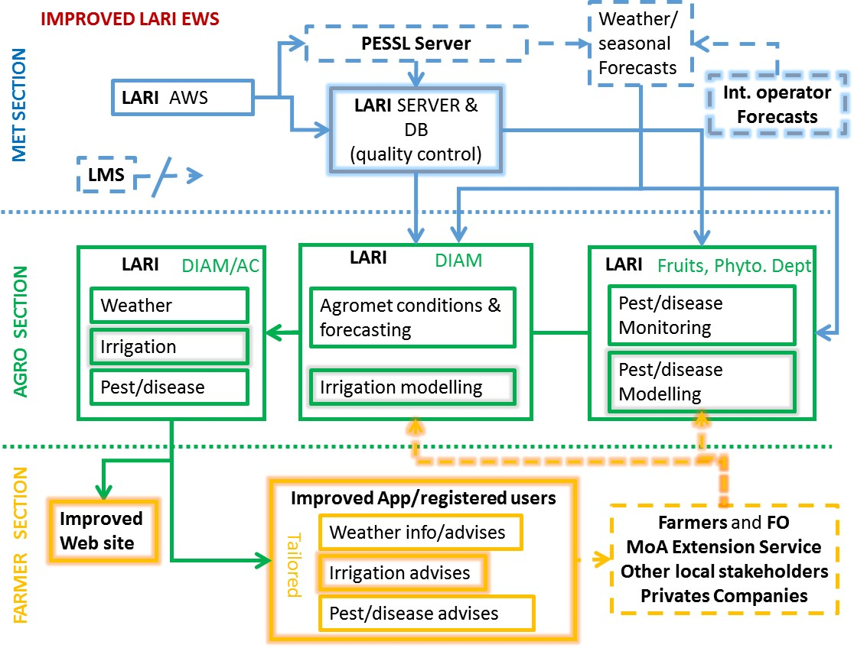
ClimaSouth Final workshop 6 February 2017 Beirut, Lebanon

Slide 7
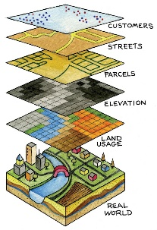
EWS Infrastructure
Agrometeorological observations
Weather forecasts
Agro-ecological zoning
Communication and information
Network
Database
Rehabilitation
Training
API download
DBMS
Users’ interfaces
QC
Training
Short
Medium
Long range
Training
Data collection
Analysis
Mapping
SOP
Improve web site
Upgrade App
Farmers
Extension
Public
ClimaSouth Final workshop 6 February 2017 Beirut, Lebanon

Slide 8
Drought and Water Management
Data
assessment
D&M
modelling
Field
testing
Model
calibration
Farmer
advising
ClimaSouth Final workshop 6 February 2017 Beirut, Lebanon

Slide 9
Estimated Costs
Component 1: 1,309,200 €
Component 2: 782,980 €
Project management: 747,820 €
Overall: 2,840,000 €
ClimaSouth Final workshop 6 February 2017 Beirut, Lebanon

