Slide 1
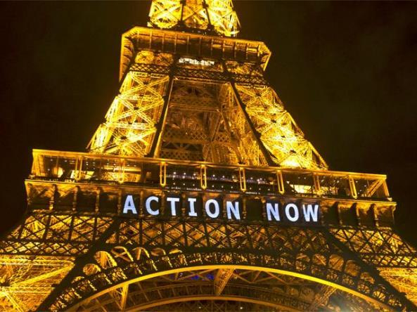
News update
ClimaSouth SC
29 March 2017
Matthieu Ballu
DG Climate Action

Slide 2
1. EU’s preparation for the implementation of the Paris Agreement
2. International climate negotiations
3. International climate initiatives

Slide 3
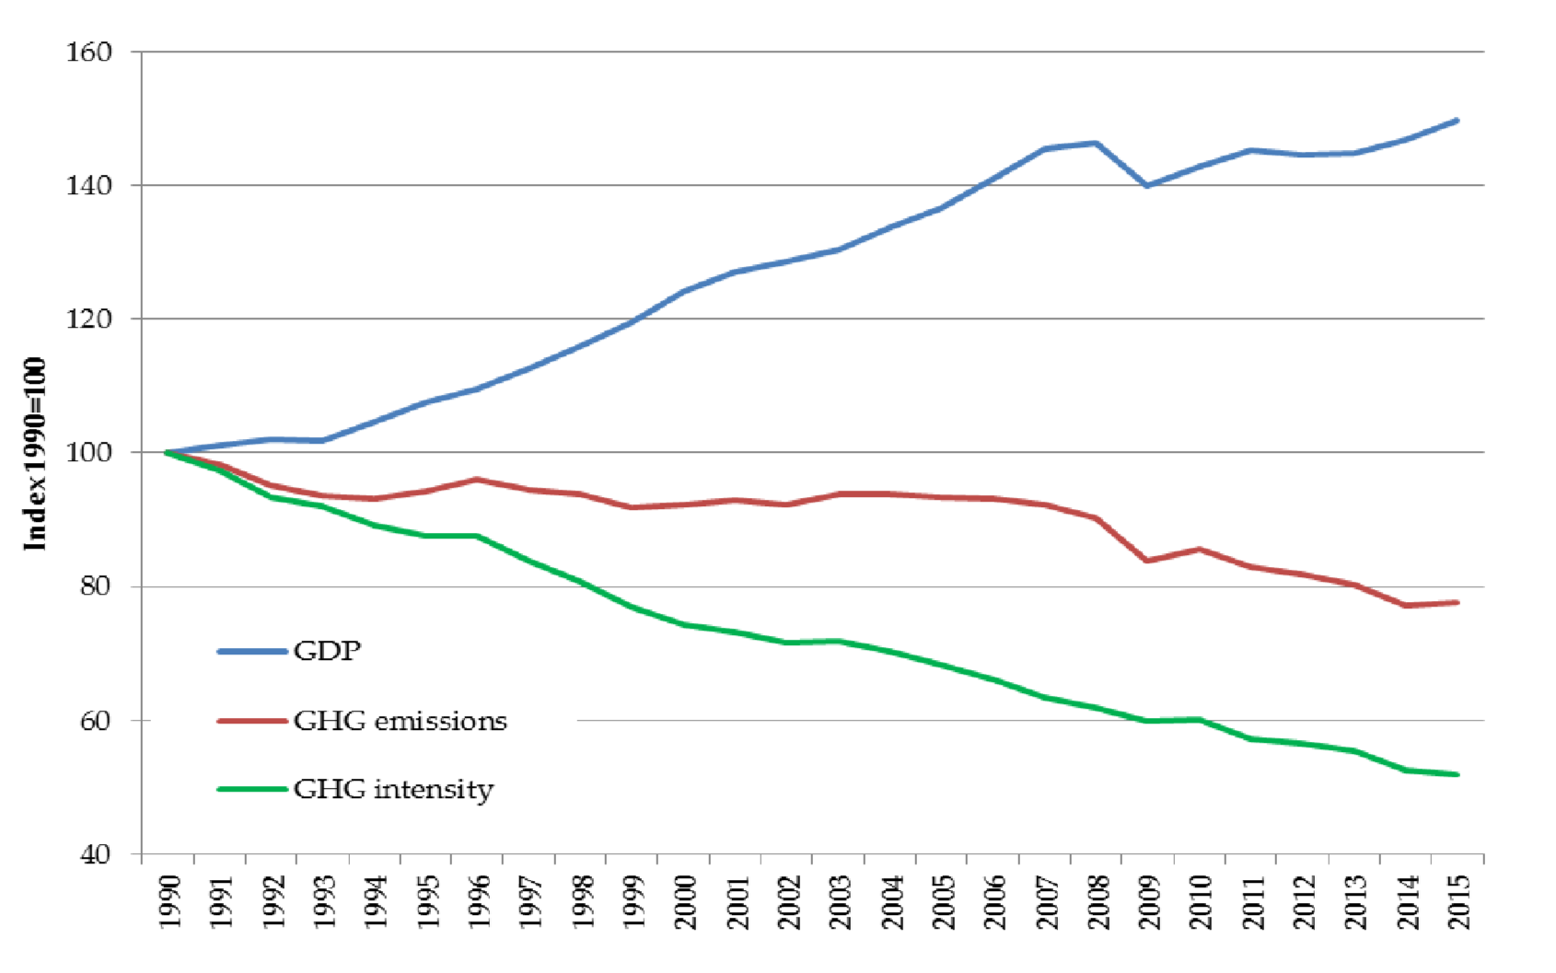
Notes:
the EU has already a compelling story to tell on decoupling emissions from growth
Not be complacent or arrogant – still a long way to go and we can also learn from the experience of others
But assume our leadership and be ready to share our experience

Slide 4
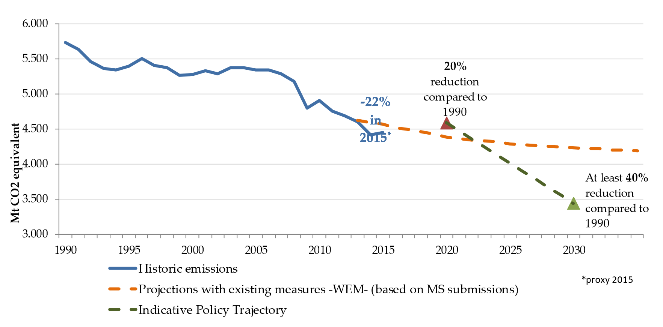
Notes:
On track to surpass the 2020 target
New policy measures are under development to put us on track for the 2030 climate and energy targets

Slide 5
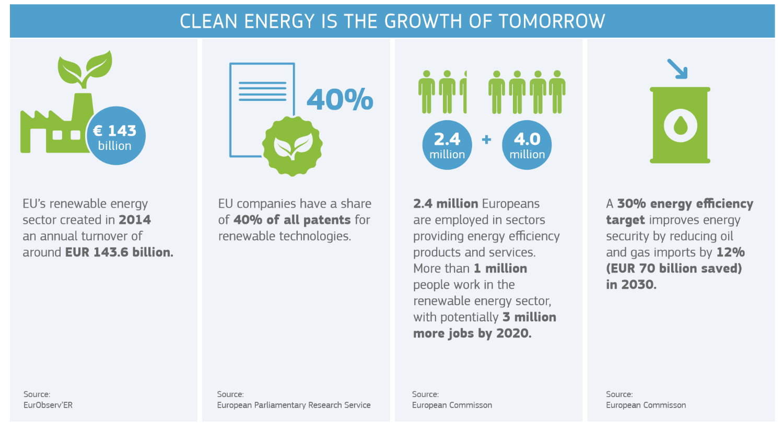
Notes:
(more figures on the EU 2030 climate and energy framework / Energy Union / winter package if needed)
(credit to DG ENER for the winter package infographics)

Slide 6
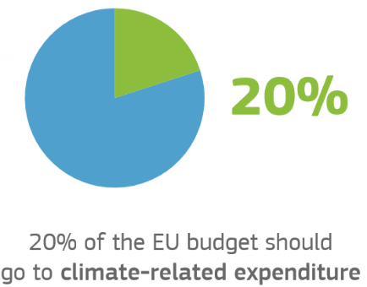
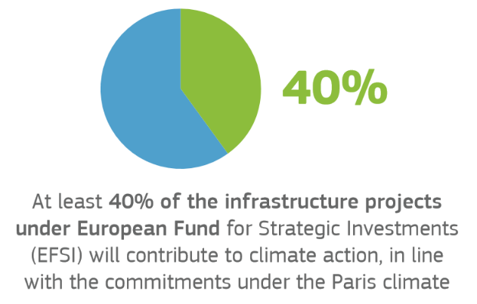
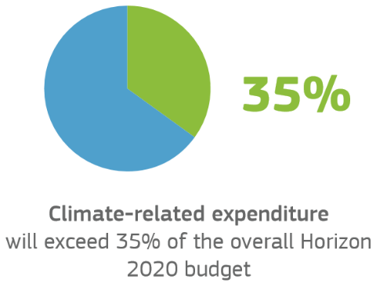
Notes:
(more figures on the EU 2030 climate and energy framework / Energy Union / winter package if needed)
(credit to DG ENER for the winter package infographics)

Slide 7
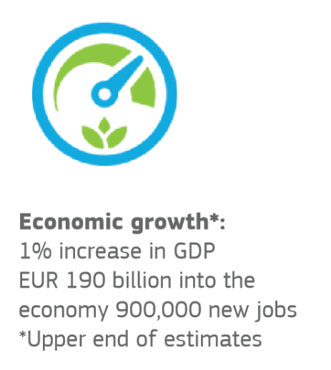
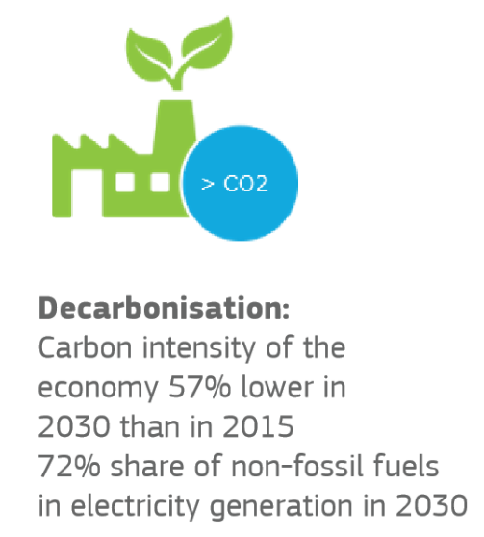
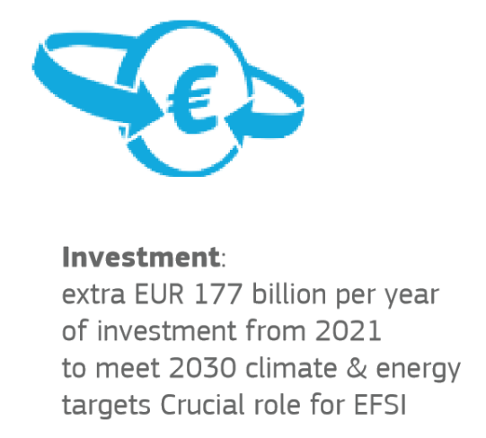
Notes:
(more figures on the EU 2030 climate and energy framework / Energy Union / winter package if needed)
(credit to DG ENER for the winter package infographics)

Slide 8
1. EU’s preparation for the implementation of the Paris Agreement
2. International climate negotiations
3. International climate initiatives

Slide 9
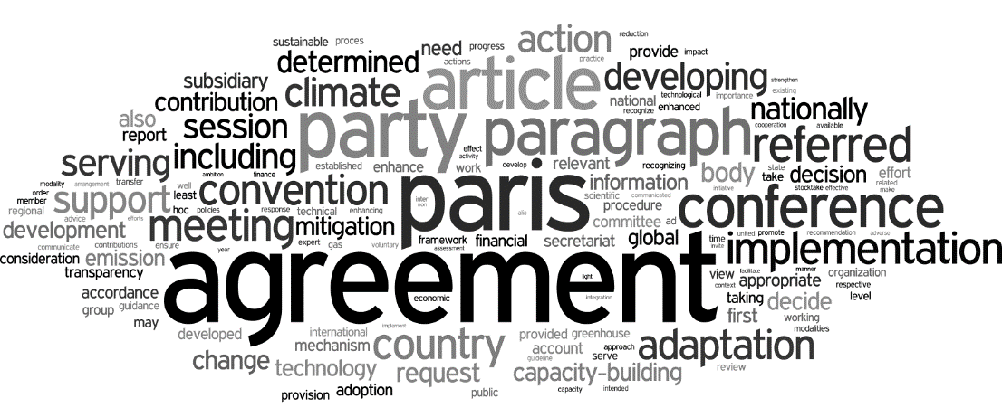
Notes:
An historic Agreement:
A new chapter in international climate governance and action (10 years in the making)
A win for multilateralism
A strong signal to policy makers, investors and businesses
What was agreed?
Fair, ambitious and legally binding agreement with targets for all Parties (although aggregate efforts are not yet in line with common goals)
Transparency and accountability through robust common rules
Dynamism - 5 yearly reviews to increase ambition towards a long term goal
A solidarity package of international support for low carbon, climate resilient sustainable development
And accelerated action pre-2020
The EU played a key role
Influx of ideas at front end of negotiation cycle to frame the terms of the negotiations
Bridge-building proposals to help broker final compromise
EU / ACP alliance to bear weight in the last few days
EU cohesion maintained until the end game

Slide 10
Marrakesh climate change conference
Sustained momentum and global determination
Strong evidence of solidarity and action
Steady progress on the Paris rulebook
Broad respect for the Paris balance, despite some muted protests
=
Preparations for the new regime on track
Notes:
COP22/CMA1: Paris Agreement institutionalised
Annual UN climate change conference took place in Marrakesh immediately after entry into force
It institutionnalised the Paris Agreement by convening the first formal meeting of its governing body
This meeting was immediately suspended to leave time to more Parties to join before decisions are made
Meanwhile the elaboration of implementing rules of the PA continues under the Convention bodies
Marrakech conference saw a very large mobilisation of state and non-state actors around concrete initiatives
And approx 70 Heads of States and Government were there and issued a "Marrakech Proclamation" to reaffirm their commitment, esp in the light of ….
… results of the US elections that were announced midway thru the Marrakech conference.
The successful Marrakech conference and in particular the prompt reaction from the EU and Chinese authorities provided general comfort that climate action continues irrespective of the political changeover in the US.
That being said, the US election result raises unexpected challenges for us:
Risk that the Trump administration withdraws from the Convention and from the Paris Agreement
Risk that they slow down or reverse the deployment of federal climate policies in the US
Risk that US Treasury reduces its expected funding for climate action in developing countries
Risk that any negative message coming from the US weakens the hand of climate policy advocates in other major economies
On the other hand, we can't afford to lose 4 more years in the global fight against climate change and to see the Paris Agreement unravelling

Slide 11
Implementing the Paris Agreement
Transparency rules
Pre-Paris
Post-Paris
5-yearly ambition cycle
2018 Dialogue
2023+ Global Stocktake
Multilateral climate regime
ADAPTATION
CAPACITY-BUILDING
MITIGATION
LAND
COM-PLIANCE
FINANCE
TECH
MARKETS
SCIENCE
Implementation
NDCs
Solidarity
Action Agenda
Notes:
Transparency
Pre- Paris:
Multilateral assessment under IAR and Facilitative sharing of views under ICA clear successes
Confirmation of mandate & role of CGE up to 2018
No final agreement to the guidelines for national communications
Post- Paris:
All hands on deck, Parties ready to engage substantively on the common guidelines, modalities and procedures
Paris text as starting point unchallenged; Parties moving away from old stalemates
Early submissions and workshop before next session to help advance the needed details
Global stocktake - Centerpiece of the ambition cycle
2018 Dialogue:
Facilitative dialogue on emissions reductions
IPCC report on 1.5°C pathways
Informs subsequent preparation of contributions by 2020
Morocco+Fiji to consult and prepare in 2017
2023+ Global Stocktake:
Consider progress on all global goals
After 2030, all to communicate emissions reductions contributions every 5 years
Progression on previous efforts
Further work on Technical and political phase of stocktake, Inputs, outcomes, modalities
Adaptation and Loss & Damage
Adaptation as key element of the Paris Agreement Implementation.
Adaptation finance: Unanimous request from developing countries for availability, accessibility, predictability and sustainability.
adaptation communication: convergence on the framing and overall themes and clear aim for substance - especially by developing countries.
The submissions envisaged before the next SB sessions and the forthcoming in-sessional workshop are expected to provide tips and linkages also relevant in the build-up of the transparency framework.
The adaptation-related institutional architecture to be reviewed in the light of the Paris Agreement
On Loss and Damage: successful review of the Warsaw International Mechanism bought some time for the Parties and the process itself, though WIM further status (either under the COP or being fully subject of CMA’s authority) may become a revolving issue. Indicative framework of the new 5 year work plan of the WIM Executive Committee adopted, with notable strength given to the finance related work stream and to the cooperation with outside-UNFCCC entities
Finance
Preparatory work to set up the Paris Agreement transparency framework (reporting, accounting)
Long-term finance: how to scale up, how and when to start the work of reflecting beyond the 2020 Roadmap ?
What would the future climate finance architecture look like ? 6th review of the financing mechanism starting, what will happen to the Adaptation fund, how to streamline the landscape ?
The functions of the UNFCCC Standing Committee on Finance will be reviewed – how will the SCF serve the Paris Agreement ?
In the High Level climate finance ministerial, a strong emphasis by the vulnerable developing countries for increased grant-based adaptation funding
Capacity-building:
Fully operational Paris Committee on Capacity-building - in 2017 focus on capacity-building activities for NDC implementation
Conclusion of the third review of CB framework - launch of the fourth review and 6th meeting of the Durban Forum on Capacity-building
Technology
Parties welcome the work of the Technology Mechanism and the cooperation with the Green Climate Fund and the Global Environment Facility.
To support for the Climate Technology Centre and Network under the Convention, the European Commission joint the USA, Canada, Denmark, Italy, Japan and Korea in announcing further support of $23 million.
Agreement of the scope and key themes of the new guiding Technology Framework.
Mitigation
NDC Guidance is a vital part of the Paris Rulebook
NDCs must be clear, transparent, accounted for etc.
Essential ingredient to transparency framework and ambition cycle
Marrakech produced a viable plan for developing the guidance needed on NDC accounting, accompanying information & features.
But progress is too slow. LMDCs reluctant to isolate technical issues from larger points of principle (e.g. differentiation)
NDC registry discussions appear to be stalled permanently until NDC guidance finalised.
Carbon markets:
Further and more focused process on Article 6 of the Paris Agreement with tacit agreement to a 2018 deadline
Three sub items:
Article 6.2 - Accounting,
Article 6.4 - A mechanism to replace CDM
Article 6.8 – A Workprogramme on non-Market Approaches
Clear that progress on accounting and a mechanism related (EU and Umbrella v Brazil), and contingent on parallel progress on non-market approaches (Venezuela, Bolivia and Saudi)
But some momentum/seriousness to be detected
Concerted effort to exclude observers and to focus on Party agreement (Venezuela and Brazil)
Brazil-EU working together but significant differences over substance – both accounting and mechanism
Absence of US from further negotiations will make things more difficult as will be absent a clear pole of opinion on accounting.
Transition from CDM to Article 6 Mechanisms a key issue for many – one we are seeking to defer pending clarity on where we are going – i.e. the design of the Article 6 Mechanism
Land
Robust rules important given prominence of sinks in the Paris Agreement goals, although as yet, no formal opportunity to develop these
Agriculture highlighted as important for many parties yet progress remains challenging
Science
Sixth IPCC assessment cycle will be key inputs to the first global stocktake in 2023 - more dialogue between IPCC experts and Parties on the findings of the IPCC products
2016 Implementation Plan of the Global Climate Observing System - full implementation encouraged
Legal, institutional issues and compliance
Paris Agreement CMA1: Supreme body of the Paris Agreement (without all UNFCCC parties yet as Parties) has taken its first decision, to ask the UNFCCC COP to complete the Paris rulebook by 2018, and the CMA1 will continue until then
COP22: Mirror Decision taken by COP22 (including all Parties) to continue this work in 2017 and 2018
CMA/ COP : Joint CMA/ COP will take place in 2017 to take stock of progress
Article 15 mechanism: Submissions invited on the Paris Agreement mechanism 'to facilitate implementation and promote compliance' by 30 March 2017

Slide 12
What is expected from partner countries to implement the Paris Agreement?
Ratification
Implementation of NDCs
NDC updating/enhancement
Mid-century strategies
Adaptation action
Enhance monitoring and reporting systems
Notes:
Ratification of the Paris Agreement: almost done, expect RUS and TUR
NDC implementation is the main piece. This involves in an integrated manner:
Further embedding the NDC into the national development strategy and sectoral strategies and the sustainable development goals;
Increasing awareness and ownership of the NDCs across branches of government, in parliaments, and with national civil societies and private sector stakeholders;
Prioritizing and organising deliverables including legislative acts and institutional arrangements;
Translating high-level targets into sectoral roadmaps and bankable projects;
Mobilising finance from the national budget, private investors and (for developing countries) international sources of support including EU aid instruments and the GCF;
Managing data and information to enable and facilitate NDC implementation, monitor impacts, demonstrate results and share good practices.
NDC updating/enhancement:
required before 2020 for countries whose NDC is on the 2025 timeline, inc. USA and BRA.
possible at any time for countries willing to improve their contribution – eg ARG working on it
required from all by 2025 at the latest
Mid-century strategies
All Parties invited to prepare and communicate a mid-century strategy by 2020 (Paris decision)
Commission communicated its an EU 2050 roadmap in 2011 already (but was never endorsed by Council).
Can share valuable experience on the methodological aspects (modelling, impact assessment, cobenefits, stakeholder consultation, political process)
USA, MEX, CAN and DE presented their 2050 strategy at the Marrakech conference
CHN’s own strategy well advanced
Adaptation undertakings
PA establishes a global goal of enhancing adaptive capacity, strengthening resilience and reducing vulnerability to climate change and requests all Parties to prepare and submit periodical adaptation communications.
Adaptation action and enhancing resilience is an important piece of climate policy for all G20 countries.
All G20 countries have either an adaptation undertaking or included adaptation action and priorities in their NDCs (ARG, BRA, IND, IDN, KOR, KSA, MEX, RSA)
We can share valuable experiences on approaches for planning, implementing and reporting on adaptation action and vulnerabilities
Monitoring and reporting systems
the PA foresees a gradual transitioning from a bifurcated transparency framework with relaxed requirements for developing countries to a framework with common modalities and procedures.
This is a major step up for developing countries. At the same time our partner governments understand the need to track progress and impact of the climate policies being implemented both domestically to verify results and internationally to live up to the commitments made.

Slide 13
1. EU’s preparation for the implementation of the Paris Agreement
2. International climate negotiations
3. International climate initiatives

Slide 14
Coming together on the "Action agenda"
NAZCA (climateaction.unfccc.int):
a global registry to track climate commitments from non-State actors
inc. 2500 cities, 200 regions, 2100 companies, 500 investors
Cooperative partnerships
inc. 77 concrete initiatives of State and non-State actors across sectors

Slide 15
Commission's priority initiatives under the action agenda
Notes:
Mission Innovation: to promote innovation in clean energy technologies
Global Covenant of Mayors for Climate & Energy: to promote engagement of local authorities. Results from a merger of the Convenant of Mayors or European origin and Bloomberg's Compact of Mayors
African Renewable Energy Initiative: fast-tracking 10GW of renewable electricity capacity by 2020 and 300GW by 2030
Insuresilience: offer insurance services against climate risk to 400m people within most vulnerable countries
Climate and Clean Air Coalition: cooperative work on short lived climate pollutants

Slide 16
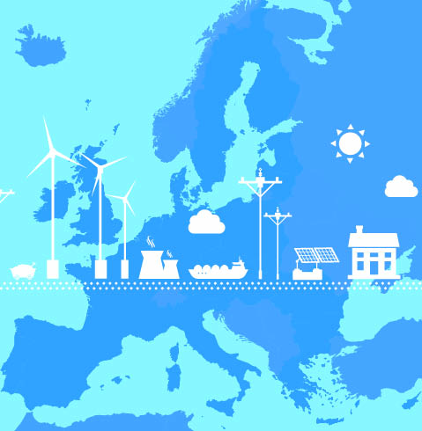
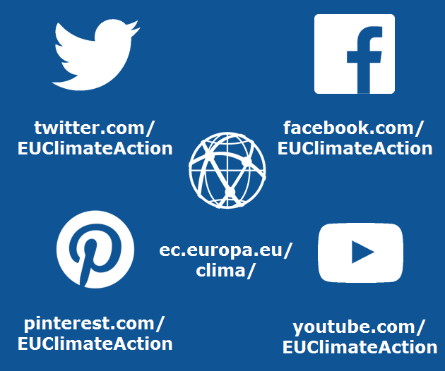
Thank you! Visit EU Climate Action online:

