Slide 1
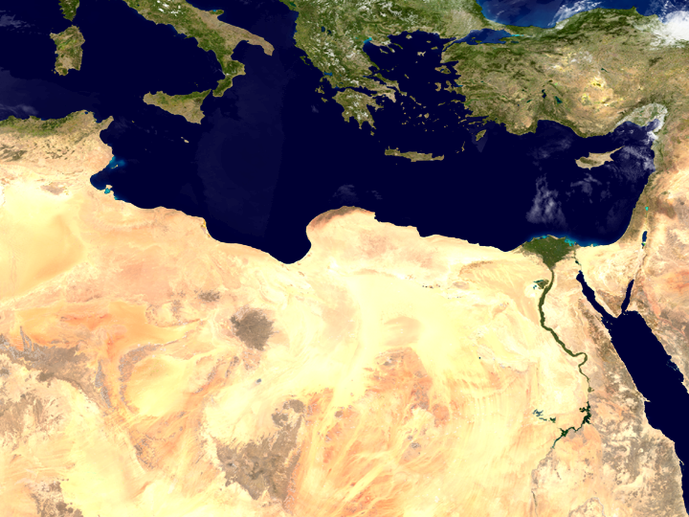
ClimaSouth project
Governing Climate Change
A Centre of Excellence in Egypt
Findings from an Assessment and Design Study
Marc A. Levy, Earth Institute, Columbia University
Low Carbon Development for climate resilient societies

Slide 2
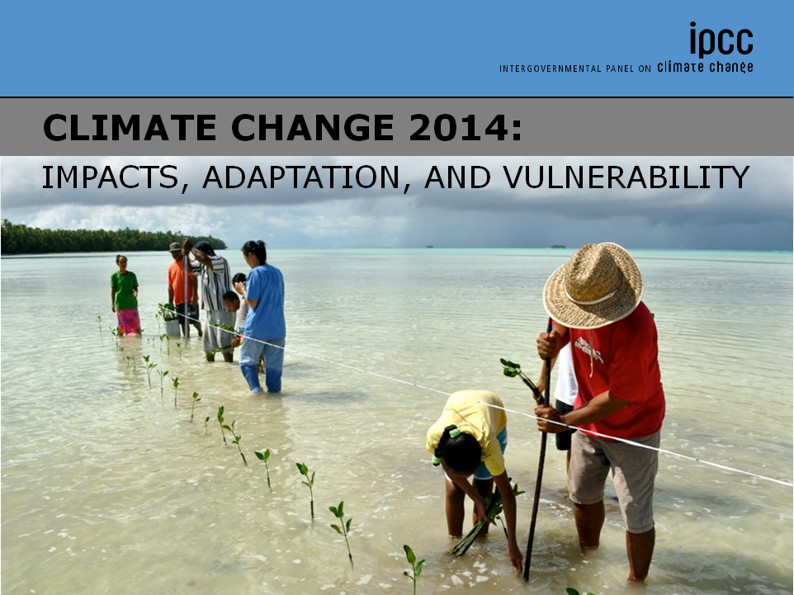
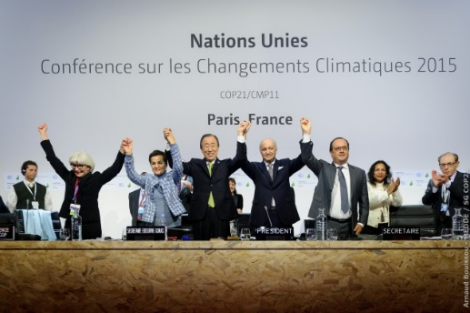
Action is required now
The consequences of inaction have been shown to be intolerable, beyond scientific doubt
COP21 charts a clear new approach:
All must do their part
We must be ambitious, flexible, and mutually accountable
Steps taken in coming couple of years will have profound impacts on the well-being of Egyptians for generations
Jobs
Health
Investment
Security
There are big transformations in the global agenda holding all to higher standards of progress
More ambitious than before
More inclusive than before
More integrative than before
Without climate action: failure
IPCC
Paris Agreement
SDGs
Notes:
Patterns: http://www.dailymail.co.uk/sciencetech/article-2033029/Russian-wildfires-Pakistan-flood-caused-weather-event-1-500miles-apart-says-Nasa.html

Slide 3
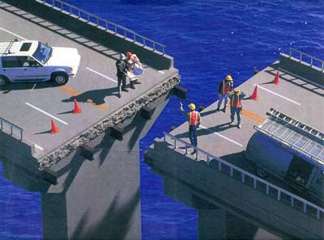
Effective leadership requires institutional innovation
COP21 provided a common destination, but it is up to each country to map a path to get there
Existing government arrangements are not able to respond effectively and quickly enough
The pitfalls of governance-as-usual are well understood:
Hard to share information
Technical and scientific capacity unevenly distributed
Hard to coordinate actions
Inter-agency coordination
Science-policy coordination
Public-Private partnerships
Global partnerships
Notes:
Patterns: http://www.dailymail.co.uk/sciencetech/article-2033029/Russian-wildfires-Pakistan-flood-caused-weather-event-1-500miles-apart-says-Nasa.html

Slide 4
It can provide services that all stakeholders agree are valuable
It is a credible, feasible, sustainable innovation
It provides a clear point of engagement for multiple high-priority
It is a model of innovation with a demonstrated track record in Egypt
It is capable of adapting and improving over time, based on experience
A Climate Change Centre of Excellence is the Right Innovation for Egypt
Central Laboratory for Agricultural Climate (1996)
CEDARE (1992)
Notes:
Patterns: http://www.dailymail.co.uk/sciencetech/article-2033029/Russian-wildfires-Pakistan-flood-caused-weather-event-1-500miles-apart-says-Nasa.html

Slide 5
Provide technical training in support of high-quality proposals for the Green Climate Fund and other climate-related investment windows
Provide digests of relevant science targeted at specific national needs
Provide training for critical assessment methodologies such as loss-and-damage estimation, climate model downscaling, and integrated assessment scenarios
Create a safe, neutral space for stakeholders to develop pragmatic solutions to problems that stand in the way of effective collaboration, such as information sharing
Can operate at across national, regional and international scales
The Center of Excellence can succeed by meeting high-priority immediate needs
Training that people already want
Training that people will find useful soon
Solutions to problems that people already want solved
Knowledge translation
Enable partnerships people want now
Encourage partnerships that will foster continued innovation
Notes:
Patterns: http://www.dailymail.co.uk/sciencetech/article-2033029/Russian-wildfires-Pakistan-flood-caused-weather-event-1-500miles-apart-says-Nasa.html

Slide 6
Designing for Success
Not controlled by any single government agency
All key stakeholders have voice in a governing board
Egyptian government ministries
Private sector
Civil society
Science
International organizations
Encourage input from many sources to ensure continued focus on priority needs and continued commitment to scientific and technical excellence
Service as core operating principle
Partnership as core modus operandi
Identify needs, design strategy to meet them, deploy agile teams, get results quickly
All stakeholders feel ownership
Structure, process, values, vision, place, people heavily interdependent. Must be designed as a whole
Core values: service and excellence
Culture of innovation and excitement
An engine of innovation, not growth
1) Soft launch
Agree on principles, vision, governance. Secure start-up funding.
2) Roll-up
Recruit staff, identify location, form board and advisory councils, develop workplan
3) Full-scale operation
All staff hired, portfolio of projects and services fully operational
A place that attracts pragmatic problem-solvers
18 months
Notes:
Patterns: http://www.dailymail.co.uk/sciencetech/article-2033029/Russian-wildfires-Pakistan-flood-caused-weather-event-1-500miles-apart-says-Nasa.html

Slide 7
Thank you

