Slide 1
ClimaSouth project
Low Carbon Development for climate resilient societies

Slide 2
Why ClimaSouth
Mediterranean region a hotspot for Climate Change
Need to promote low carbon development and climate resilience
Need to overcome political, institutional and technical constraints (MRV, INDC, LEDS, UNFCCC, negotiations, mainstreaming,…)
Launch of ClimaSouth in 2013

Slide 3
ClimaSouth work areas

Slide 4
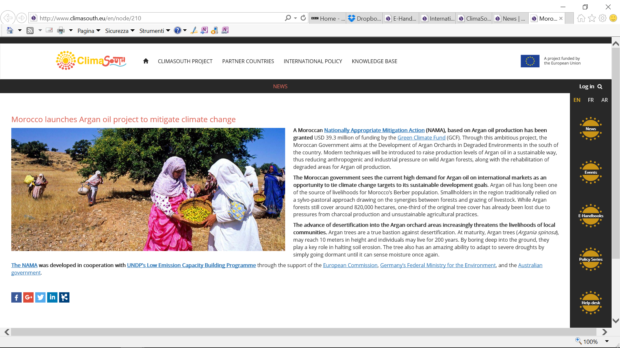
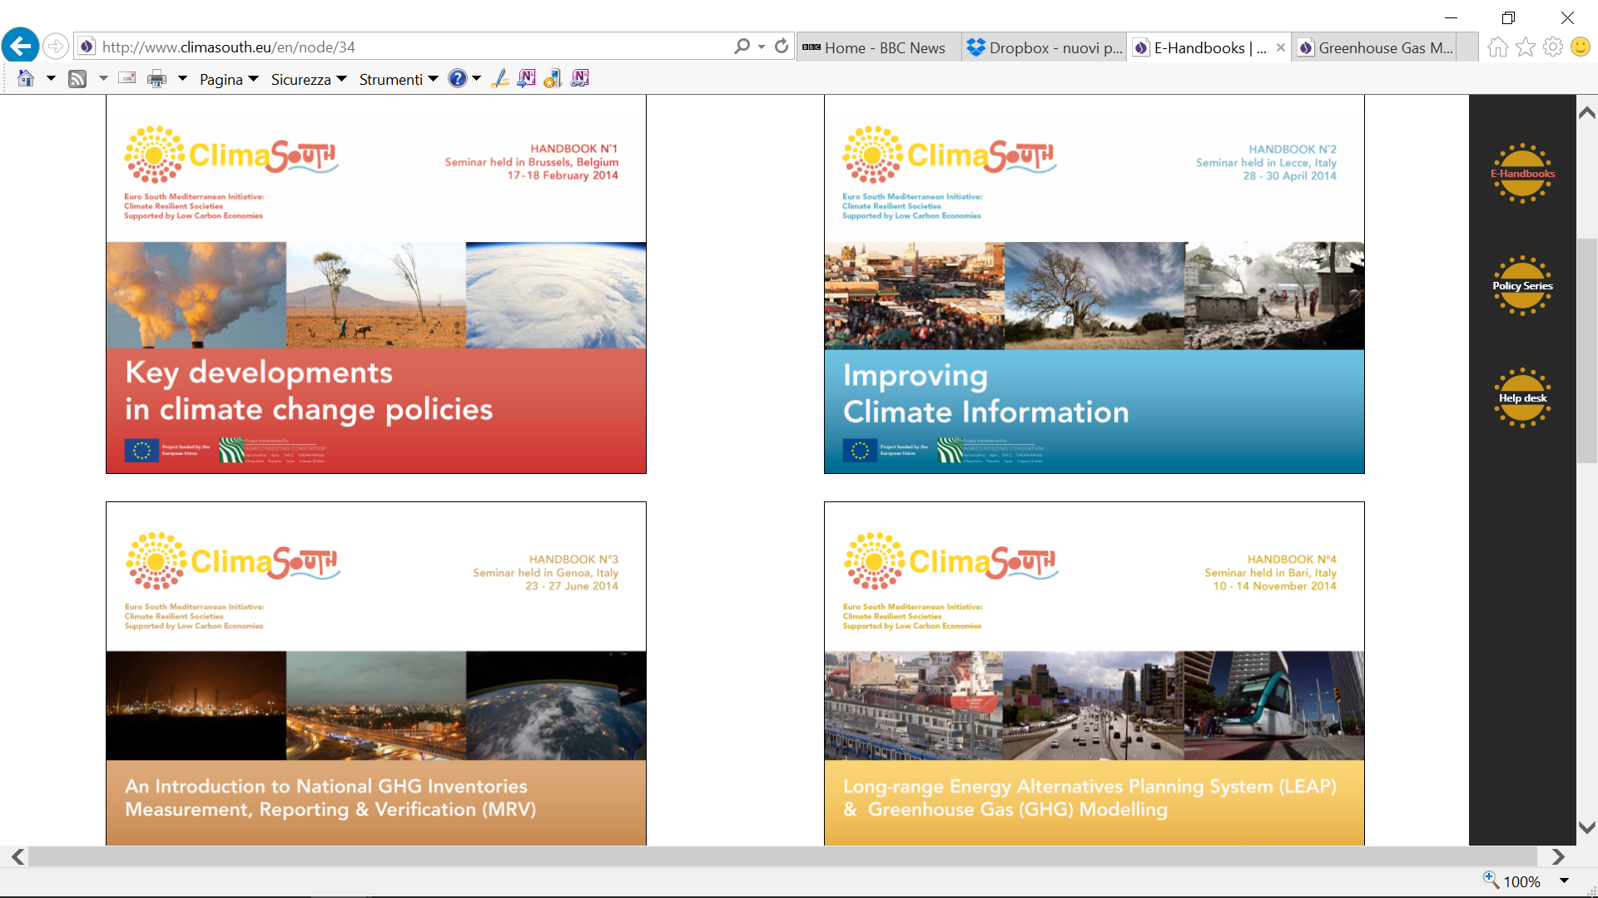
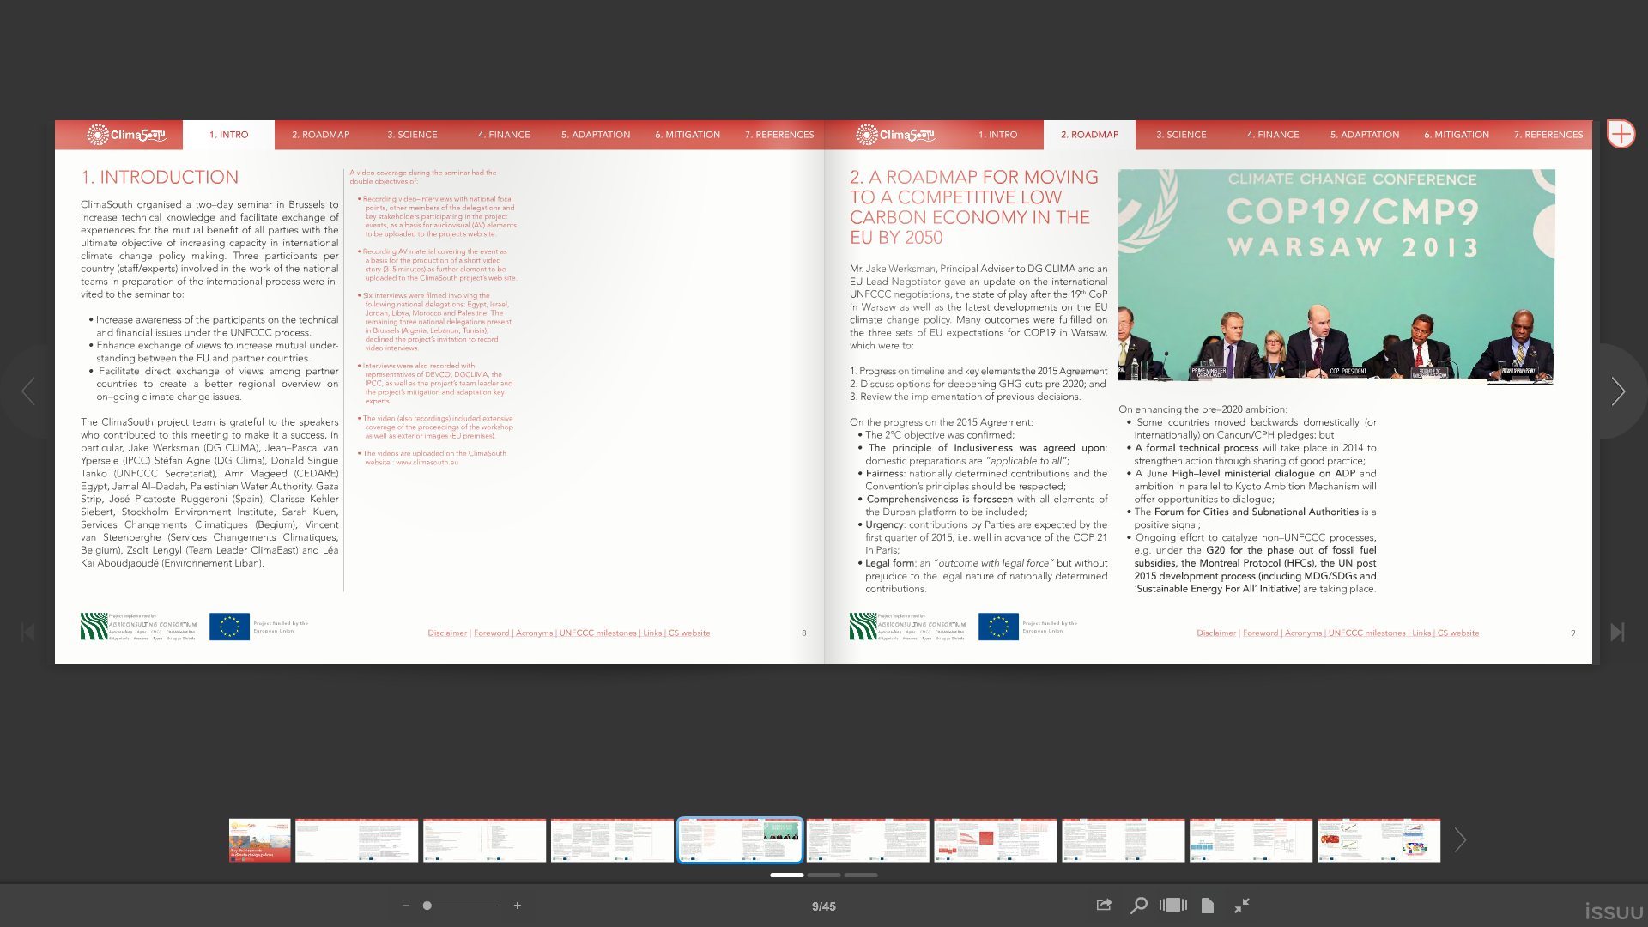
Road to Paris…
Regional & national activities, contributing to efforts by partner countries toward a global climate deal at the COP21 in Paris :
Strengthening general negotiations capacities
Institutional mitigation capacities
Capacity to use climate finance
Promoting dialogue & regional cooperation

Slide 6
…while reducing vulnerability
Strategic planning for climate change adaptation through enhanced use of climate science and climate modelling
Methods and Tools for Vulnerability Assessment
Case study 1: Palestine
Downscaling and Climate Modelling
Creation of forest fire risk indicators

Slide 7
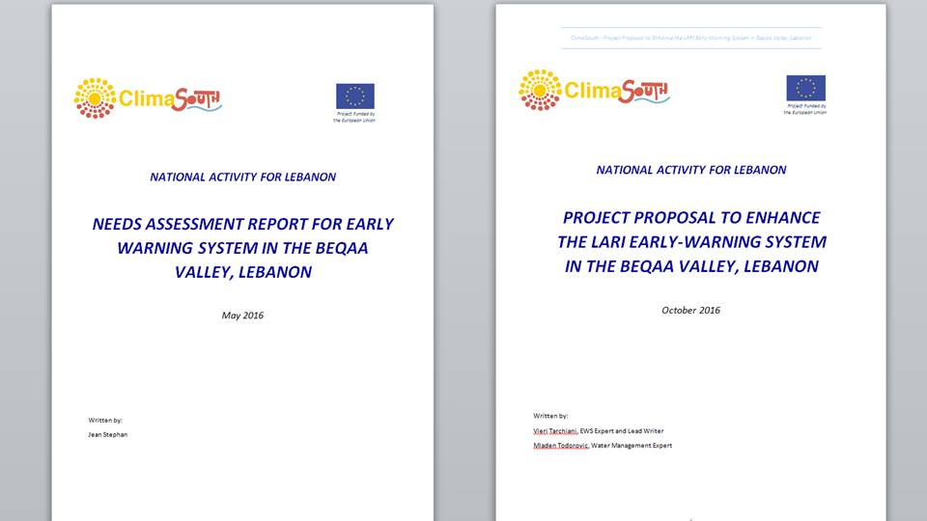
The way forward
Build on lessons learned over 3 years of project cycle, to assist in operationalization of Paris Agreement and NDCs enactment :
Access to climate finance
Support to the establishment of MRV systems
Mainstreaming of CC with State and non-State actors, including private sector
Enhance climate change adaptation
work in progress……

Slide 8
Thank you

