Slide 1
6th STEERING COMMITTEE
Amman, Jordan
29th March 2017
INFORMATION & COMMUNICATION

Slide 2
TOPICS COVERED
1. WEBSITE & KNOWLEDGE PLATFORM
2. INFORMATION & COMUNICATION TOOLS
3. CAPITALISATION PHASE

Slide 3
WEBSITE &
KNOWLEDGE PLATFORM

Slide 4
WEBSITE & KNOWLEDGE PLATFORM
KEY DEVELOPMENTS
ClimaSouth web site / knowledge platform (KP), upgraded in early 2017, following critical review of its functionalities, as presented at 5th SC.
An analysis of the metrics for the CS website at the end of 2016, highlighted the overall positive trend recorded in its performance.

Slide 5
Audience overview: comparative data for CS website, 2015 – 2016

Slide 6
WEBSITE & KNOWLEDGE PLATFORM
KEY DEVELOPMENTS
ClimaSouth web site / knowledge platform (KP), upgraded in early 2017, following critical review of its functionalities, as presented at 5th SC.
An analysis of the metrics for the CS website at the end of 2016, highlighted the overall positive trend recorded in its performance.
Scores significantly better than industry average, based on benchmarks extrapolated from CC sites available through Google’s analytics tool.

Slide 7
Benchmarking summary data for CS website, year 2016

Slide 8
WEBSITE & KNOWLEDGE PLATFORM
KEY DEVELOPMENTS
ClimaSouth web site / knowledge platform (KP), upgraded in early 2017, following critical review of its functionalities, as presented at 5th SC.
An analysis of the metrics for the CS website at the end of 2016, highlighted the overall positive trend recorded in its performance.
Scores significantly better than industry average, based on benchmarks extrapolated from CC sites available through Google’s analytics tool.
On the other hand, the analysis also emphasized the need to :
update and improve dynamic content of website,
enhance external referral to website by intensifying social media activities,
strengthen reach and impact among Arabophone segment of audience.

Slide 9
Map overlay of users of CS website by country in 2015 and 2016

Slide 10
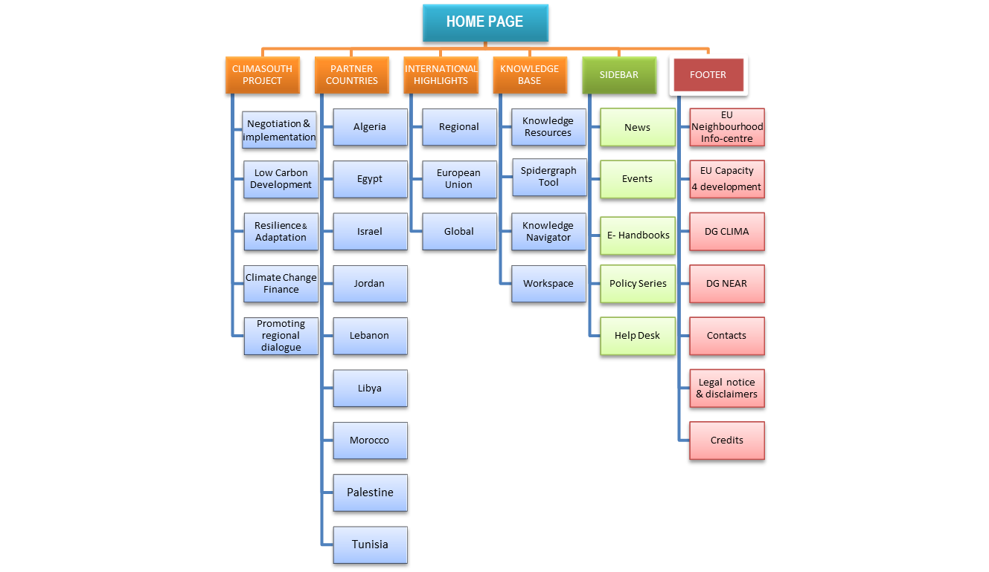
WEBSITE & KNOWLEDGE PLATFORM
KEY DEVELOPMENTS
Further upgrade in progress, to make the CS web platform more dynamic:
- optimising the management of content presently being generated;
- while minimizing the need to expand the technical and financial resources.
Final outcome : the CS web platform is a credible and recognized source of information on climate change in the South Mediterranean region.

Slide 11
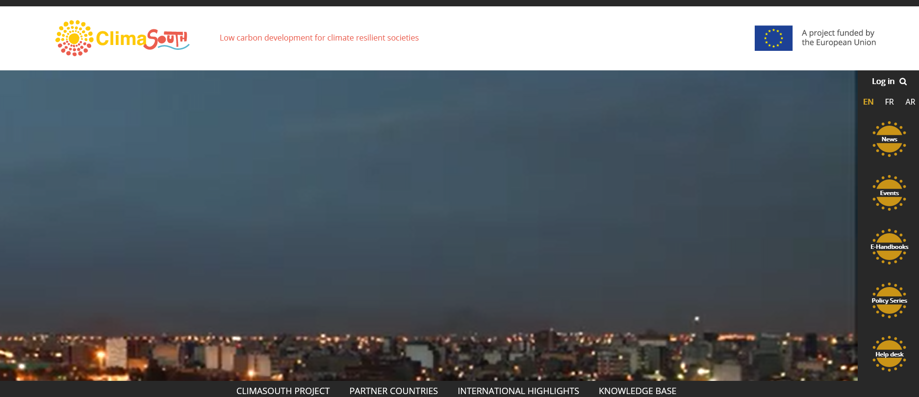
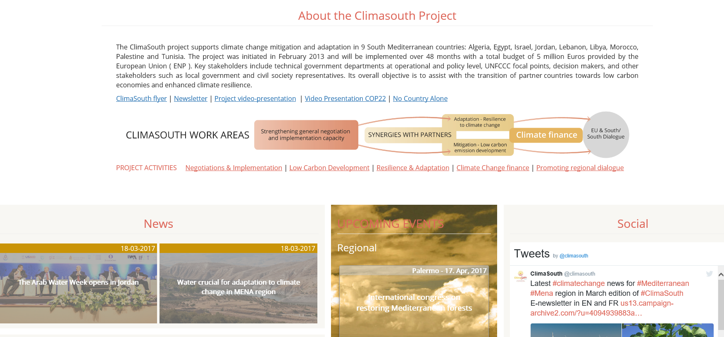
HOME PAGE
Interchanging video loops to complement/ replace existing HP video (in progress)
New dedicated window for upcoming CS & relevant regional and international events

Slide 12
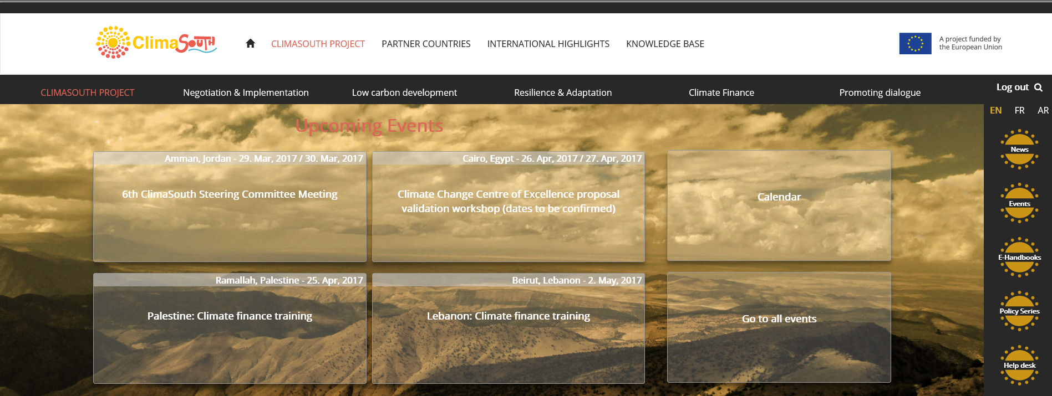
CLIMASOUTH PROJECT - landing page
Up to four upcoming CS events now displayed
When event date coincides w/system date, automatically replaced by next in line
Buttons linked to a calendar of CS events and general page with all CS events

Slide 13
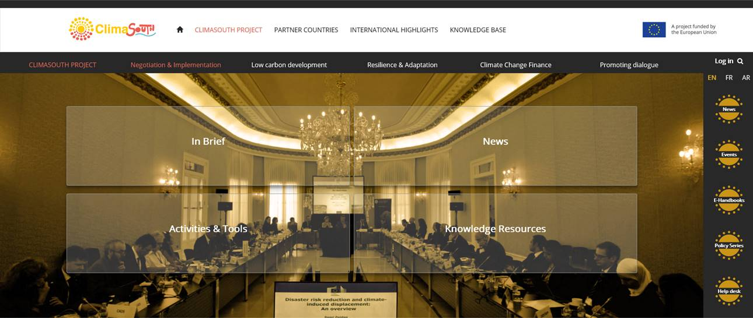
CLIMASOUTH PROJECT - component pages
In Brief: introductory textual content outlining the project component.
News: thematically tagged items for component & dynamically updated
Activities & Tools : drawn from CS event items
Knowledge Resources: tagged items from knowledge base.

Slide 14
PARTNER COUNTRIES - landing page for each country
Overview & key data: introductory textual content outlining project component
CS focal point : contact details + video interview if available
News: country-specific items, dynamically updated from general pool

Slide 15
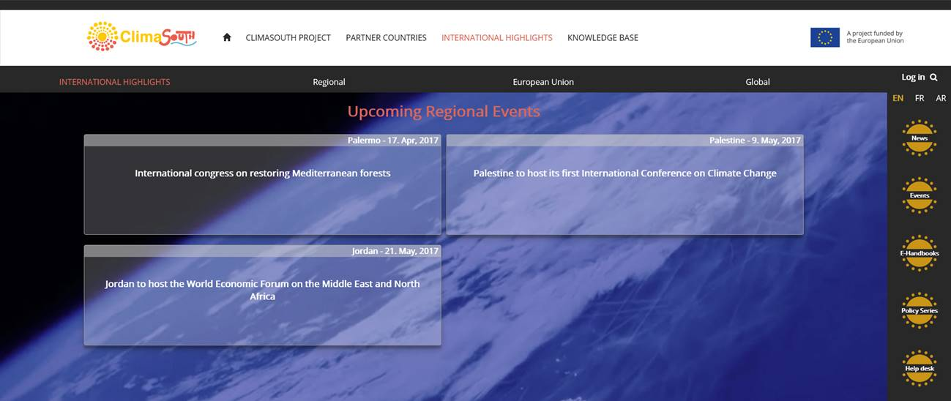
INTERNATIONAL HIGHLIGHTS – landing page
Upcoming events: Up to four upcoming international/ regional events displayed
When event date coincides w/system date, automatically replaced by next in line

Slide 16
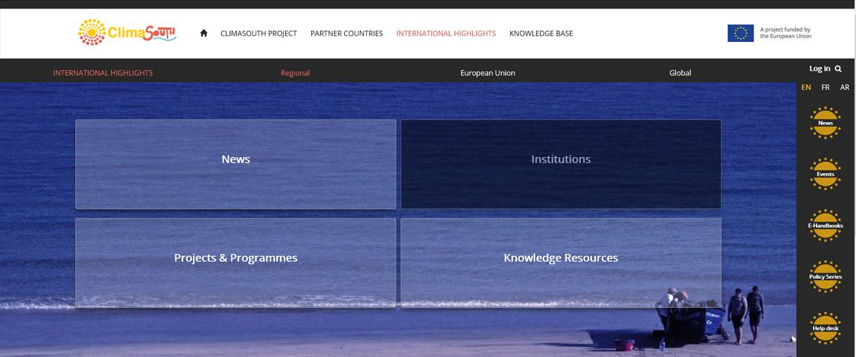
INTERNATIONAL HIGHLIGHTS – regional page in progress
News: thematically tagged & dynamically updated items for region
Institutions: annotated lists & links to relevant regional
Projects & programmes : annotated lists & links
Knowledge Resources: tagged items from knowledge base.

Slide 17
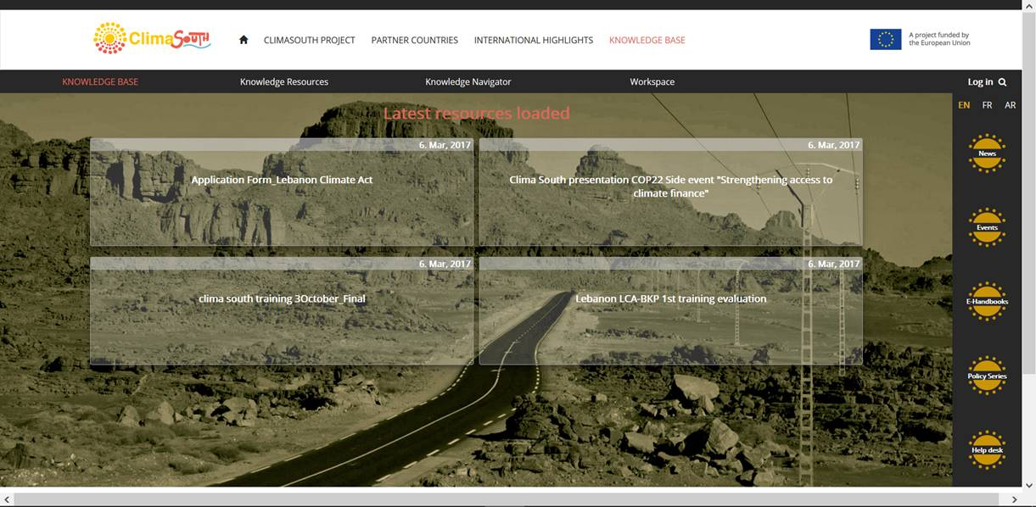
KNOWLEDGE BASE
Now displays the 4 latest resources which have been uploaded on KB.
Dates automatically assigned when items are loaded on the system

Slide 18
WEBSITE & KNOWLEDGE PLATFORM
ACTION POINTS
A1. Finalise and transpose all changes to the French and Arabic editions.
A2. Intensify CS social media activity, by :
- pursuing regular targeted postings on the CS Twitter channel and
- open a CS Facebook page, upgrade of existing page on video documentary
A3. Creation and management of Twitter and Facebook social media channels in Arabic.
A.4. Enhance the participation of CS team members, NFPs and other project partners in sharing relevant information and generating content for the web platform.
A.5. Table preliminary discussions with potential stakeholders for long-term hosting of the CS platform at the end of the project cycle.

Slide 19
INFORMATION & COMUNICATION TOOLS

Slide 20
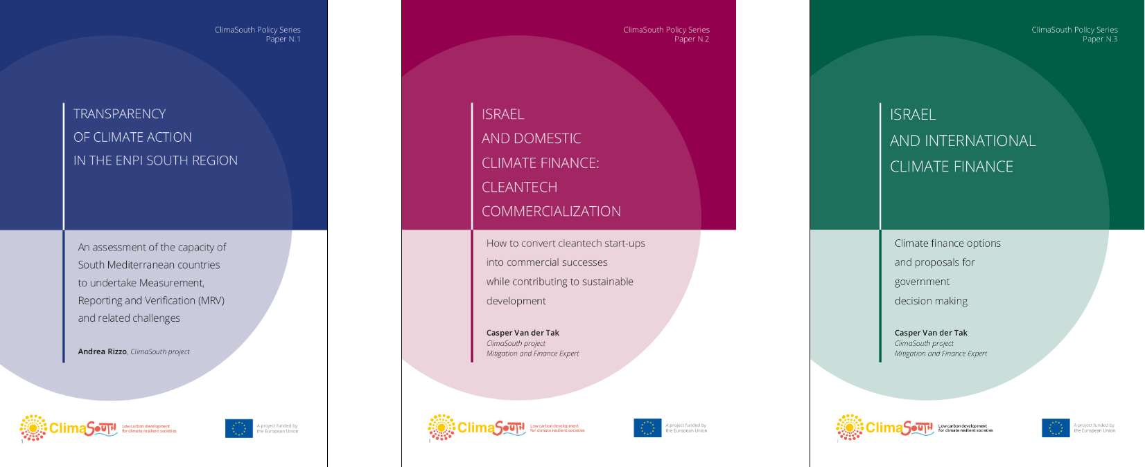
INFORMATION & COMUNICATION TOOLS
KEY DEVELOPMENTS
Production/ update of the following :
E-Newsletter. Monthly compilation, aggregating news on climate change and climate action from the region.
E-handbooks. A total of 8 E-handbooks available in English and French editions, the first 2 in Arabic.
Policy Series. A new series of publications to support national administrations in the development of climate change policy. First 3 papers published in English, one in French.

Slide 21
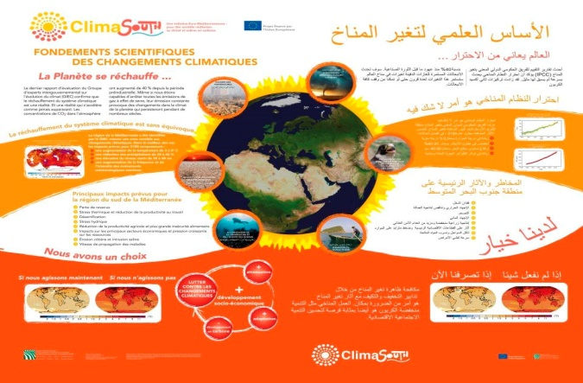
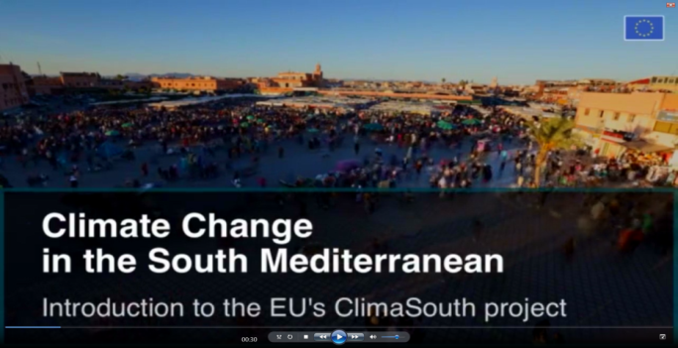
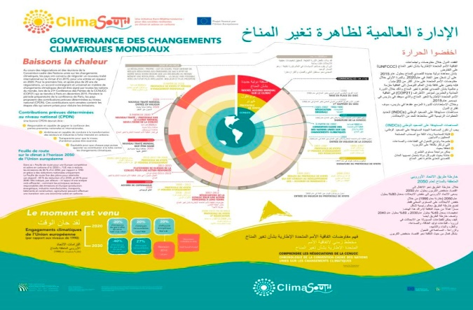
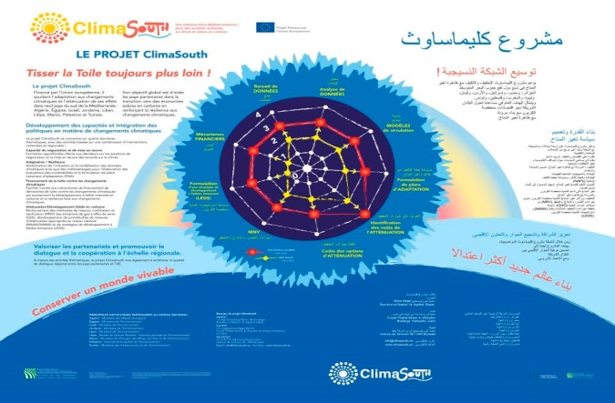
INFORMATION & COMUNICATION TOOLS
Flyer. Multi-purpose ClimaSouth flyer, in 3 language editions.
COP22 side events. Video presentation, PowerPoints, brochures and other promotional material.
Video-PowerPoint. Update of tool based on outcome of Paris agreement. Available in 3 language versions.
Info-panels. Updated ,based on outcome of Paris agreement. Set of 3 large-scale, roll-up, self-supporting info panels, produced and customised according to national requirements.

Slide 22
INFORMATION & COMUNICATION TOOLS
Video documentary.
Language editions. French and Arabic editions finalised.
Trailers. Short trailers produced for web based applications and social media.
Distribution. Plan developed and implemented, based on available financial resources :
- Web distribution: social media, mainly Facebook, Twitter, Utube
- Climate change events: e.g. MEDCOP, other international conferences
- Duplication and distribution in the form of interactive DVDs.
- TV broadcast : excerpts on Lebanese TV.

Slide 23
CAPITALISATION PHASE

Slide 24
CAPITALISATION PHASE
OUTLINE PROCESS
Objective. Design and produce a series of tools to capitalise project results, for wide dissemination in partner countries and online.
Approach. Highlight the collective achievement of EU-supported climate action by collaborating with other national & regional EU-funded projects (CES-MED, SUDEP, etc.).
Outcome. Climate action promoted in partner countries, highlighting current priorities (e.g. NDC process, NAP, NDC/SDG nexus.. ), and illustrating the role of the European Union and of EU-supported projects and activities.
Key steps.
(i) assessment of needs,
(ii) identification of potential tools,
(iii) feasibility and budget requirements,
(iv) setting-up of partnerships,
(v) collaborative production of identified tools,
(vi) distribution & promotion.

Slide 25
CAPITALISATION PHASE
POTENTIAL IC TOOLS
E-learning platform [for selected priority subjects e.g. climate finance, LEAP, MRV] :
video recordings of specialised lectures;
online tutorials /webinars;
other dedicated resources
Publications :
policy papers & e-handbooks;
technical reports;
edited volume on climate action & project results.
Audio visual productions:
brief video reportages on climate action in selected partner countries;
content for the project’s website and social media channels;
- documentary on project outcomes, towards the end of the project’s cycle.
Mainstreaming & promotional events [e.g. COP23 side events, national CC events, etc.]

Slide 26
Thank you

