Slide 1
CLIMATE RESILIENCE AGRICULTURE, ENHANCING LARI EARLY WARNING SYSTEM
Ihab JOMAA
Head Irrigation and AgroMeteorology Dep.
LARI
BEIRUT, 6TH FEBRUARY 2017,
EUROPEAN UNION DELEGATION
Beirut, Lbanon
LAUNCH OF PROJECT PROPOSAL
Project funded by the European Union

Slide 2
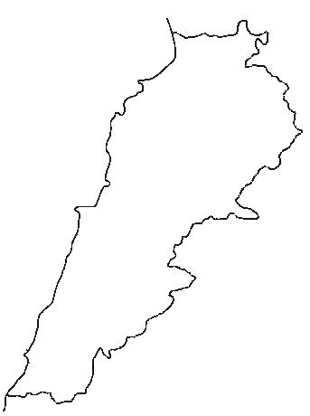
سوريا
LARI Locations
سوريا
العبده
كفرشخنا
هرمل
كسروان
كفردان
المرفأ
Lebanese Agricultural Research Institute
LARI
بيروت
الفنار
تل العمارة
تربل
سوريا
المطار
بعقلين
لبعا
حاصبيا
New locations
صور

Slide 3
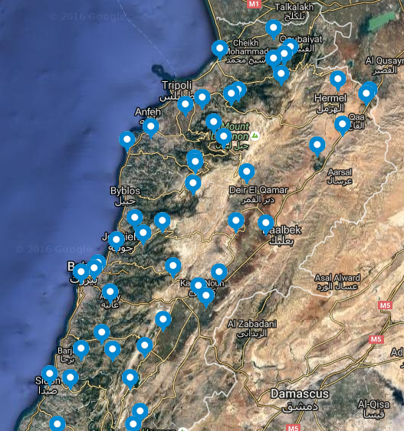
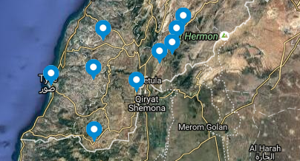
Irrigation and AgroMeteorology Department
LARI
Climatic parameters
Max/Min Temp
Relative Humidity
Total Radiation
At. Pressure
Wind sp/direction
Rainfall

Slide 4
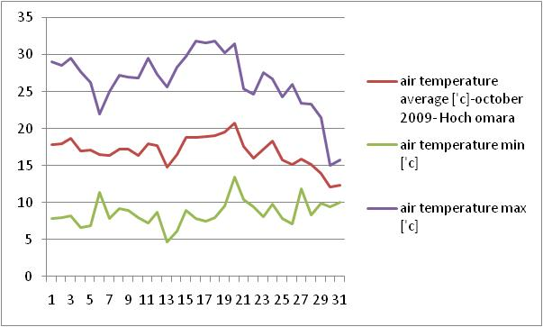
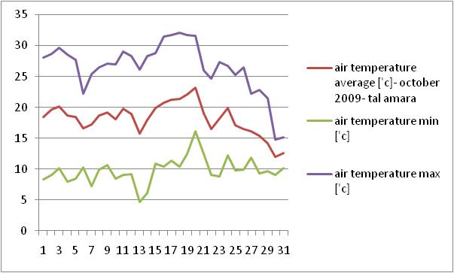
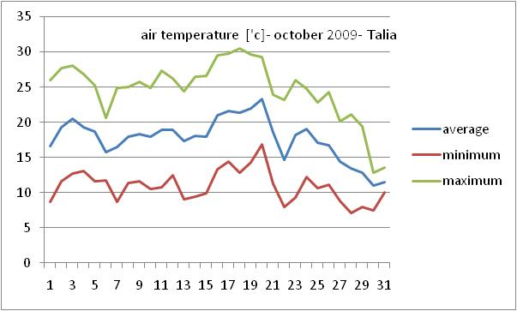
Climatic Data Accuracy
Monitoring Climatic Data
Using graphs for manual monitoring
Locating errors and sensors mis-registration/disfuction
Comparing Min/Max temperatures

Slide 5
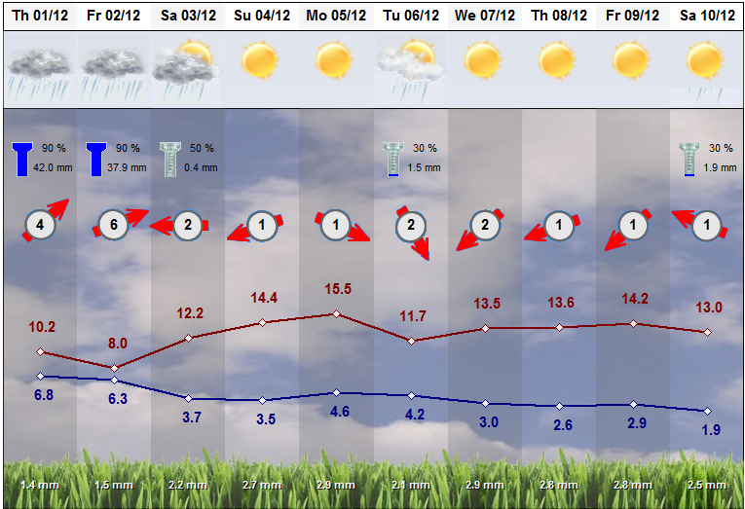

Slide 6
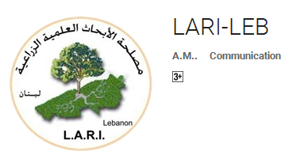
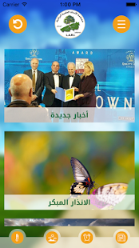
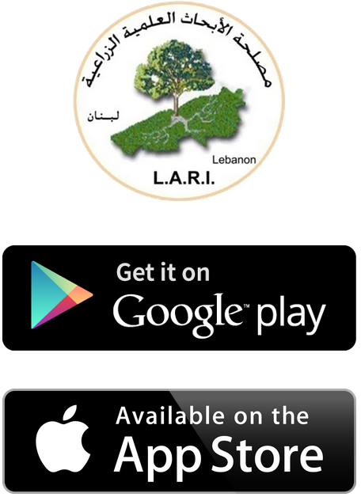
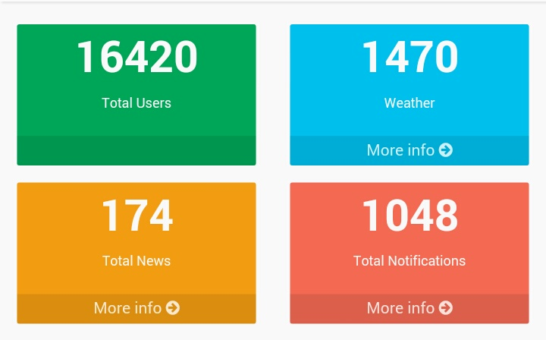
Smart Phone Application
Smart Phone Application
أندرويد
أبيل
LARI has launched
LARI-LEB
In Early March 2015
Replacing the SMS service

Slide 7
Irrigation Water Management
Region Site
Sprinkler
A Chmestar
C Kfardan
Region Site
Mini-sprinkler
B Chmestar
D Hawch Barada
H Kfardan
F Sarhin
G Kfardan
E Sarhin

Slide 8
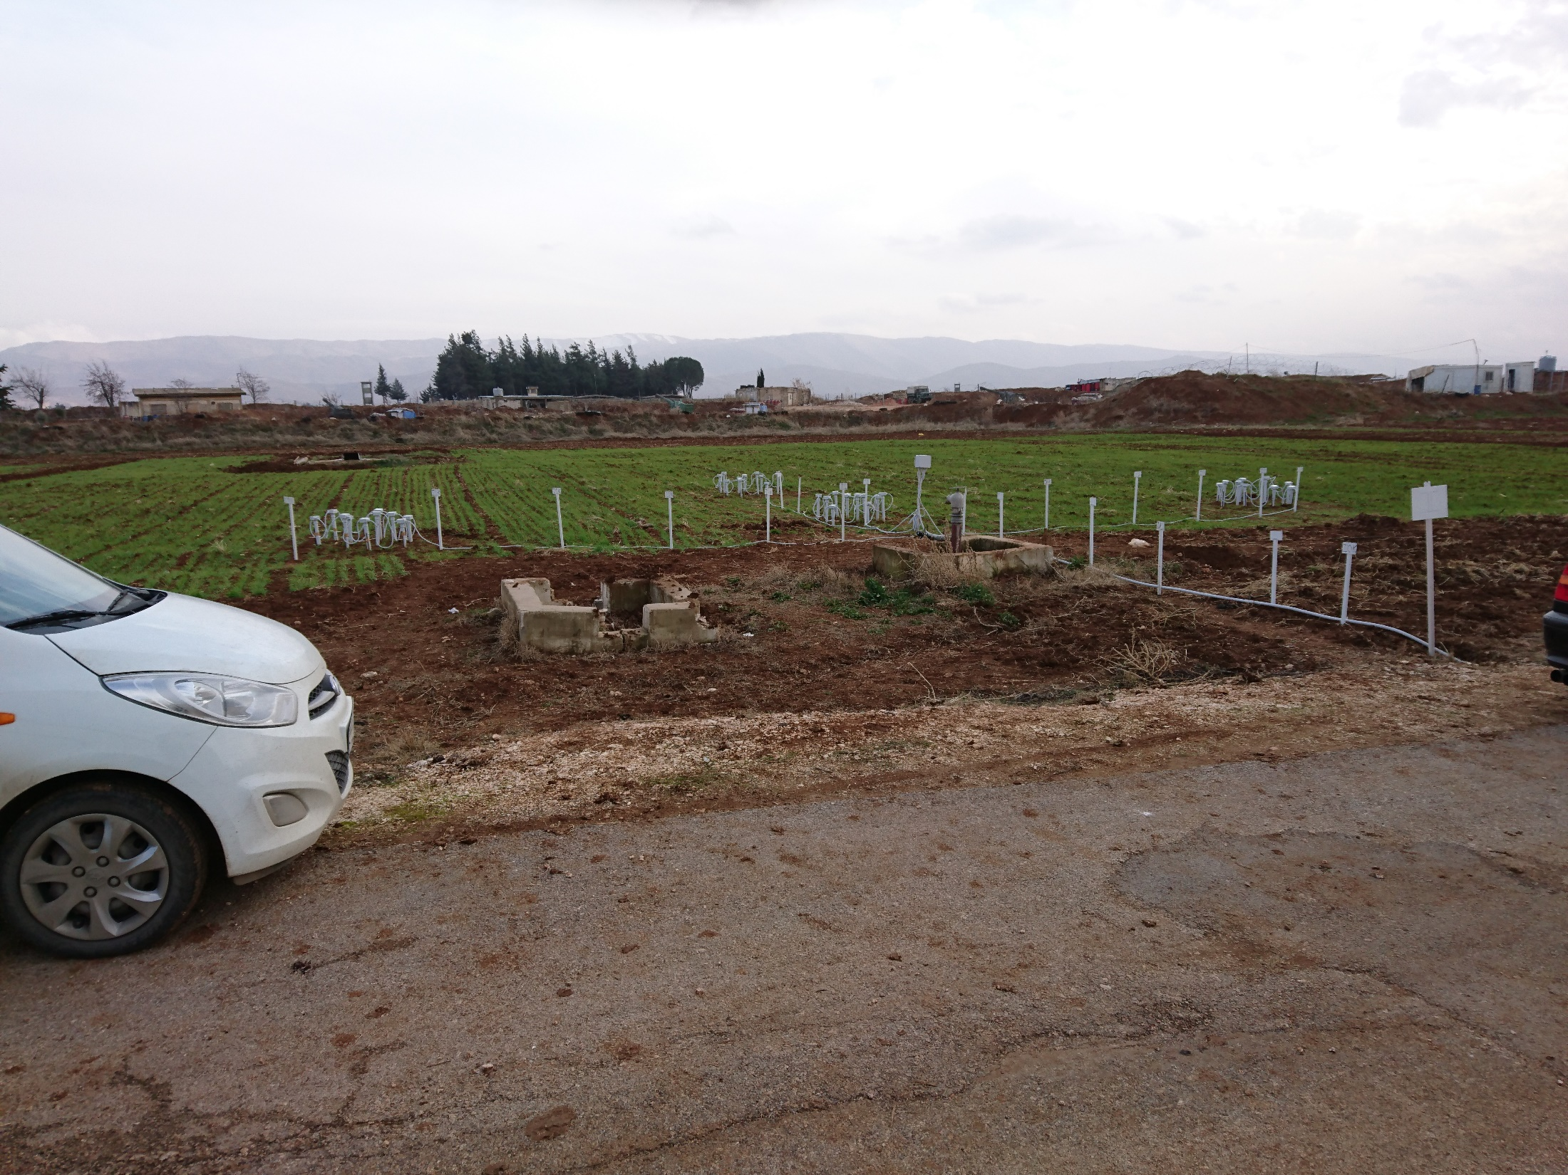
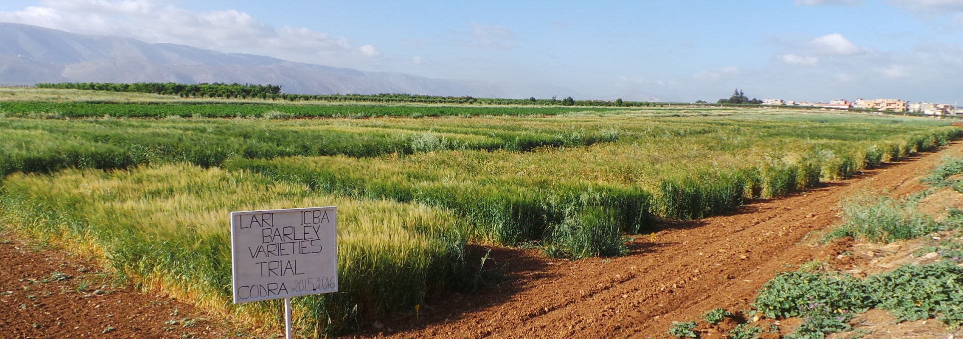
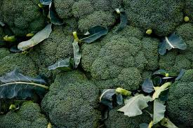
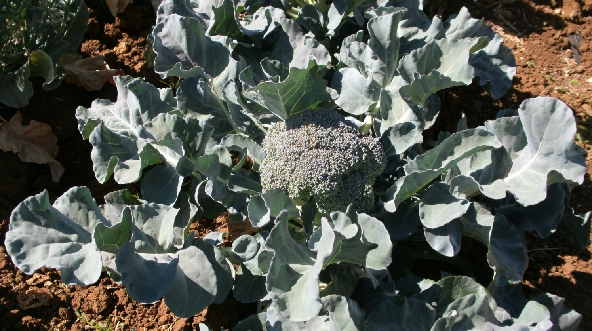
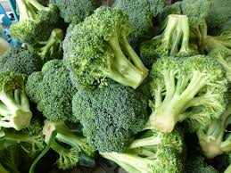

Slide 9
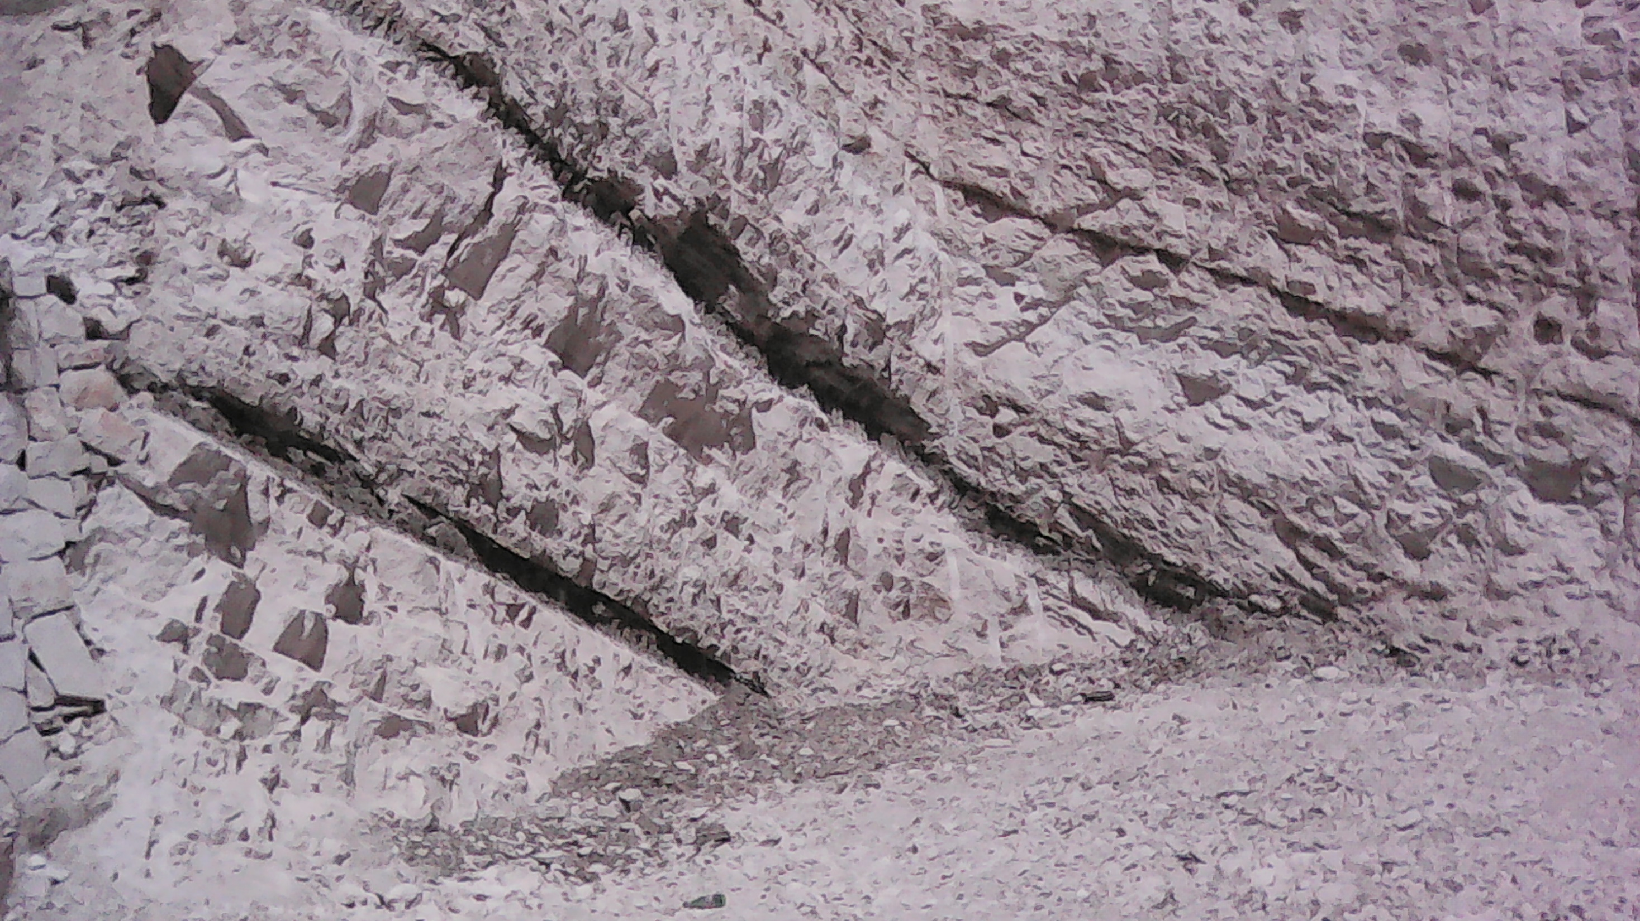
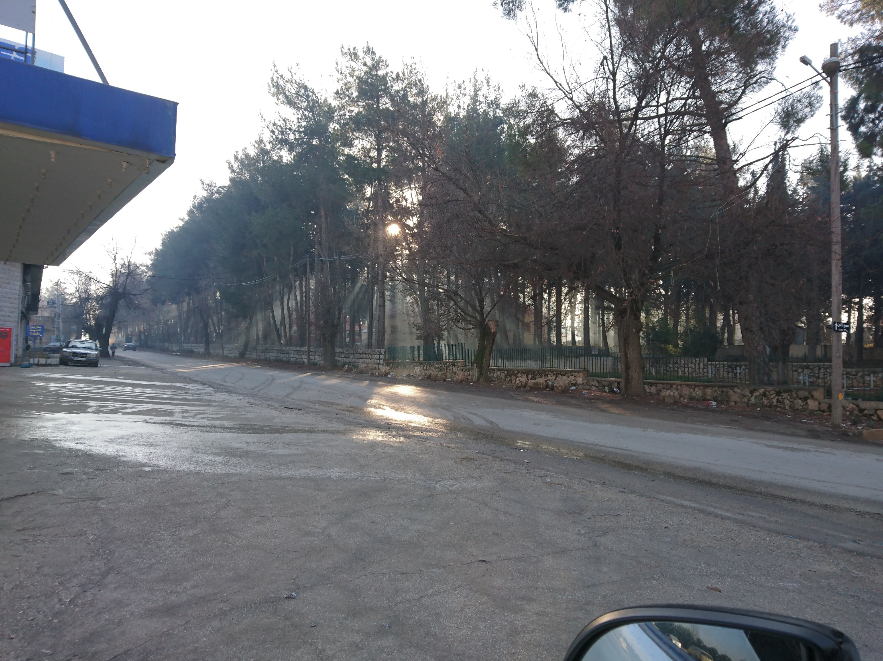
شكـــرا
Thank you

