Slide 1







Slide 2

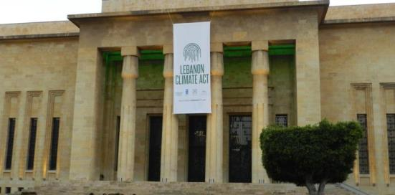
The only platform existing in Lebanon and in the Arab World where businesses are being supported in becoming engaged in the fight for climate change
And hence, support the government of Lebanon to achieve its emission reduction target of 15% that has been committed in 2015 at the COP21 in Paris.

Slide 3
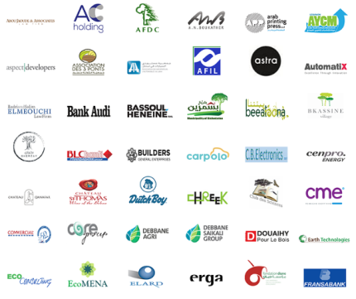
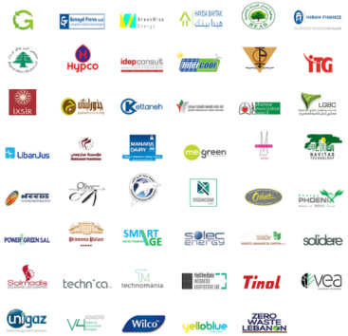




Until this date, about 100 organizations have registered in LCA, 120 of them are private sector companies.

Slide 4
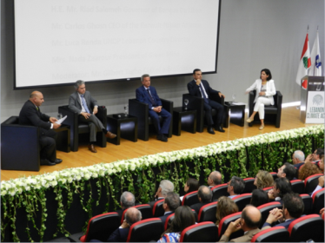
Collaboration between Sectors
It’s true that the concept of collaboration between the government, civic and the business sectors on climate actions was newly introduced to Lebanon,
but is fortunately picking up very well, but around this world this is happening big time.

Slide 5
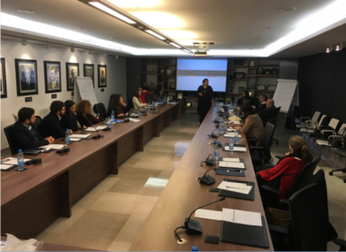
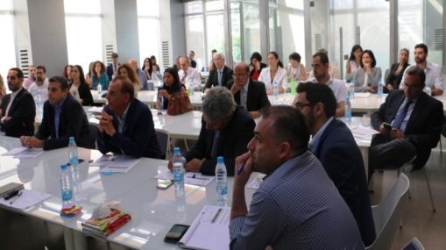
Business Knowledge Platform
A series of training sessions, funded by the EU Climasouth Project, and led by our professional international experts, provided a space for businesses to showcase and support climate action through concrete initiatives and multi-stakeholder approaches.

Slide 6
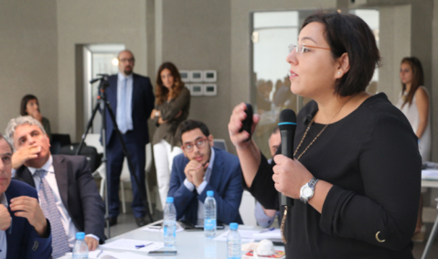
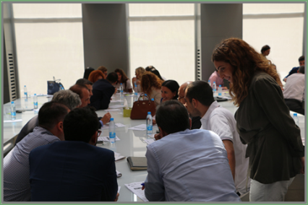
Business Knowledge Platform
The BKP aims at enabling businesses to design and implement activities to reduce the impacts of climate change and capturing success stories to inspire others.

Slide 7
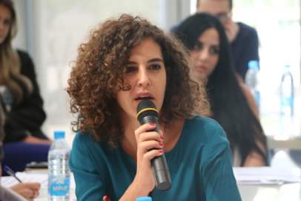
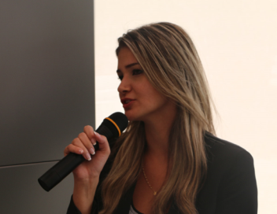
Business Knowledge Platform
It provides the essentials for developing a credible strategy and developing leadership in the field of climate change. Successful companies are eventually awarded as our “Climate Change Champions”.

Slide 8
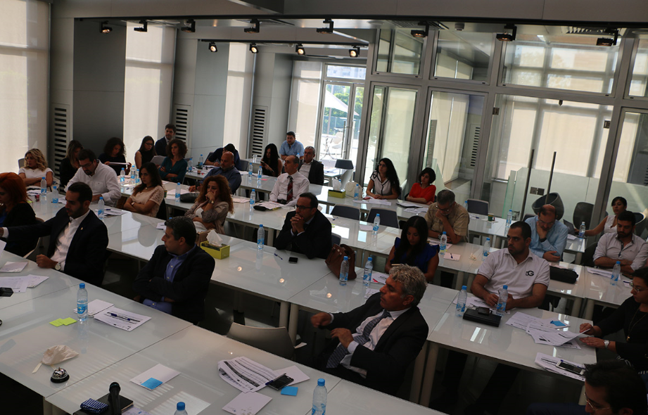

Slide 9
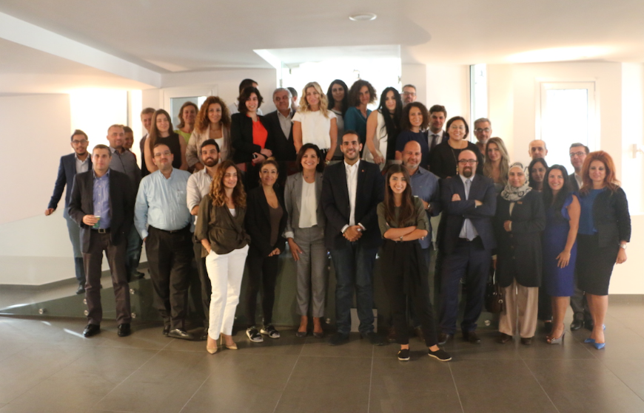

Slide 10



Guidebook
Under the EU Climasouth project, A guidebook was equally created to help businesses generate value from climate change by developing and implementing an action plan
to mitigate climate change in and outside the company.
This guidebook helps to take advantage of emerging opportunities arising from climate change mitigation policies.

Slide 11
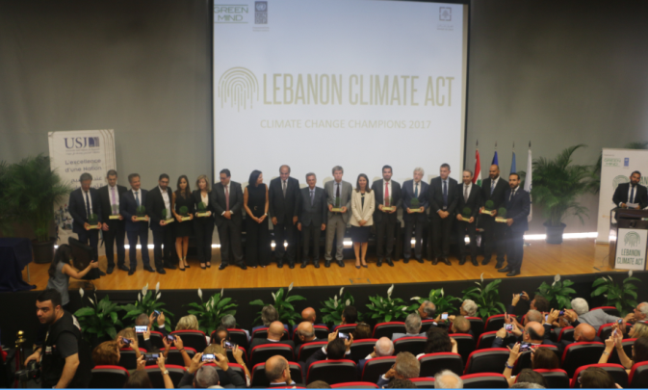
Climate Champions
Our Climate Champions are companies from different business sectors (industrial, commercial, tourism, real estate, banking etc.)

Slide 12
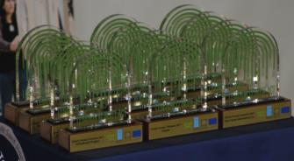
Climate Champions
who have shown a true commitment to the Lebanon Climate Act, efficiently participated the Business Knowledge Platform, and succeeded in developing their own credible climate actions strategies, and started its implementation.
These Climate Champions have set an example to follow in the country, and their successful experience is now the main driver for other companies to join the mission.

Slide 13

Climate Champions
One of the Champions is here with us today:

Slide 14

Climate Actions directly linked to many SDGs

Slide 15



Thank you
Nada Zaarour, President
Green Mind NGO
Lebanon
www.LebanonClimateAct.com

