Slide 1
Partnerships for Climate Change
February 1st, 2017
in cooperation with

Slide 2
Introductions
Name
Organisation
Background
czc

Slide 3
Objectives
Help NGOs develop projects that meet corporate requirements
Support NGOs create effective proposals
Guide NGOs to communicate more effectively

Slide 4
Modules
Overview on climate change
Module 1: Be in their shoes: evaluating project proposals
Module 2: Project Dynamics: Business & NGO expectations
Module 3: Understanding stakeholder relationships
Module 4: Project management for impact maximisation
Module 5: Effective Communication

Slide 5
Introduction

Slide 6
Lebanon Climate Act– Definitions
Climate Change: significant and lasting change in the statistical distribution of weather patterns over periods ranging from decades to millions of years.
It may be a change in average weather conditions, or in the distribution of weather around the average conditions (i.e., more or fewer extreme weather events).
INDC: Intended Nationally Determined Contribution by 2030
Climate Mitigation: An anthropogenic intervention to reduce the sources or enhance the sinks of greenhouse gases
Adaptation: An action / actions taken to help communities and ecosystems cope with changing climate condition

Slide 7
Paris Agreement
Lebanon – Commitments
Lebanon is a party to the UNFCCC since 1994
Lebanon signed the PA in April 2016
All Parties must provide emission reduction and adaptation targets (INDC) to fight climate change
Notes:
UNFCCC: UNITED NATIONS FRAMEWORK CONVENTION ON CLIMATE CHANGE

Slide 8
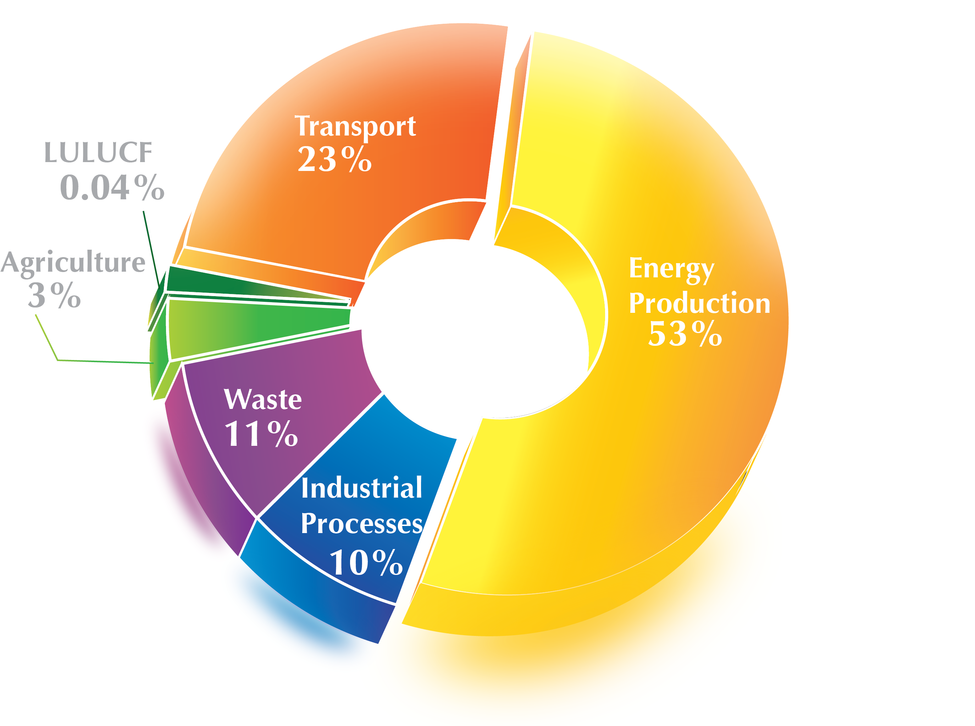
Lebanon – Background information
26 million tons of CO₂eq.
0.07% of global emissions

Slide 9
Main climate projections by 2090
Lebanon – Climate Change Impacts
3.5ºC 5ºC
Temperature increase
25%
45%
Rainfall decrease
50
Additional hot summer days (Tmax > 35ºC)
Second National communication, 2011
34
Additional tropical nights (Tmin > 25ºC)
18
Days increase on drought period

Slide 10
Lebanon – Climate Change Impacts
Exacerbation of existing challenges to water availability and quality
Reduction of 40% to 70% of the snow cover of Lebanon, and shift of elevation of snow (from 1,500 to 1,900 m)
Geographic dislocation of plantations (cherry, citrus, apple, etc.)
Sea flooding and inundation due to increase in the mean sea level, or in the frequency and intensity of episodic events
Financial losses in coastal and marine economic activities (tourism, agriculture, fisheries, transportation)
Sea flooding and inundation due to increase in the mean sea level, or in the frequency and intensity of episodic events

Slide 11
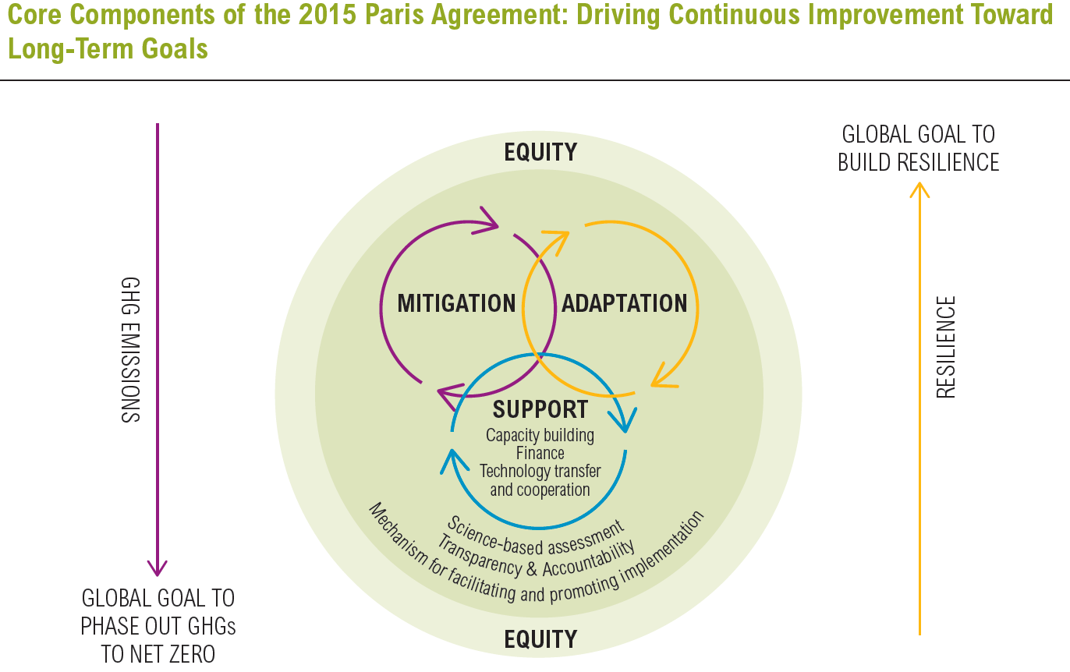
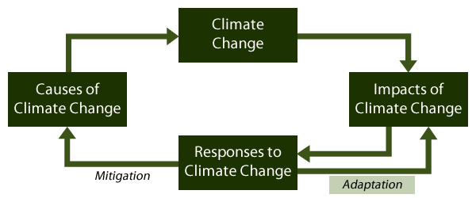
Lebanon – Intended Nationally Determined
Contribution
blueprint-effective-international-climate-agreement – WRI 2014.

Slide 12
Lebanon – Intended Nationally Determined
Contribution
2030
Cut CO_{2e} emissions
15%
Unconditional (UC) target
30%
$
Conditional (C) to finance, technical support and capacity building

Slide 13
Lebanon – Mitigations
Energy:
Energy Efficiency (EE) and Renewable Energy (RE)
Transport:
Public transport (PT)and fuel-efficient (FE) cars
 | EE | RE
Unconditional | 3% | 15%
Conditional | 10% | 20%
 | PT | FE
Unconditional | 36% | %
Conditional | 48% | 20%

Slide 14
Lebanon – Mitigations
Forestry:
Waste:
Waste management throw Energy Recovery (WtE) Treated & Reused (T&R)
 | Million Trees
Unconditional | 20
Conditional | 26
 | WtE | T&R
Unconditional | 25% | 51%
Conditional | 30% | 70%

Slide 15
Lebanon – Adaptation
Overarching objective: Adaptation in the INDC is tackled through mitigation actions with adaptation co-benefits
Highlights most vulnerable sectors as:
Water
Agriculture
Health
Forestry
Biodiversity

Slide 16
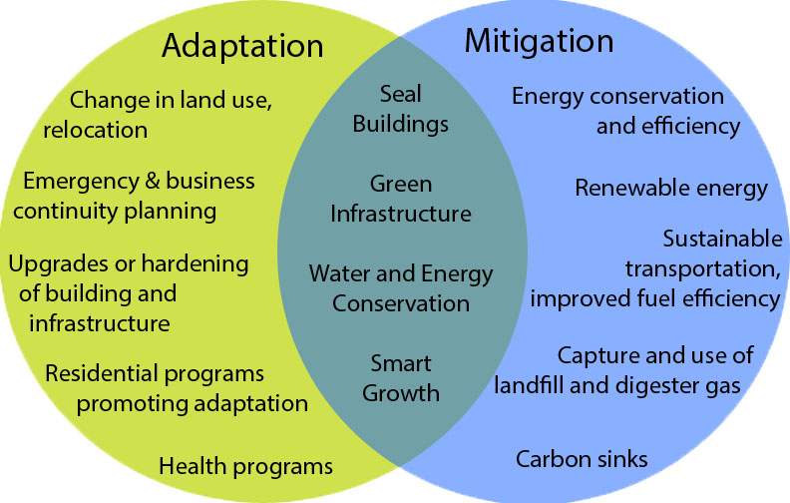
Examples on Adaptation & Mitigation

Slide 17
Module 1
Be in their shoes: proposals evaluations

Slide 18
Case Study
NGO - ABC Sustainability & ABC village:
Established in 2010, ABC Sustainability focuses its work in ABC village
Part-time/project based paid members: 4
Active members: 10
Non-active members: 35
ABC village is 90 Km far from Beirut
ABC has 1,400 inhabitant (58% of them remain in winter)

Slide 19
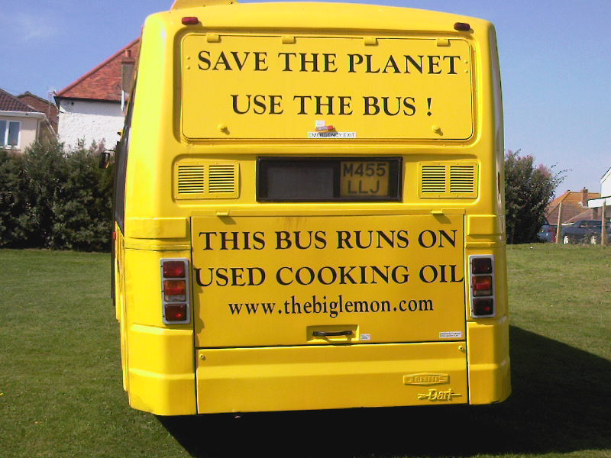
Case Study
Bus Running on Used Cooking Oil with a Green Roof

Slide 20
Case Study
Connectivity with Beirut; Consume cooking oil; Reduce the transport fees for oil providers; Reduce the environmental impact of travellers; Create more job opportunities; Engage students in solving the transportation problem; Increase inhabitant during winter; Capture the interest of people driving near the bus; Create awareness on the need of public transportation; Create 6 jobs |  | The project has been done and uprunning in other parts of the world Fund to buy ONLY one bus

Slide 21
Case Study
Social
Environmental
Educational
Create new jobs
Engage the students
Increase winter inhabitants
Self-sufficient in few months
Increase the visibility of the village
Wellbeing of population
New technology for students
Engage students in the job market
Engage students in sustainability projects
Create environmental awareness
Reduce the CO2e
Reduce the dependency on cars
Solve the cooking oil waste problem

Slide 22
Case Study
Category | Items | Unit Price | Total Price ($)
Salaries | Part time project manager | 1,000 | 6,000.0
 | Students’ coordinator | 1,000 | 4,000.0
 | Transportation for three students | 500 | 3,000.0
 | Two full-time bus drivers | 1,000 | 16,000.0
 | Certified Accountant | 750 | 750.0
Equipment | Diesel bus | 22,000 | 22,000.0
 | Replacement parts and maintenance | 7,000 | 7,000.0
 | Permit | 400 | 400.0
Consumables | Bus tickets | 800 | 800.0
 | Print out materials | 0.33 | 500.0
 | Cooking Oil transporters | 5 | 50.0
 | Oil reservoir
 | Recycled wooden plates | 100 | 100.0
 | Soil and plants | 100 | 100.0
 |  |  | $ 60,700.0

Slide 23
Case Study
 | M1 | M2 | M3 | M4 | M5 | M6 | M7 | M8 | M9 | M10 | M11 | M12
Preparation with partners
Preparing/ building the bus
Running the bus service
Project review & evaluation

Slide 24
Case Study
Interested parties (not exhaustive list) | Contribution
Country diesel bus providers | buy a suitable diesel bus
The local engineering faculty and technical school professors | create a team of teachers / students responsible of the modifications.
After sale department of the bus provider | help in the implementation of the modifications. and provide the parts for the students.
Local municipality | get the permit for the bus
Local communities and individuals | use the bus
Local restaurants and local households | provide used cooking oil for the bus
Local publishing houses / libraries | provide small explanatory booklets on the bus
ABC | Good coordination and management

Slide 25
SWOT Analysis
Strengths
Weaknesses
Opportunities
Threats
Internal Environment
External
Environment

Slide 26
Activity
Role playing
Split into 2 groups.
Group 1: takes up the role of NGO
Group 2: takes up the role of company

Slide 27
Errors to Avoid & Tips
Be clear & specific in defining the NGO/Municipality
Have a website, Facebook or any social media account where they can see more on your activities
Link the proposal to climate change (in this case)
Focus on self-sufficient projects
Be clear in describing the project and methodology
Highlight sustainability of the project

Slide 28
Errors to Avoid & Tips
Be clear and correct in your calculation, double check
Support your proposal with real and valid numbers
Show that you are transparent in using their money
Make sure that you included every component you need your partner to support (no hidden costs)
Include salaries if you need to, but be realistic

Slide 29
Errors to Avoid & Tips
Never to do:
Highlight that they can they use you for publicity (unless if you are a PR firm);
Use their money to facilitate the sales of other products or businesses;
Say “I have good reputation”, if so, they will call you for projects;
Always do:
Understand their business requirements
Do research on their strategy: penetrating
new markets, new regions
Highlight that the project will be self
sufficient, companies look for innovation,
not repeating the same project…

Slide 30
Errors to Avoid & Tips
Don’t use broad terms: Marketing, awareness raising
Give good indicators: tons of waste to be treated
Submit a complete applications (CVs)
Be innovative but realistic (Bikes for free?)
Write a good proposal
Know to whom you are presenting the proposal

Slide 31
Errors to Avoid & Tips
Link to Climate change
MITIGATION
CO₂ reduction
Energy saved in kWh
Waste composted in tonnes
Forest planted in hectares
ADAPTATION
Increase resilience
Saved water or increased availability in liters
Forests planted in hectares
Preserved biodiversity
Improved emergency health care
Diversified tourism
Notes:
Cement factories
Profile: municipalities, benefeciaries
Recycling paper not a project- composting is a CC solution, sorting at source too

Slide 32
Module 2
Business & NGO expectations

Slide 33
Discussion in Groups
Split into 2 groups. Discuss within your group
Group 1:
What do NGOs expect/require from companies?
Group 2:
What do companies expect/require from NGOs?

Slide 34
Discussion in Groups
How is this knowledge going to positively change the way you approach a potential partner?

Slide 35
Module 3
Understanding Stakeholder Relationships

Slide 36
Key Questions
What do we mean by stakeholders?
Why are they so important
What do we mean by stakeholder engagement?
Why is stakeholder engagement so important?

Slide 37
Sustainability Related Topics
Shareholders and Investors ask about
Notes:
State of profession

Slide 38
Stakeholders
Individuals or groups who are affected directly or indirectly by the company activities or affect company activities & decisions.
c

Slide 39
Stakeholders
Company
Suppliers
General public
Clients
Local Community
Unions
Advertisers
Financial Analysts
Shareholders
MPs
NGOs
community
Government
Competitors
Users
c

Slide 40
Discussion in Groups
Split into 2 groups. As a group please define:
Group 1:
Define the stakeholders of NGOs
Group 2:
Define the stakeholders of private companies
c

Slide 41
Issues to consider
Time & Resources required
Manage expectations of stakeholders and company
Lack of transparency
Current corporate culture
Some stakeholders may be under/over estimated
Parties not seeing the importance of the engagement
Need for senior endorsement
Identifying the starting point
Fear of Change
Who is the driver –the company or the stakeholder?
c

Slide 42
Issues to consider
After this exercise, what are you going to change in the way to structure your proposals for partnerships?
c

Slide 43
Module 4
Project management expectations

Slide 44
Key question
What are the steps of a project?

Slide 45
Group Work-
Identify the steps of our Case Study
Resources/
Input
Activity
Output
Outcome
Impact

Slide 46
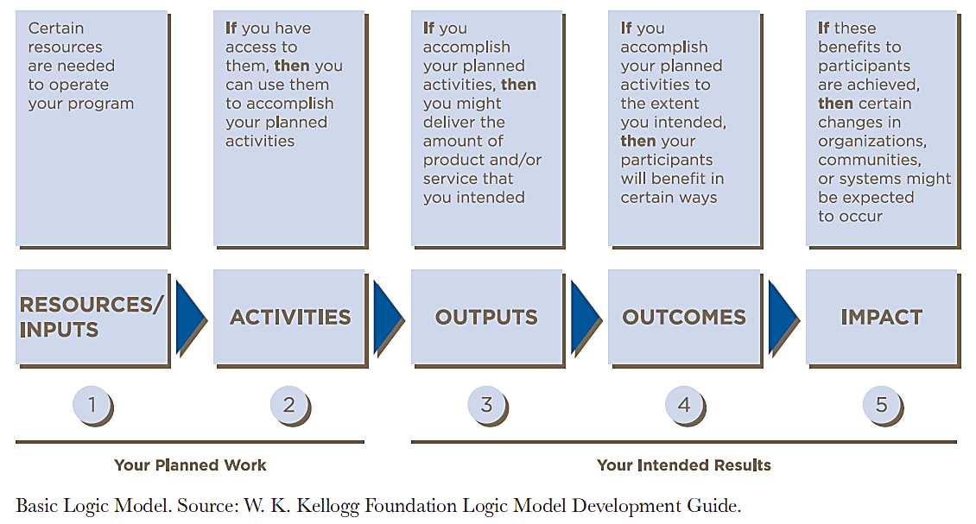
Measurement as a Process
Notes:
!encouraging corporate philanthropy
The most basic forms of performance metrics:
Activities: such as the number of staff trained or amount of goods purchased
Outputs: such as the number of clients served, products distributed, and areas reached
Impact:output and activity metrics alone cannot indicate that positive societal changes are being achieved or if unintended harm is being caused. Impact outlines clearly how success is defined and track whether and how the programs affect their beneficiaries
Encouraging corporate philanthropy pdf
However, output and activity metrics alone cannot indicate that positive
societal changes are being achieved or if unintended harm is being caused. In the
case of program initiatives such as signature projects, companies share a strong
connection with the cause and are concerned about the social outcomes of their
efforts. Managers of these programs and their nonprofit partners must articulate
the process by which changes and results are expected to occur. They should
outline clearly how success is defined and track whether and how the programs
are affecting their beneficiaries.
With respect to giving programs comprising primarily short-term, one-off grants driven by community obligations, simply identifying activities and measuring output may be all that is feasible.

Slide 47
Performance Measures
Good Performance Measures:
A way to see if our strategy is working
Focus on what matters most to success
Allow measurement of accomplishments, not just of tasks
Provide a common language for communication
Defined specific information (eg owner, unit of measure, collection frequency, data quality, expected value, targets)
Measure the right things
Are specific

Slide 48
Module 5
Effective Communication

Slide 49
The Key Skill: Communication!
Notes:
pwc-sustainability-executive-profile-and-progress.pdf

Slide 50
Communicate
Why
To whom
How
What
Notes:
Why: purpose and goal
To whom: audience (eg millennials)
What: content – facts for brand and product
How (which way): means

Slide 51
Business Must Lead to Solve Problems
Edelman, 2016, Trust Barometer
Notes:
Source: 2016 Edelman Trust Barometer Q249. Please indicate how much you agree or disagree with the following statement? (Top 4 Box, Agree). General Population, 27-country global total, question asked of half the sample.

Slide 52
Which Stakeholders Impact Companies the
most on Sustainability?
BSR/GlobeScan, 2016, State of Sustainable Business Survey

Slide 53
Key principles of communications
Demonstrate your strategy/plan
Use facts and numbers to highlight your impact
Prioritise and focus on what matters
Have a purpose/clear objective

Slide 54
Case study
What are the key impacts of our selected case study?
Group work
Prepare the key points to communicate to your selected stakeholder group
Notes:
pwc-sustainability-executive-profile-and-progress.pdf

Slide 55
Case study
Local community
-
-
-
Municipality
-
Businesses
-
-
Notes:
pwc-sustainability-executive-profile-and-progress.pdf

Slide 56
The Key Skill: Communication!
Notes:
pwc-sustainability-executive-profile-and-progress.pdf

Slide 57
Closing remarks

Slide 58
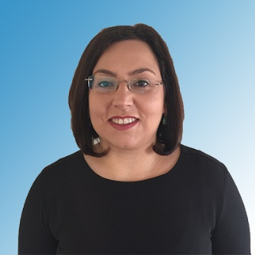
About Aglaia Ntili
Aglaia is the Managing Director of Sustainability Knowledge Group, providing Sustainability and CSR advisory and training services at international corporate level. She is the founder of CSR Coaching, supporting professionals in Corporate Responsibility and Sustainability, and the founder of the CSR & Sustainability meetup, the 1st and only open platform to support active learning and knowledge sharing on CSR and Sustainability in the UAE. Aglaia is the Chair of the UAE Chapter of the International Society of Sustainability Professionals (ISSP), the only professional body for Sustainable Professionals in the region.
With nearly 15 years’ experience in the fields of Sustainability Strategy, Reporting, Training, CSR Programs, Stakeholder Engagement, SROI, Quality, Performance, Environmental Management and Systems Implementation, Aglaia has made important contributions as practitioner, trainer, coach and advisor.
To date, she has trained over 450 professionals from the Middle East, Europe, Asia, Africa, and North America on sustainability topics including: Strategy, Reporting, CSR Programs, Stakeholder Engagement, SROI, Quality, Performance and Environmental Management. She has led Sustainability projects in Construction, Consulting, Banking, FMCG, Education, Local Authorities, Oil & Gas, Telecommunications, Pharmaceuticals, NGOs, Cosmetics, Technology, Shipping, Facility Management, Concessionaire and Hospitality
Aglaia developed the Middle East and Greek local standard version of GRI G3.1, G3.1 & G4 Bridging Module and G4 Training for local providers. Her qualifications include: MBA• MSc in Total Quality Management & Business Excellence • ISO 9000 Lead Auditor • EFQM Accredited Excellence Assessor • Institute of Environmental Management & Assessment (IEMA), Global Reporting Initiative (GRI), Institute of Leadership & Management (ILM) approved trainer.
Notes:
The state of sustainability 2015

Slide 59
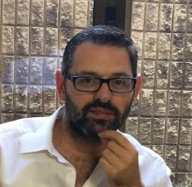
About Rawad Massoud
Rawad Massoud is a senior level executive with 7 years of experience in the field of air pollution and climate change with emphasis on greenhouse gas emission auditing and reduction.
Rawad Massoud is the co-founder of V4 Advisors, which is the only private company in the Middle East and Africa that is authorized by the World Resources Institute (WRI) and the World Business Council for Sustainable Development (WBCSD) to audit the Carbon
Footprint of establishments as per the "Built on GHG Protocol" standard. Mr. Massoud has solid experience in GRI-4 requirements and reporting.
Prior to V4 Advisors, Rawad Massoud was one of the core team members of the American University of Beirut (AUB) to research and monitor air pollution levels.
Rawad has actively participated in Clean Energy Business Council events and was invited to 2 consecutive panel discussions during their annual meetings in Dubai to talk on GHG audit, Climate Change and Waste to Energy challengeces.
Rawad Massoud holds a Masters degree in Risk Assessment in toxicology and environmental health from Utrecht University in Utrecht Netherlands and Bachelors degree in chemistry and Biochemistry from the Lebanese University.
Notes:
The state of sustainability 2015

Slide 60
About Sustainability Knowledge Group
Our clients include*
Banking
Construction
Consulting
Concessionaire
Cosmetics
Education
FMCG
Facility Management
Local Authorities
Oil & Gas
Pharmaceuticals
NGOs
Shipping
Telecommunications
Technology
* sample clientele

Slide 61
Thank You!
Aglaia Ntili
Managing Director
+30 6972031126,
+971 553231190
www.SustainabilityKnowledgeGroup.com
Rawad Massoud
Executive Managing Director
+961 71 139943
+961 9 911 953
www.V4Advisors.com
in cooperation with

Slide 62
Partnerships for Climate Change
February 2nd, 2017
in cooperation with

Slide 63
Introductions
Name
Organisation
Background

Slide 64
Objectives
Help companies define their criteria for successful selection of external partners for joint project implementation.
Introduce companies to potential initiatives that could fit with their corporate objectives

Slide 65
Modules
Module 1: Where are we now?
Module 2: Working with NGOs: Key criteria
Module 3: Find your perfect match

Slide 66
Summary of 1st Training

Slide 67
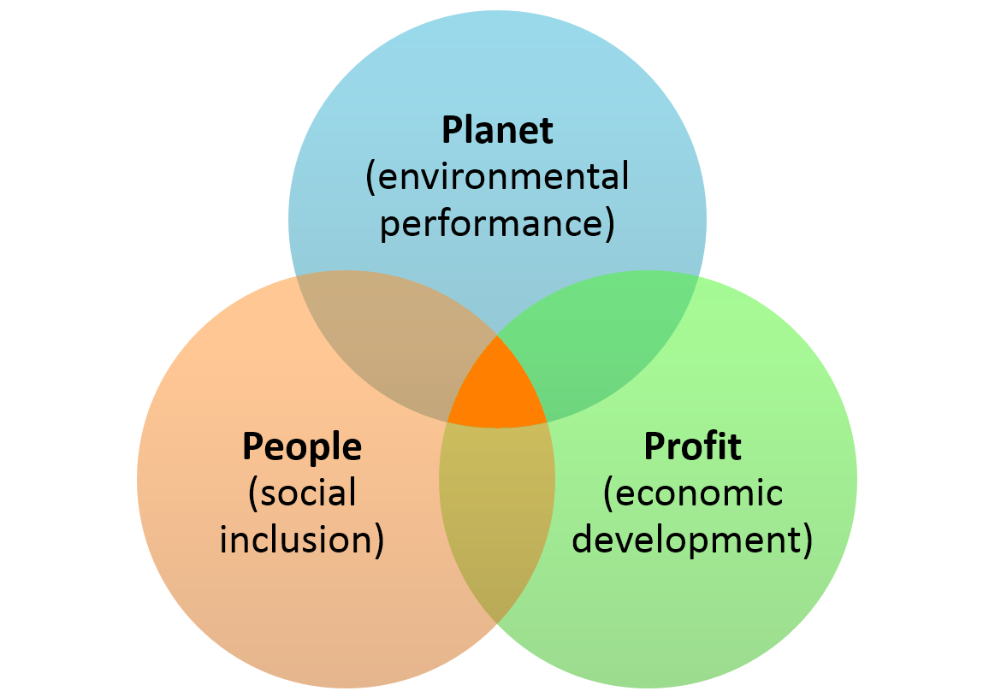
Sustainability Approach

Slide 68
What Do We Mean by Climate Change?

Slide 69
Lebanon – Intended Nationally Determined
Contribution
blueprint-effective-international-climate-agreement – WRI 2014.

Slide 70
A Road-Map
Pillar: Environment Company Strategic Objective:
Climate Change Topic | Measures KPIs | Target | Initiative | Initiative Resources | Initiative Timeline | Initiative Goal
Water heating -electricity consumption -Diesel | Kwh Kwh/night Kwh/day | Increase night consumption 2% -decrease day consumption By 2% | Passive/Habit change -Washing during night -full washing machine Active -building envelop -PVC -cards | Passive Educate/awareness/communication-understanding Active Research High financial investment | 60% employees educated in year 1 +40% in year 2 -2 idea /employee /year Passive 2 Months for research / 3 financing/ 3 implementation | 1% reduction in 6 months 2% in 6 months 10% in 1 year
- Fuel for generator | Consumption Ltr/year | Reduce consumption by 2% -maintain the same level

Slide 71
Strategy
SELECTED ORGANISATION
Environment Objective:
Area/Issue | Measures KPIs | Targets | Initiatives
Social Objective:
Area/Issue | Measures KPIs | Targets | Initiatives
Corporate Governance and Strategy
Workplace Objective:
Area/Issue | Measures KPIs | Targets | Initiatives
Marketplace Objective:
Area/Issue | Measures KPIs | Targets | Initiatives

Slide 72
Module 1 Where are we now?

Slide 73
Case Study
Insert here the case study

Slide 74
Measurement as a Process
Notes:
!encouraging corporate philanthropy
The most basic forms of performance metrics:
Activities: such as the number of staff trained or amount of goods purchased
Outputs: such as the number of clients served, products distributed, and areas reached
Impact:output and activity metrics alone cannot indicate that positive societal changes are being achieved or if unintended harm is being caused. Impact outlines clearly how success is defined and track whether and how the programs affect their beneficiaries
Encouraging corporate philanthropy pdf
However, output and activity metrics alone cannot indicate that positive
societal changes are being achieved or if unintended harm is being caused. In the
case of program initiatives such as signature projects, companies share a strong
connection with the cause and are concerned about the social outcomes of their
efforts. Managers of these programs and their nonprofit partners must articulate
the process by which changes and results are expected to occur. They should
outline clearly how success is defined and track whether and how the programs
are affecting their beneficiaries.
With respect to giving programs comprising primarily short-term, one-off grants driven by community obligations, simply identifying activities and measuring output may be all that is feasible.

Slide 75
Group Work-
Identify the Steps of our Case Study
Resources/
Input
Activity
Output
Outcome
Impact
Notes:
!encouraging corporate philanthropy
The most basic forms of performance metrics:
Activities: such as the number of staff trained or amount of goods purchased
Outputs: such as the number of clients served, products distributed, and areas reached
Impact:output and activity metrics alone cannot indicate that positive societal changes are being achieved or if unintended harm is being caused. Impact outlines clearly how success is defined and track whether and how the programs affect their beneficiaries
Encouraging corporate philanthropy pdf
However, output and activity metrics alone cannot indicate that positive
societal changes are being achieved or if unintended harm is being caused. In the
case of program initiatives such as signature projects, companies share a strong
connection with the cause and are concerned about the social outcomes of their
efforts. Managers of these programs and their nonprofit partners must articulate
the process by which changes and results are expected to occur. They should
outline clearly how success is defined and track whether and how the programs
are affecting their beneficiaries.
With respect to giving programs comprising primarily short-term, one-off grants driven by community obligations, simply identifying activities and measuring output may be all that is feasible.

Slide 76
Measurement as a Process
How is this exercise assist you in the communication with your partners?

Slide 77
Module Collaboration with NGOs/Civil Society

Slide 78
Value of Module
Assist participants to identify the principles of successful projects
Enable participants to develop successful partnerships

Slide 79
Projects
Split into 2 groups. As a group please define:
Group 1:
How would you describe a successful project? What are the characteristics of a successful project?
Group 2:
How would you describe a project that is not successful? What are the characteristics of a not successful project?

Slide 80
Partnerships
Split into 2 groups. As a group please define:
Group 1:
How would you describe a successful partnership?
Group 2:
How would you describe a partnership that is not successful ?

Slide 81
Criteria: Project
Project Based Criteria
Cost
Relevance to my business
Meets my stakeholder needs
Can I implement it alone?
Meets my environmental goals
Is it innovative?
Will I be recognised for this initiative?

Slide 82
Criteria: NGO
NGO Based Criteria
Reputation
Geographic area of focus
Experience
Do you want to be associated with this NGO?

Slide 83
Module 3

Slide 84
How NGOs were selected
Provide a description about your organization (up to 100 words).
Specify your project’s environmental category: (Energy, Water , Transport, Waste, Forestry and/or Agriculture
What is the climate problem that you are addressing and how do you think that your climate initiative will help to solve this problem?
Please provide your initiative’s detailed scope of work
Please list the beneficial outcomes of your project on the environmental, social, and educational levels. How will these benefits be measured?
Will your solution create new jobs to be implemented, if yes how many?
Who will be the team working on the implementation of this initiative?
What is the required fund for implementing your initiative? Please list how will this fund be spent with the most possible details.
Considering that the required fund is secured, what would be the timelines for implementing your initiative?
What are the innovation aspects of your project? What would make it better than other similar projects implemented in Lebanon and in the region?
Will you be collaborating with any other organization(s) to implement your initiative? Who are they, and what are their roles?
How do you think that your project will contribute to reducing the country’s CO2 emissions?

Slide 85
Presentation from NGOs

Slide 86
Criteria: Project
Project Based Criteria | Rate 1-10 | Comments
Cost
Relevance to my business
Meets my stakeholder needs
Can I implement it alone?
Innovation and new concept

Slide 87
Criteria: Project
NGO Based Criteria | Rate 1-10 | Comments
Reputation
Geographic area of focus
Experience
Do you want to be associated with this NGO?

Slide 88
Closing remarks

Slide 89
Thank You!
Aglaia Ntili
Managing Director
+30 6972031126,
+971 553231190
www.SustainabilityKnowledgeGroup.com
Rawad Massoud
Executive Managing Director
+961 71 139943
+961 9 911 953
www.V4Advisors.com
in cooperation with

