Slide 1
National policy framework for increasing resilience towards the adverse impacts of climate change
Yara Daou
Climate change projects
UNDP – Ministry of Environment
Monday February 6, 2017

Slide 2
1.
How vulnerable is Lebanon

Slide 3
Future climate risks Moderate case scenario – mid century
1.2˚C warming and up to 3.2°C by 2100
4% decrease in precipitation, up to 5.8 mm decrease in average monthly precipitation
Temperature and precipitation extremes will also intensify causing the seasonal prolongation and geographical expansion of drought periods
15 additional days with maximum daily temperature higher than 35°C
Notes:
This combination of significantly less wet and substantially warmer conditions will result in hotter and drier climate

Slide 4
Impacts on Lebanon
Less snow
Less water availability
Increase drought period
Less agriculture productivity
Higher energy demand
Weakened tourism
Sea level rise
Forests at risk
Increased mortality and morbidity
Damaged infrastructure
Notes:
Less snow - a reduction of 40% of the snow cover with snow that currently falls at 1,500 m shifting to 1,700 m
Less water availability - Snow will melt earlier in the spring. These changes will affect the recharge of most springs, reduce the supply of water available for irrigation during the summer, and increase winter floods by up to 30%.
Increase drought period - The already dry regions, such as the Bekaa, Hermel, and the South, will experience the sharpest effects. In addition, cost impacts will be added to irrigation needs, as more pumping hours will be required, therefore consuming more energy.
Less agriculture productivity - Soil moisture will decline in response to higher temperatures, reduced precipitation, and higher evapotranspiration. Changes in temperature and rainfall will decrease productivity of lands currently used to produce most crops and fruit trees, especially wheat, cherries, tomatoes, apples, and olives, and may affect the quality of grapes. Most crops also will face increased infestation of fungi and bacterial diseases.
Higher energy demand - increase demand for cooling, with related consumption of electricity increasing 1.8% for a 1°C increase in temperature, and 5.8% for a 3°C increase in temperature.
Weakened tourism - Winter outdoor tourism will diminish as warmer temperatures and reduced precipitation shorten the skiing season. Other impacts on tourism will occur in response to changes in ecosystems, loss of natural attractions, such as sandy public beaches, and structural damage to the nation’s archaeological heritage.
Sea level rise - Sea levels will rise up to 30-60 cm in 30 years, if the recent rate of rise, approximately 20 mm/year, continues. The higher sea levels will lead to seawater intrusion into aquifers, increase the risk of coastal flooding and inundation, increase coastal erosion, cover sand beaches, and alter coastal ecosystems in natural reserves and elsewhere.
forest stands suffer from fragmentation, pest outbreaks, forest fires and unsuitable practices that already challenge their capacity to survive and develop.
Increased mortality and morbidity - Increases in temperatures will cause 2,483 to 5,254 additional deaths per year between 2010 and 2030. ebanon will experience increases in the incidence of infectious diseases, morbidity, and mortality resulting from higher temperatures, more frequent extreme weather events, increased malnutrition from droughts and floods that affect agriculture, and reduced availability of clean water
Damaged infrastructure - damage from changing patterns in precipitation, sea level rise, and increased frequency and intensity of storms. This damage will materialize from inundation of coastal settlements and buildings, floods, mudslides, and rockslides.

Slide 5
Economic costs from climate change impacts in 2040
Potential costs from cumulative effects of global GHG emissions
Potential savings in 2040 from reducing global GHG emissions to the lowest emissions scenario

Slide 6
\What about agriculture?
The effects of climate change on five main crop types: cereals, fruit trees, olives, industrial crops, such as sugar beets and tobacco, and vegetables, such as potatoes (a strategic crop).
Notes:
In 2020, the value of farm production would fall about USD 80 million below the level that would occur without the anticipated changes in climate. This reduction would ripple through the economy, with the manufacturing and services sectors, combined, experiencing a reduction in production of about USD 220 million. The overall reduction in GDP would total USD 300 million.

Slide 7
2.
How is Lebanon planning to adapt

Slide 8
Technology Needs Assessment – adaptation in the agriculture sector
Conservation Agriculture
Risk Coping Production Systems
Selection of adapted varieties and rootstocks
Integrated Pest Management
Integrated Production and Protection for greenhouses
Early Warning System - ICT
Index Insurance
Early warning system through snowpack monitoring
Rainwater harvesting from hill lakes
Rainwater harvesting form roads
Rainwater harvesting from greenhouse tops
Efficient water use irrigation system
Water users’ association
Soilless agriculture
Use of treated wastewater in irrigation
Notes:
Early Warning System - Information and Communication Technologies (EWS-ICT)
Relies mostly on weather stations, satellite and aerial images for weather forecast, topped up with software technologies

Slide 9
Strategy of the Ministry of Agriculture

Slide 10
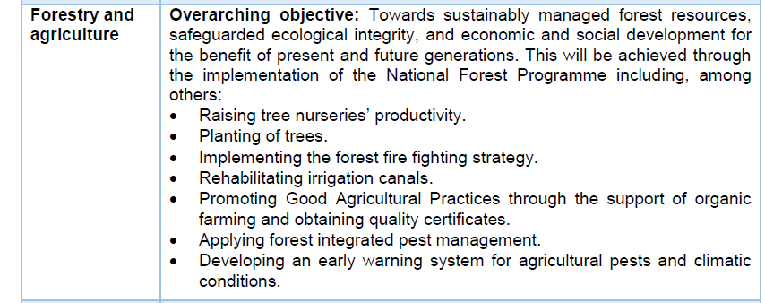
Intended Nationally Determined Contribution

Slide 11
National Adaptation Plan on the way

Slide 12
Thanks!
Any questions?
Yara.daou@undp.org
climatechange@moe.gov.lb

