Slide 1
Beirut 18-20 September 2017
Dario Berardi
dberardi@dev4u.it
Funded by the European Union

Slide 2
OBJECTIVES
Facilitate sharing and access to information on Policies, Measures, Actors, Finance related to Lebanon’s actions against climate change
Facilitate Reporting to UNFCCC of Lebanese NDC implementation progress
Funded by the European Union

Slide 3
STRATEGY
Implementation of an Internet Portal dedicated to Ministries and National Entities involved in the NDC exercise
Funded by the European Union

Slide 4
CHALLENGES
to create a comprehensive and user-friendly tool, ensuring ownership of the data and quality of the information, that is flexible enough to adapt to evolving situations
No previous well-established experiences
Multi-sectoral dimension and the willingness of each sector to get involved
Funded by the European Union

Slide 5
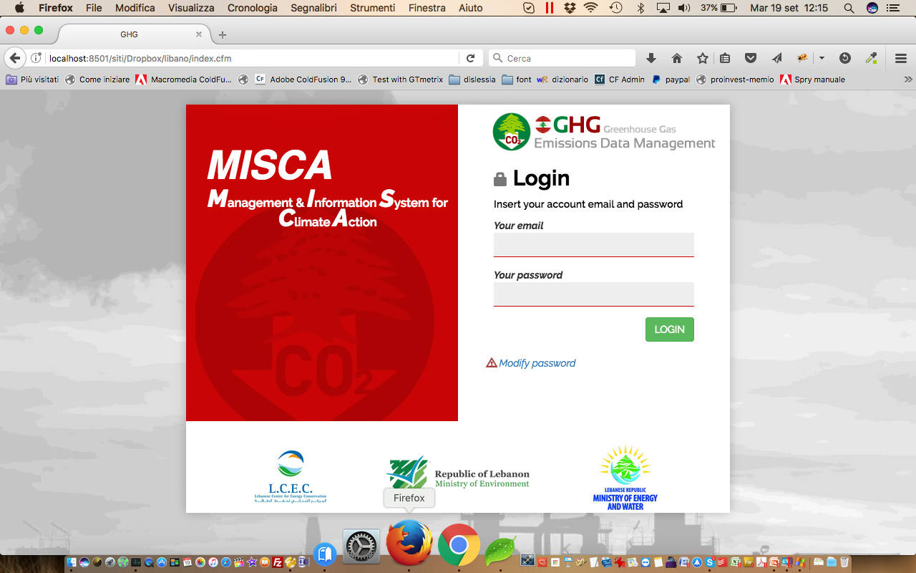
MISCA
Management Information System for Climate Action
(MISCA)
Funded by the European Union

Slide 6
MAIN FEATURES
Work-flow management
Data Quality enforcement by means of role separation:
Data is entered
Data is verified
Data is released
Management of sensitive data (included in the calculation but not shown in the output)
Funded by the European Union

Slide 7
MAIN FEATURES
Automatic calculation of CO₂ produced both following Reference and Sector Approaches.
Management of Mitigation Measures
Automatic calculation of CO₂ avoided
Exporting in excel
Funded by the European Union

Slide 8
MAIN FEATURES
Reference repository
Open architecture (database driven): it allows easy customization and portability
Funded by the European Union

Slide 9
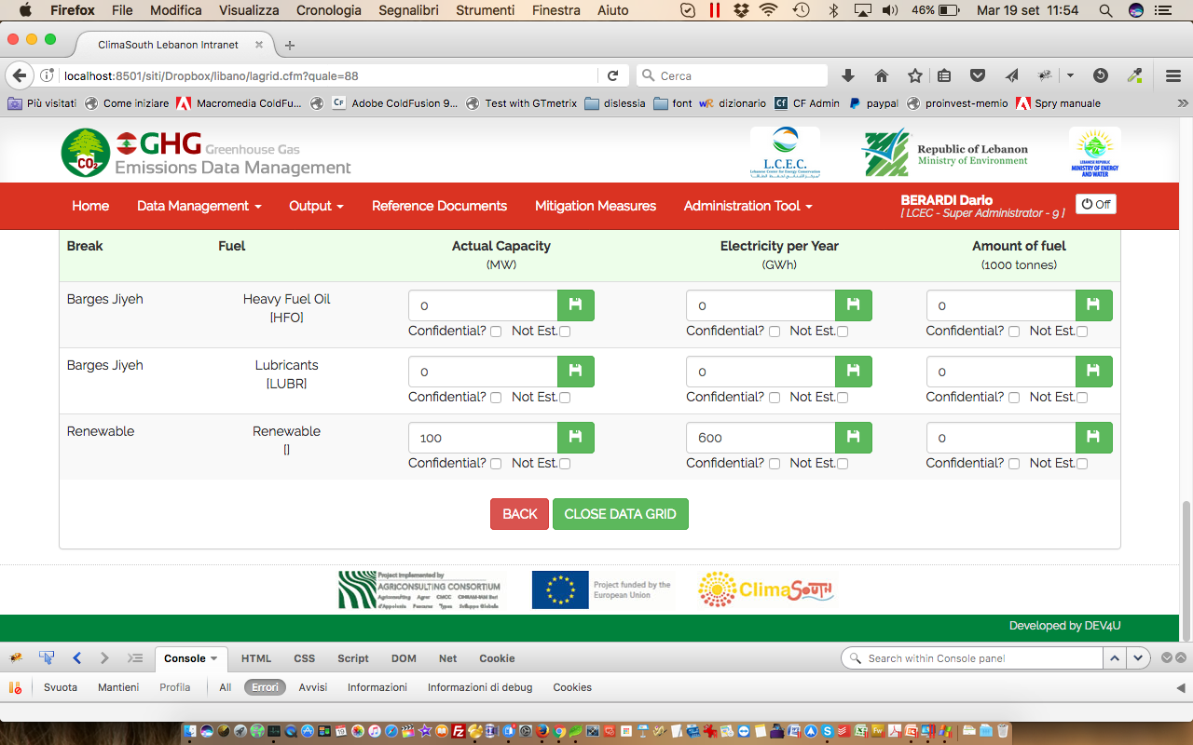
SCREEN-SHOTS – DATA ENTRY
Funded by the European Union

Slide 10
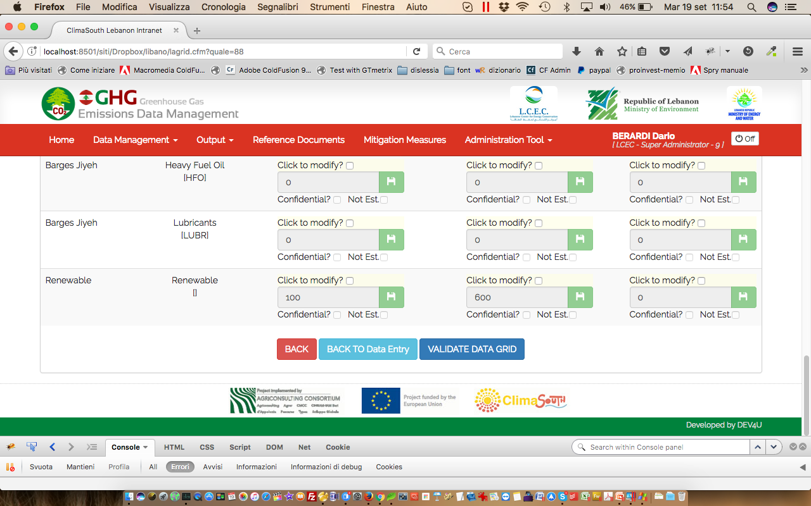
SCREEN-SHOTS – DATA ENTRY
Funded by the European Union

Slide 11
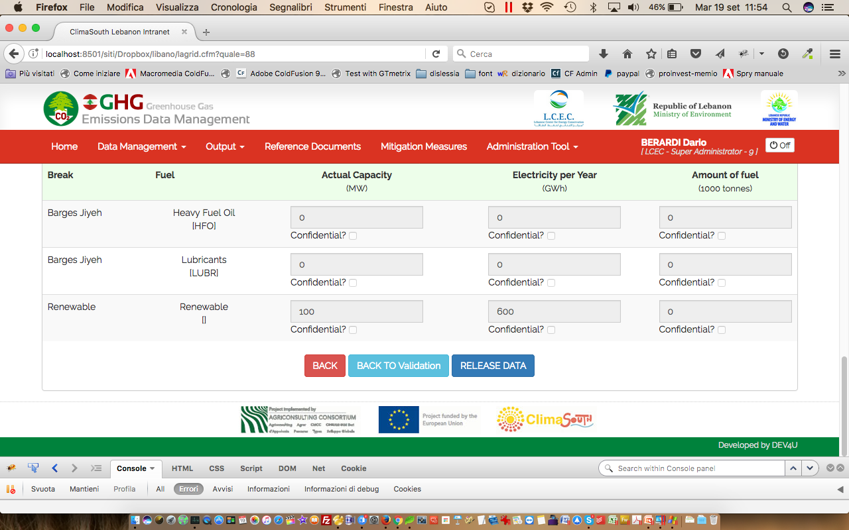
SCREEN-SHOTS – DATA ENTRY
Funded by the European Union

Slide 12
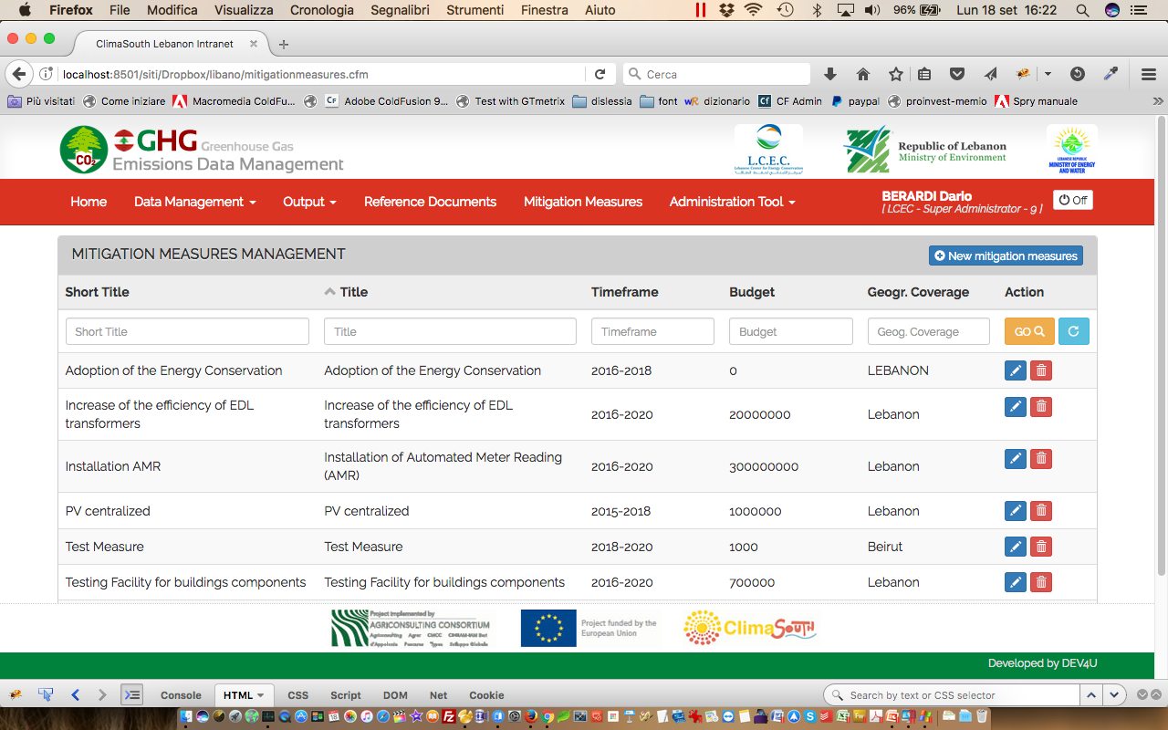
SCREEN-SHOTS – DATA ENTRY
Funded by the European Union

Slide 13
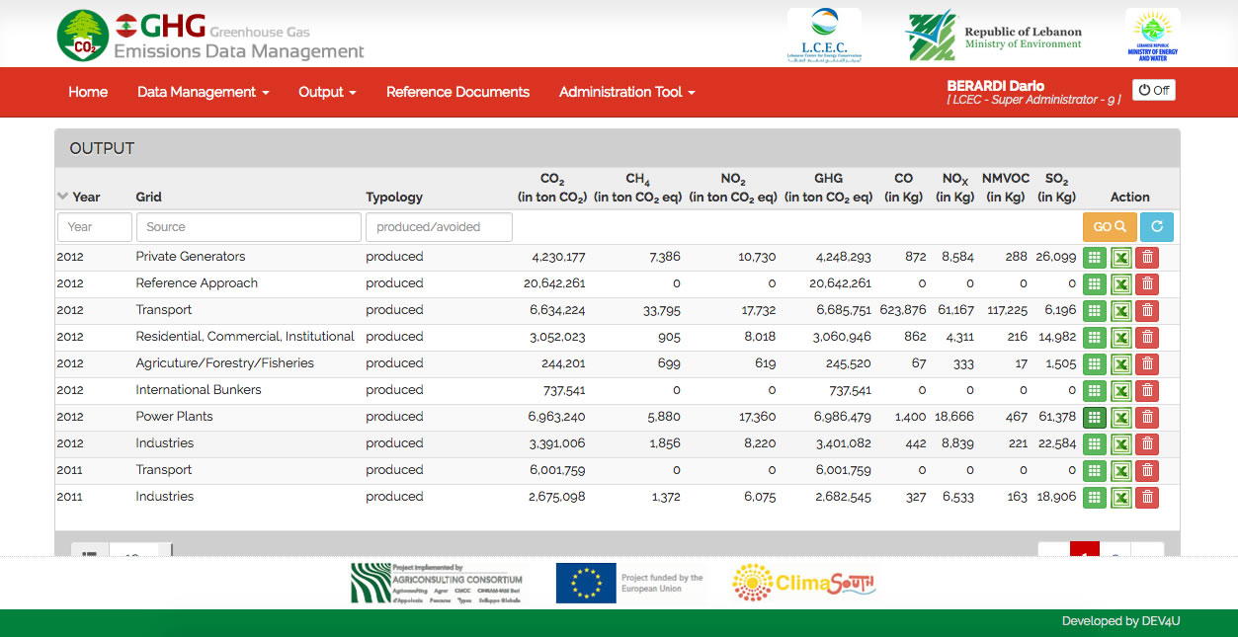
SCREEN-SHOTS – OUTPUT
Funded by the European Union

Slide 14
SCREEN-SHOTS – OUTPUT
Funded by the European Union

Slide 15
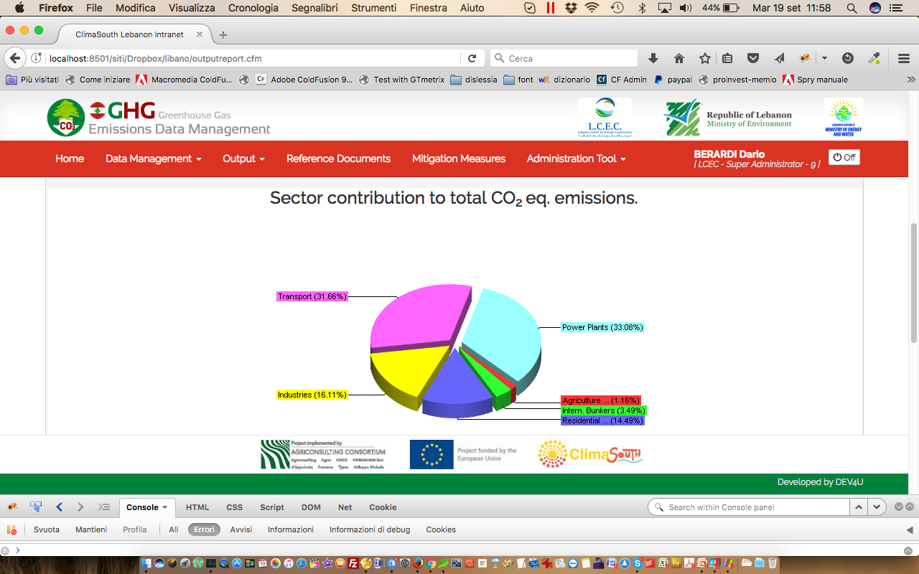
SCREEN-SHOTS – OUTPUT
Funded by the European Union

Slide 16
WHERE WE ARE?
The System is up-and-running
Connection between MOE, MoEW and LCEC is well established
Training, final testing and fine-tune are going-on
Funded by the European Union

Slide 17
WHERE WE ARE?
Thank you!
Funded by the European Union

