Slide 1
Welcome February 2017

Slide 2
GREEN NEIGHBORHOOD DEVELOPMENT AT SAHAB CITY MAIN FOCUS ON SAHAB MUNICIPALITY Implementation Phase – All Implemented Systems

Slide 3
Implemented Energy Efficiency & Renewable energy measures for Sahab Municipality

Slide 4
-Project’s City-
“Sahab Municipality-Amman-Jordan”
-Project Objectives-
The Main objective is to enable Sahab Municipality in Jordan to be a pilot for the local authorities in ENPI South partner countries to address local sustainable development challenges related to energy.
This will be achieved through the following:
Develop a local Energy Efficiency & Renewable Energy Plan for Sahab Municipality.
Promote and implement energy efficiency, energy savings & renewable energy measures at Sahab Municipality buildings and Introduce energy efficient technologies
Build capacities of employees of Sahab Municipality in the field of sustainable energy & public awareness of the general public and relevant stakeholders.
Enable Sahab to become a model Municipality through joining the Convention of Mayors and through implementing energy efficiency demonstration pilots.

Slide 5
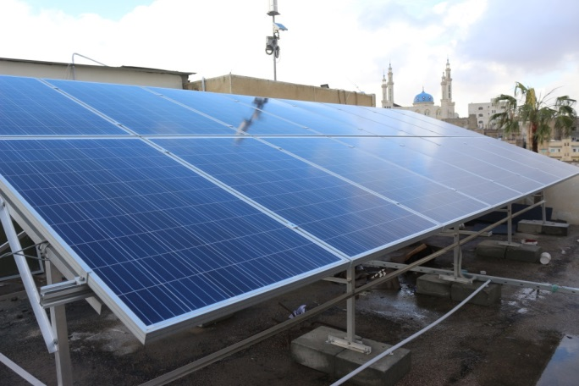
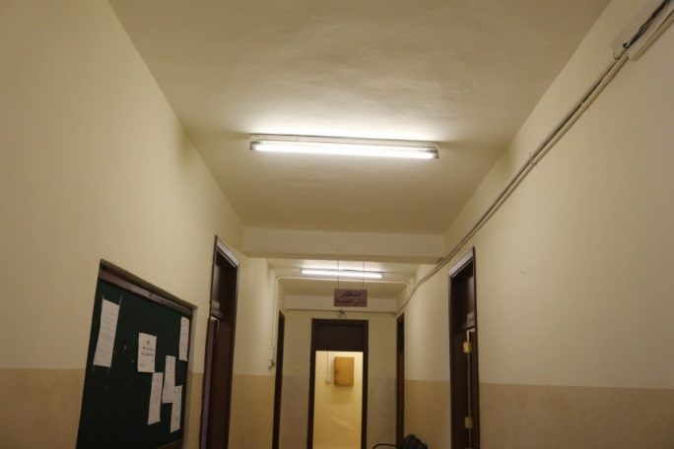
MUNICIPALITY MAIN BUILDING
Installing Photovoltaic system
10 kWp rooftop PV system.
Lighting Retrofit
Replacing (127) fluorescent lighting units by LED lighting units.
Install Solar Thermal Unit
Saved energy so far : 8328.8 kWh
Reduction of CO₂ : 4664.128 kg

Slide 6
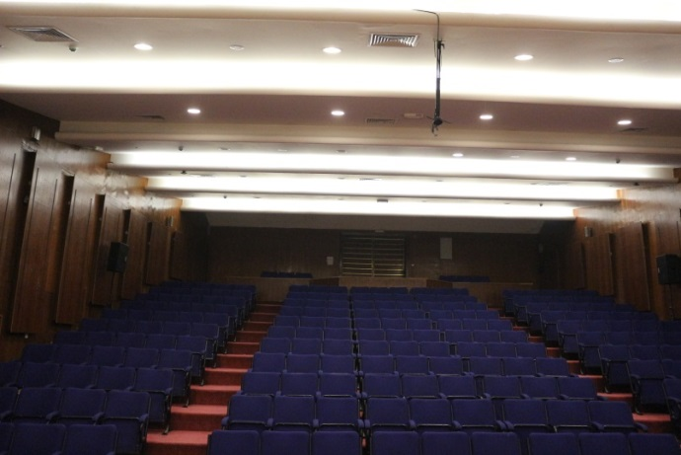
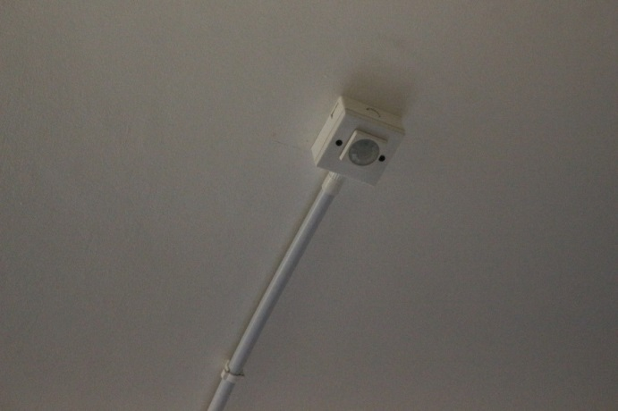
CULTURAL CENTER
Lighting Retrofit
Replacing (310) fluorescent lighting units by LED lighting units.
Replacing (20) External lighting fixtures by LED Flood light fixtures.
Install motion & occupancy sensors
Install Solar Thermal Unit for domestic hot water uses.
Saved energy so far : 7164 kWh
Reduction of CO₂ : 4011.84 kg

Slide 7
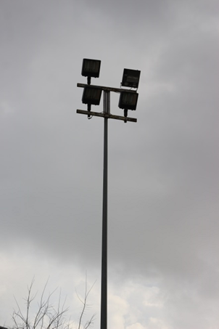
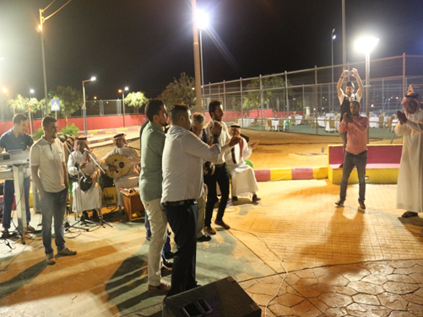
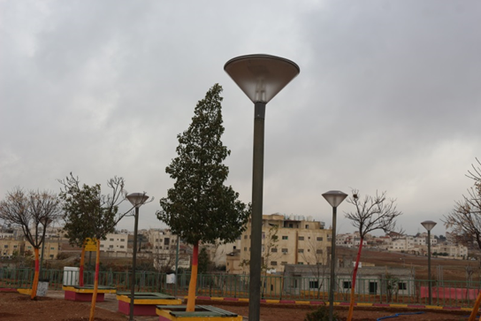
PUBLIC GARDEN
Lighting Retrofit
(45) Outdoor LED lighting fixtures.
(21) LED street lighting fixture.
(6) LED Flood light fixtures for the play ground area.
Saved energy so far : 2025 kWh
Reduction of CO₂ :1134 kg

Slide 8
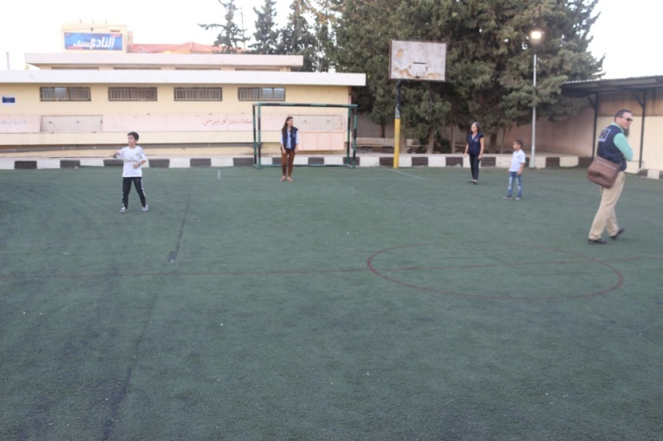
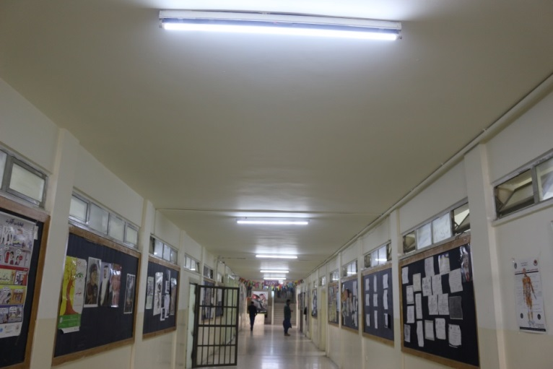
SAHAB SCHOOLS
Sahab High school for Boys
Sahab High school for girls
Um Amara High school for girls
Judge Ieas school
Install LED lighting units
Install (4) External Flood Lighting in the yard of each school.
Replacing all fluorescent lighting units in corridors & class rooms to LED lighting units.
Saved energy so far : 8,100 kWh
Reduction of CO₂ :4,536 kg

Slide 9
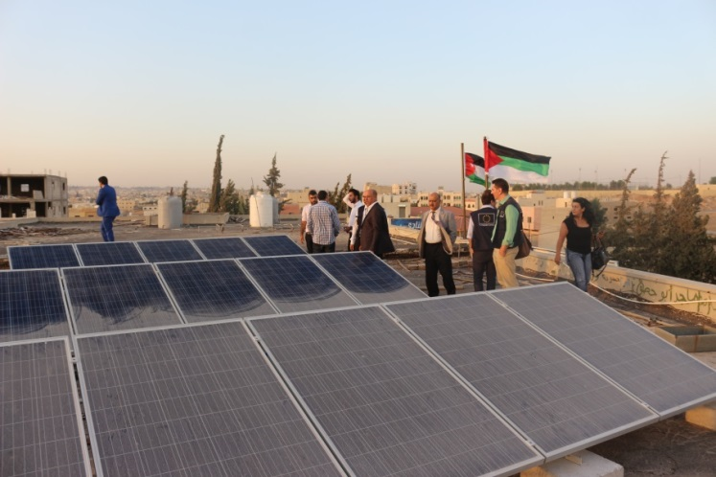
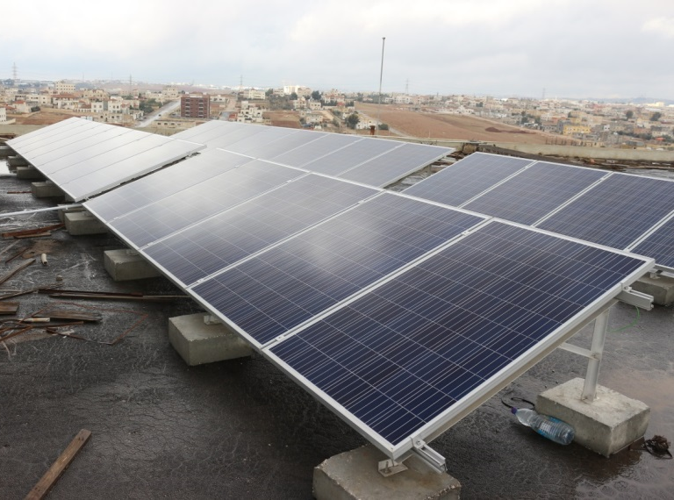
SAHAB SCHOOLS
Installing Photovoltaic system
Install Rooftop Photovoltaic systems to cover partially the electric demand of each school;
Sahab High school for Boys;
(10 kWp) rooftop PV system.
Sahab High school for girls
(10 kWp) rooftop PV system.
Um Amara High school for girls
(9 kWp) rooftop PV system.
Judge Leas school
(10 kWp) rooftop PV system.
Saved energy so far : 25350 kWh
Reduction of CO₂ : 14196 kg

Slide 10
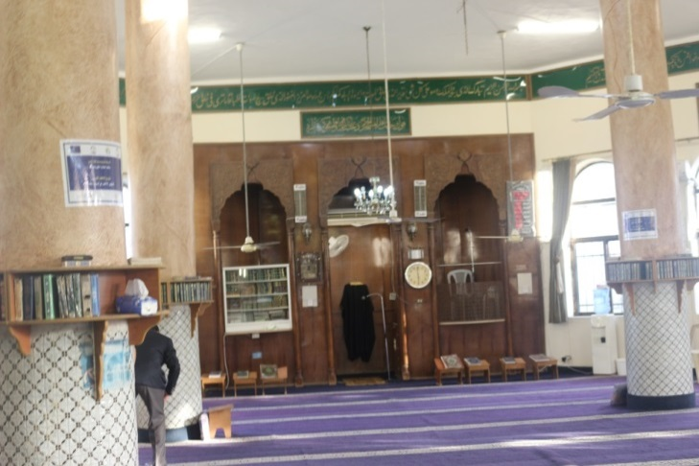
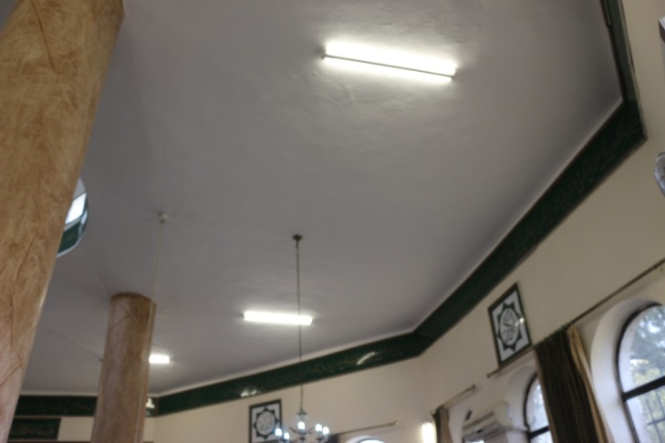
SAHAB MASJIDS
Lighting Retrofit
Oied Masjid;
Replacing (38) fluorescent lighting units by LED lighting units.
Southern Sahab Masjid;
Replacing (74) fluorescent lighting units by LED lighting units.
Masjid Al Noor;
Replacing (104) fluorescent lighting units by LED lighting units.
Saved energy so far : 3110.4 kWh
Reduction of CO₂ : 1741.824 kg

Slide 11
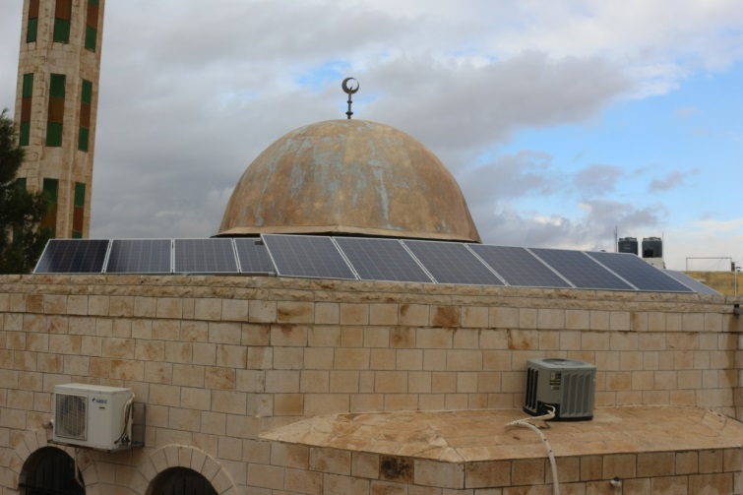
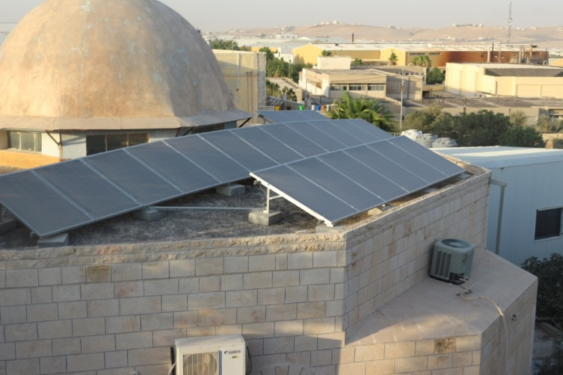
SAHAB MASJIDS
Installing Photovoltaic system
Install Rooftop Photovoltaic systems to cover partially the electric demand of each Masjid;
Oied Masjid;
(5.5 kWp) rooftop PV system.
Southern Sahab Masjid;
(2.6 kWp) rooftop PV system.
Saved energy so far : 5265 kWh
Reduction of CO₂ : 2948.4 kg

Slide 12
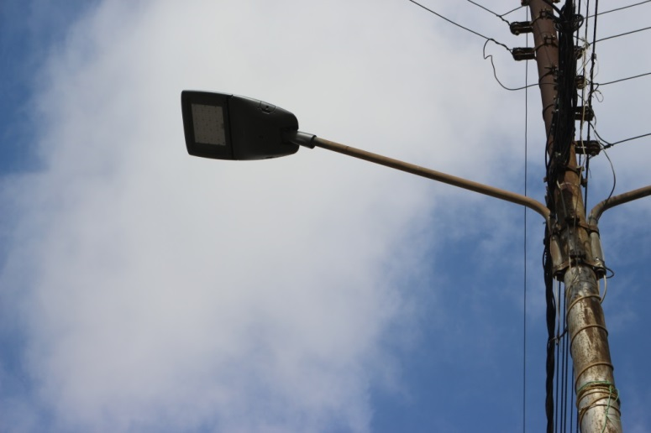
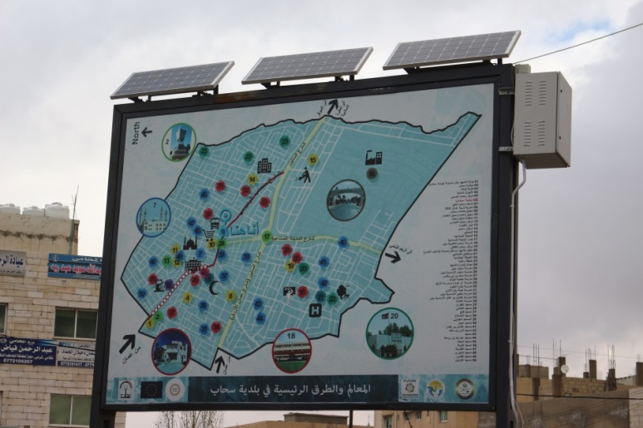
SAHAB MAIN STREET
Lighting Retrofit
Replacing (40) High Pressure Sodium (HPS) lighting fixtures with LED street lighting fixtures.
Solar Powered Map
Install (2) guidance maps for Sahab city, internally illuminated by (300W) PV panels each.
Saved energy so far : 1080 kWh
Reduction of CO₂ : 604.8 kg

Slide 13
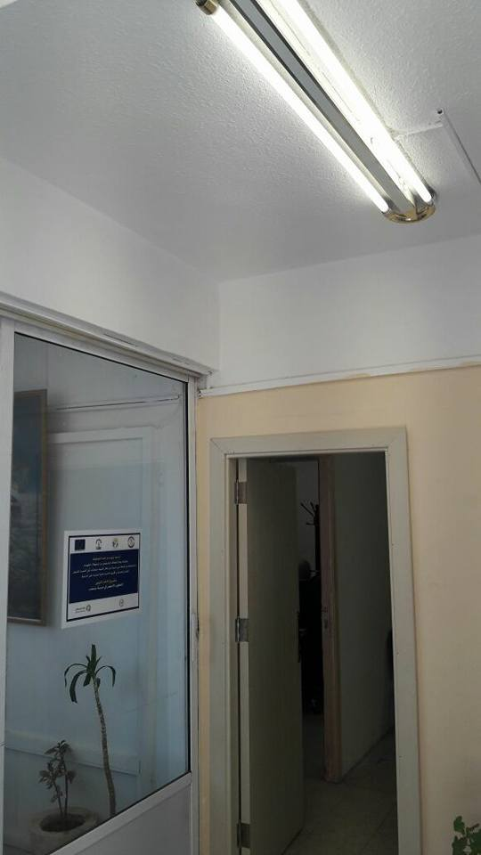
SAHAB MUNICIPALITY LIBRARY
Lighting Retrofit
Replacing (28) fluorescent lighting units by LED lighting units.
Saved energy so far : 403.2 kWh
Reduction of CO₂ : 225.792 kg
SAHAB BUS STATION
Lighting Retrofit
Install (15) LED lighting fixtures powered by built in PV panels technology.
To be installed

Slide 14
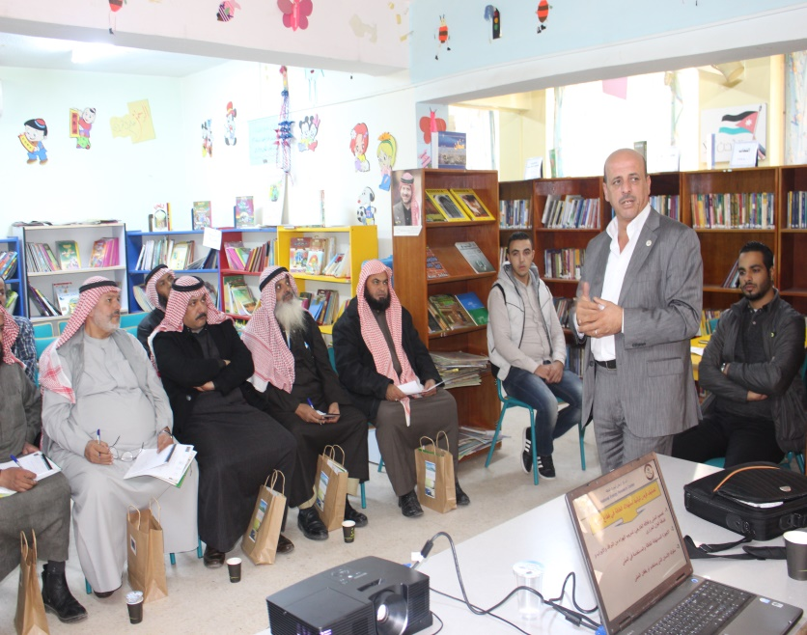
Engaging Sahab Community
Conducted (10) awareness workshops for the four schools, religious leaders, the community to increase their awareness and involvement in spreading the Culture of Green Energy.
Distributing 5,000 brochures

Slide 15
Media Campaign
200,000 (SMS) to Sahab have been sent to Sahab Citizens that includes awareness texts
1,000,000 e-mail have been sent to promote Sahab project
2,000 DVDs of an interactive game for students about solar power have been distributed
10,000 stickers have been distributed that promote awareness messages
A documentary movie have been developed
Facebook
Participate in talk shows such as Yum Jadeed
Develop a T.V. spot which will be broadcasted soon on T.V. channels to promote Sahab Project.

Slide 16
Institutional Strengthening of Sahab
Joining the Covenant of Mayors to be the first Municipality in Jordan and the second at the Arab Countries level.
Articulate and formulate regulations at the Municipality to ensure energy efficiency and/or renewable energy requirements/standards in public procurement of products and services.
Building the capacities of relevant staff in the Municipality
Install instructions signs in the different municipality buildings and offices that promote the project and best practices for saving energy

Slide 17
THANK YOU
ANY QUESTIONS

